Slide 1


Slide 2
Unified Data Management

Slide 3
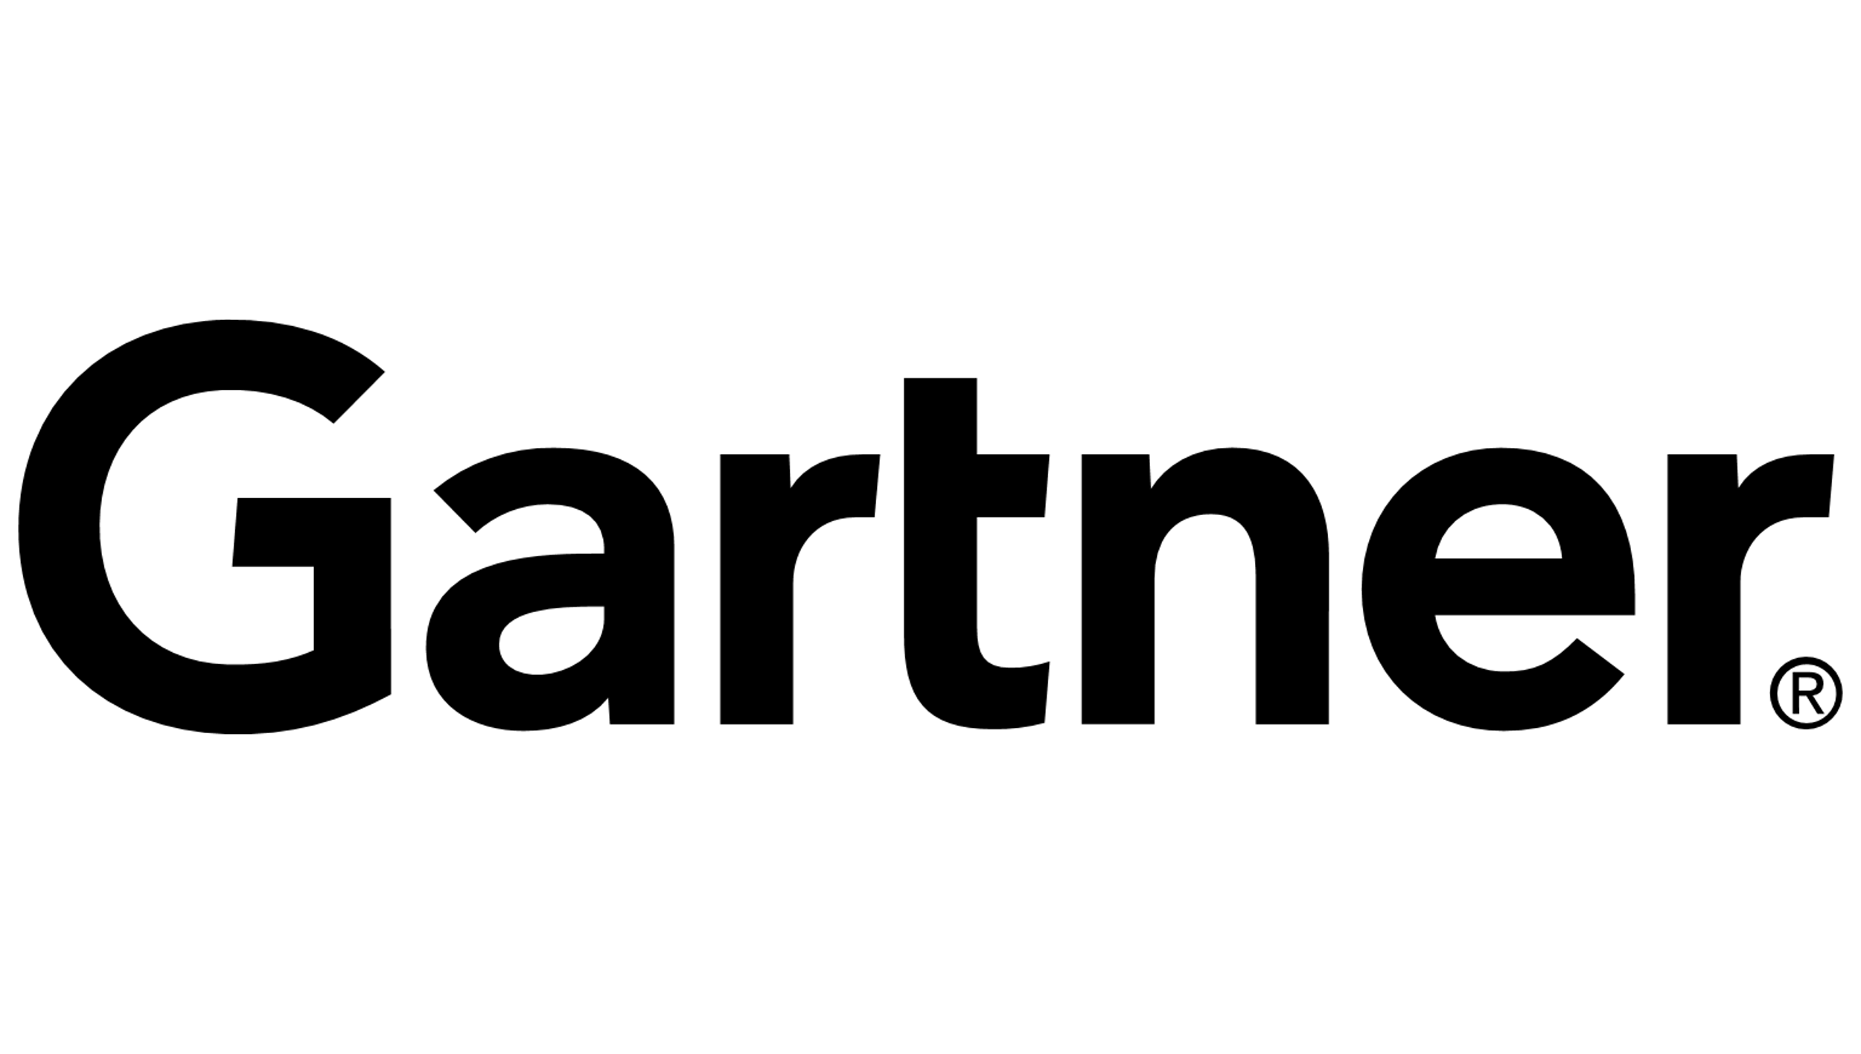






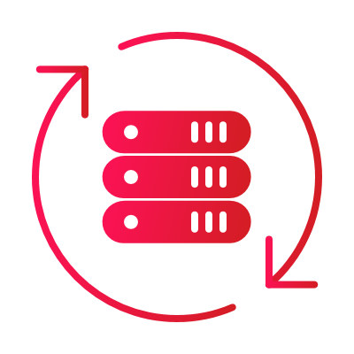
Veritas: Industry Leader for 30+ Years
for Enterprise Backup and Recovery Software Solutions
for Enterprise Information Archiving
17x
95%
15x
LEADER
of the Fortune 100 Trust Veritas
LEADER
6,000+
Employees
Worldwide
20,000+
Global
Partners
80,000+
Global
Customers
2,000+
Developers
Worldwide
2,200+
Global
Patents
800+
Supported
Workloads
100+ EB
Data Under
Management
Gartner is a registered trademark and service mark of Gartner, Inc. and/or its affiliates in the U.S. and internationally,and is used herein with permission. All rights reserved. *Fortune Global 500 and Fortune 100, June 2022
Notes:
We allow customers to get access to their data where and when they want it. ​
We do this at scale for the worlds largest and most complex environments, ​including 95% of the Fortune 100.
For decades, Veritas has been leading in data protection, and no company in the industry can match this record.
17x leader in Gartner’s Magic Quadrant, over 2,000 global patents and over 100 exabytes under management.
We protect the world’s most important asset—data.

Slide 4
Veritas Data
Compliance & Governance Portfolio
eDiscovery Platform / Advanced eDiscovery
CONTENT AGGREGATION
Capture ALL relevant communication and file content sources
ONE PLATFORM, COMPLETE DISCOVERY
Accelerate collection, processing and review for eDiscovery and FOIA/Subject access requests
Merge1
Discover
Capture
EFFICIENT REVIEW OF ALL CONTENT
Advanced Supervision provides monitoring of communications to ensure regulatory compliance
FILE VISIBILITY
Understand your content in place via monitoring, classification, usage analysis and PII detection
Advanced Supervision
Data Insight
Data Compliance & Governance Portfolio
Monitor
Visualize
Archive
CAPTURE & INDEXING
Efficiently store content with flexible deployment (on-prem, hybrid, customer cloud tenant; SaaS).
ENRICH METADATA
Surface relevant content and eliminate noise. Take proper action based on content analysis.
Enterprise Vault (On-prem/SaaS)
Classify
Information Classifier

Slide 5
Veritas Data
Compliance & Governance Portfolio
eDiscovery Platform / Advanced eDiscovery
CONTENT AGGREGATION
Capture ALL relevant communication and file content sources
ONE PLATFORM, COMPLETE DISCOVERY
Accelerate collection, processing and review for eDiscovery and FOIA/Subject access requests
Merge1
Discover
Capture
EFFICIENT REVIEW OF ALL CONTENT
Advanced Supervision provides monitoring of communications to ensure regulatory compliance
FILE VISIBILITY
Understand your content in place via monitoring, classification, usage analysis and PII detection
Advanced Supervision
Data Insight
Data Compliance & Governance Portfolio
Monitor
Visualize
Archive
CAPTURE & INDEXING
Efficiently store content with flexible deployment (on-prem, hybrid, customer cloud tenant; SaaS).
ENRICH METADATA
Surface relevant content and eliminate noise. Take proper action based on content analysis.
Enterprise Vault (On-prem/SaaS)
Classify
Information Classifier

Slide 6







Why Archive? – Today’s Challenges
ARCHIVE
Data Growth and Cost of Maintenance
Audit and Security
Prepare for eDiscovery
Impose Retention Control
Ensure Supervisory Compliance
Provide Easy Access to Information
Notes:
Organizations require archiving for a number of different reasons. Here are the most common reasons we hear from our customers:
Control Data Growth and Cost (keep only the recent and frequently accessed data on your front-line systems, and move older infrequently accessed data to cheaper storage. Front-line systems perform better, easier to DR, etc)
Prepare for eDiscovery (Using Discovery Accelerator or Veritas eDiscovery Platform the information can be searched and the review set greatly reduced resulting in a reduced eDiscovery cost and effort)
Ensure Supervisory Compliance (Enterprise Vault can scan and sample email as it’s sent and received by users, and based on certain rules or content of an email it can bring those items to a supervisory reviewer’s attention. Enterprise Vault provides supervisory review capabilities to cater for Dodd Frank requirements)
Audit and Security (Enterprise Vault can store archived data on tamper proof storage, and any access or searches of the archive can be audited)
Impose Retention Control (keep only the information you need, discard lunch menus, Google alerts etc)
Provide Easy Access to Information (Enterprise Vault archives can be accessed from any IMAP compatible device, and information can be cached offline using Vault Cache – not possible with Exchange archives)

Slide 7
Veritas Enterprise Vault Helps You
Enhancing information classification, retention, supervision and discovery
Classify
to retain only meaningful info for
the organization
Retain
info efficiently and delete at end of useful lifecycle
Supervise
communications
to help ensure compliance with regulatory bodies
Search & Discover
info efficiently
to help reduce eDiscovery costs

Slide 8
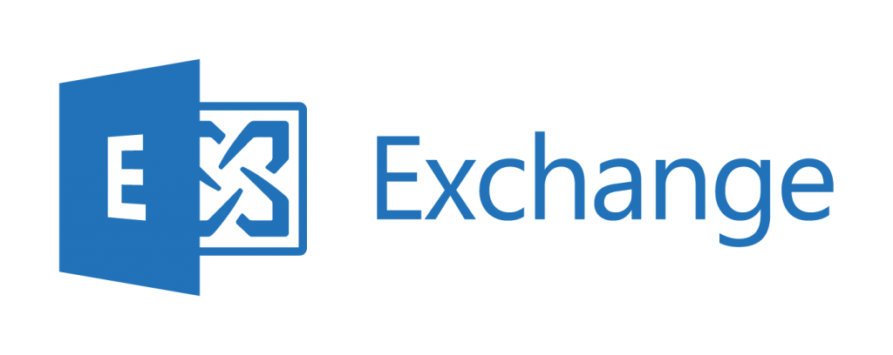
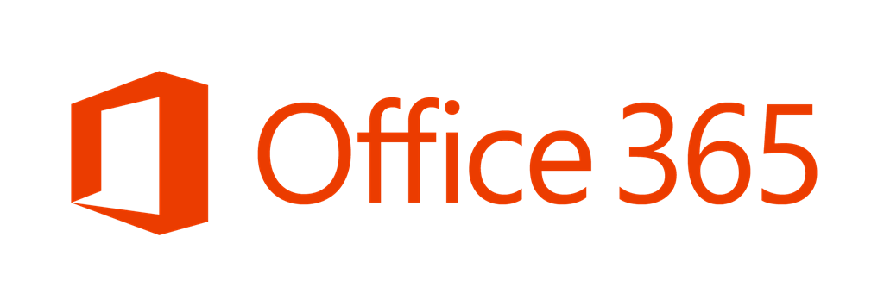
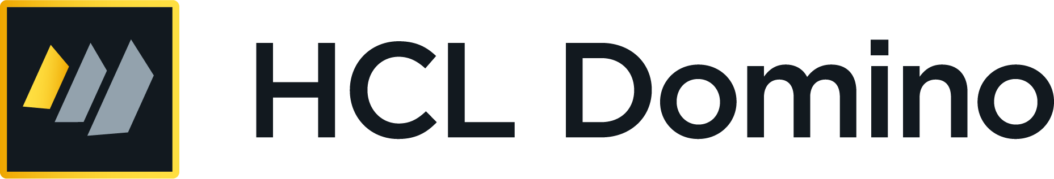

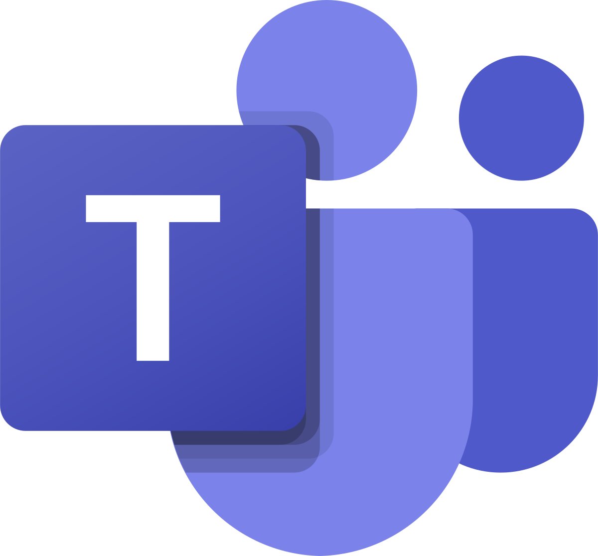
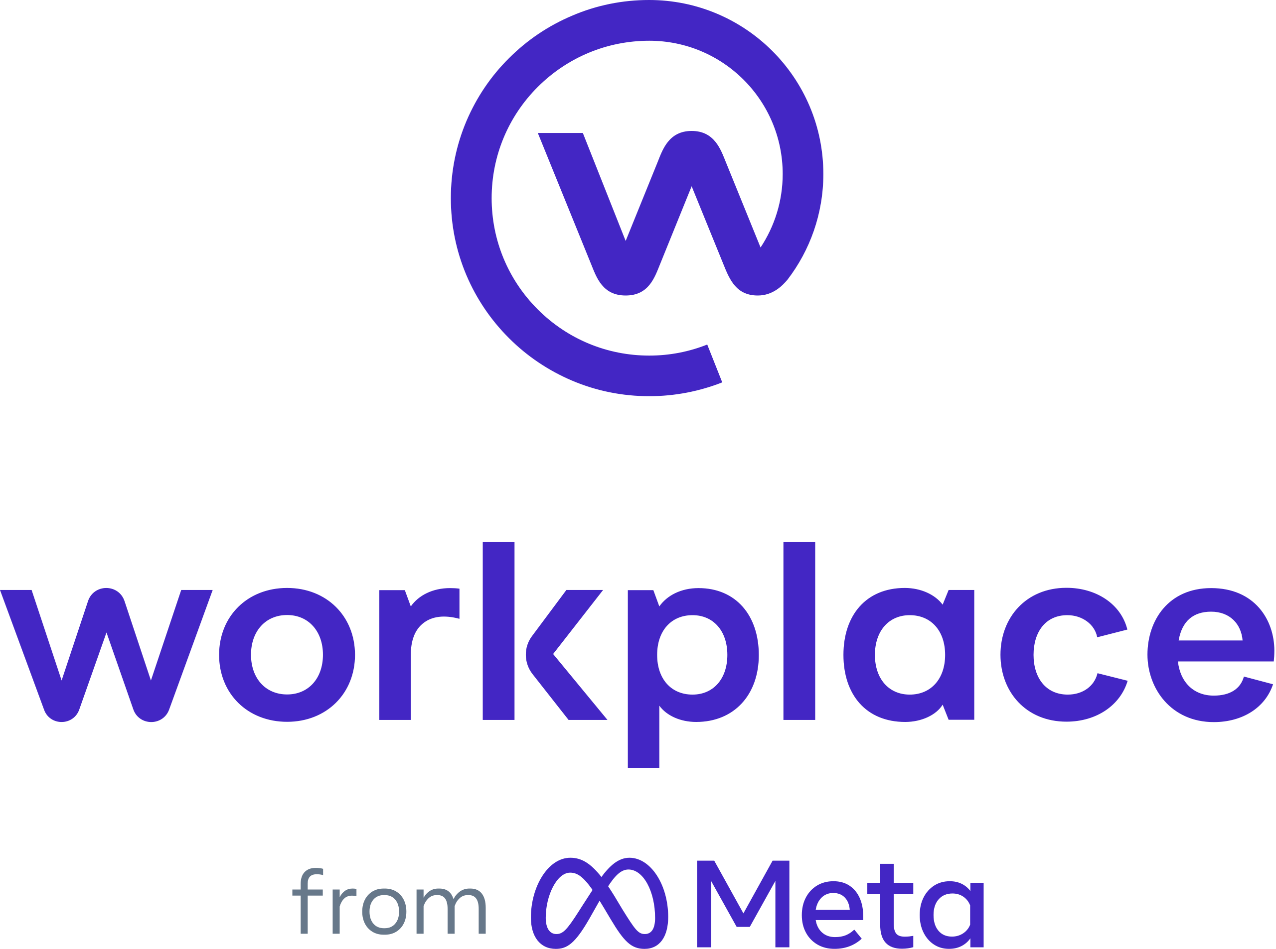
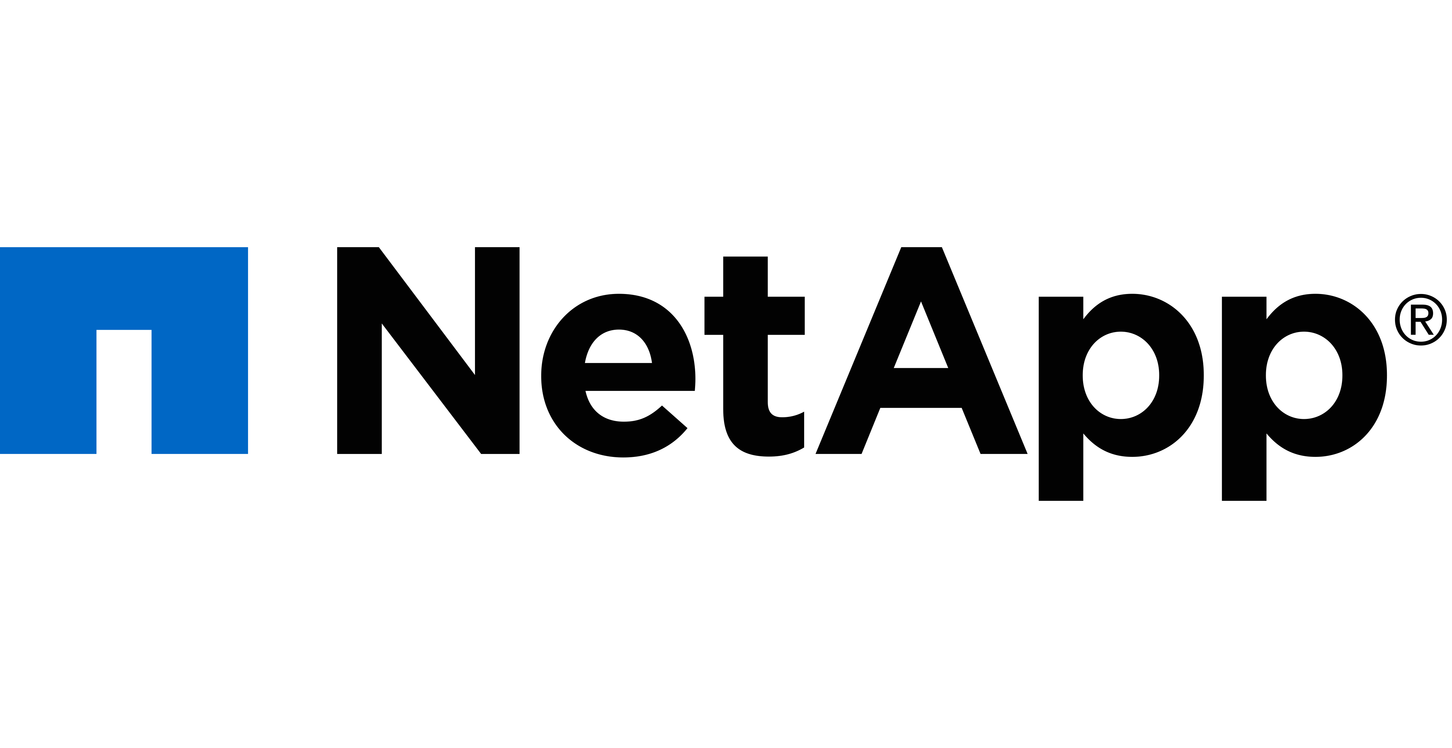
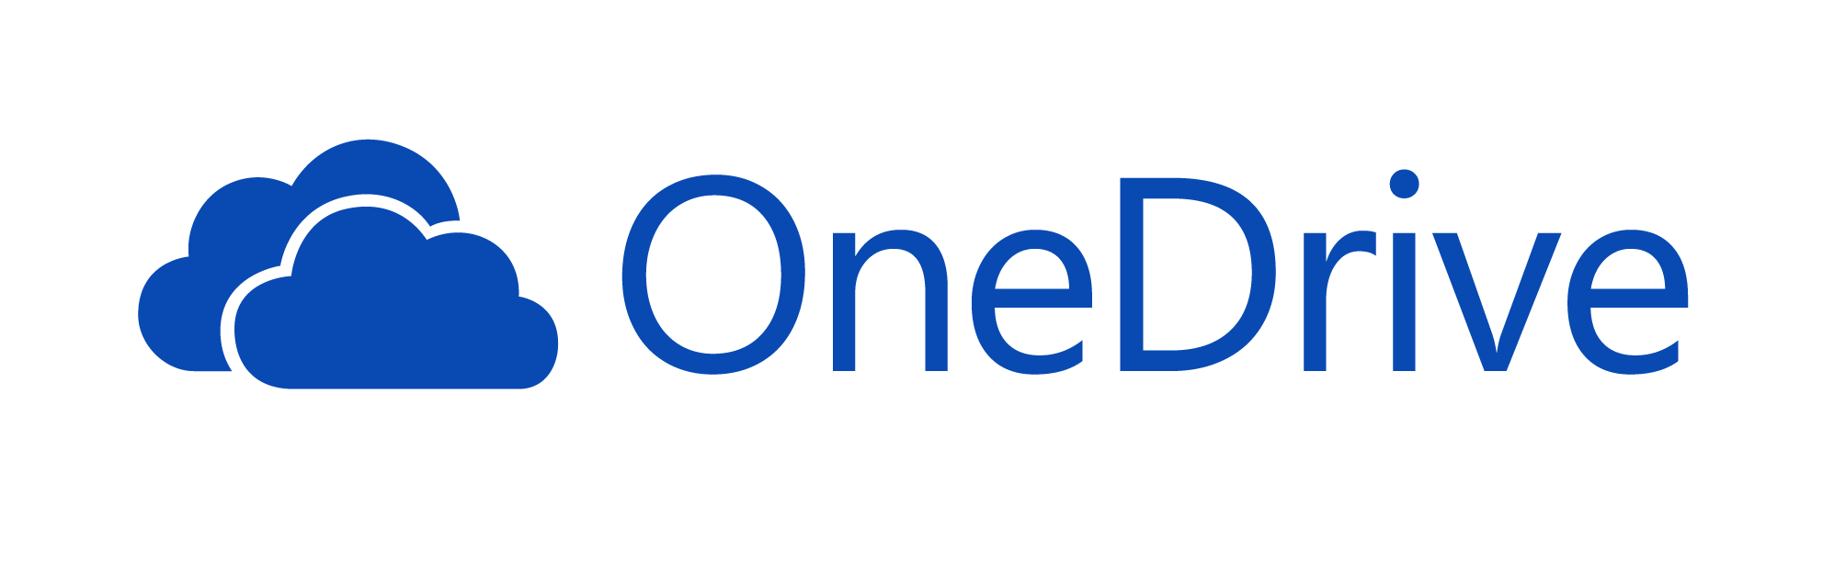



Veritas Enterprise Vault Portfolio
120+ Content Sources
eDiscovery & Compliance
Flexible Deployment
Options
Email
Discovery Accelerator
Veritas Information Classifier
On-Premise
Veritas eDiscovery
Platform, powered by Clearwell
IaaS in AWS &
Azure cloud
Enterprise Vault Extensions
IM
File
Hybrid
Analytics Connector
Veritas Advanced Supervision
Social
Media
Managed by Partner
Generic S3 Storage Connectors
Veritas Enterprise Vault
A Leader in On-Premise Information Archiving
Notes:
This slides slows the Enterprise Vault product portfolio.

Slide 9
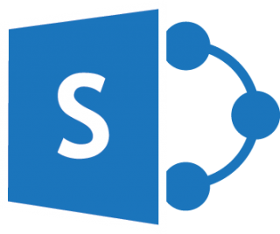



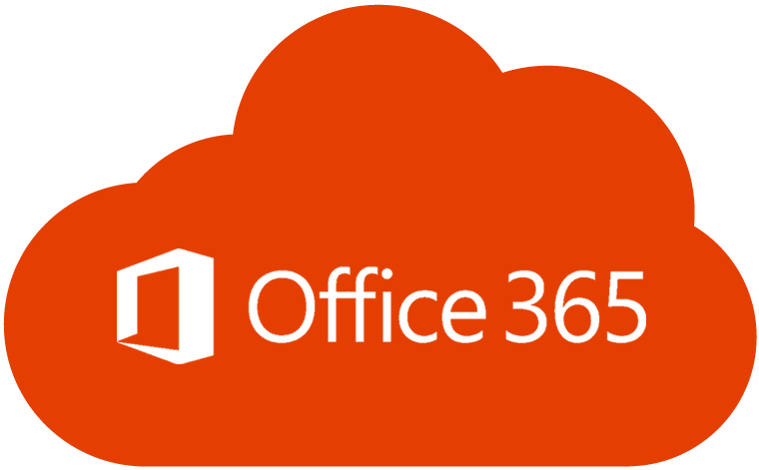

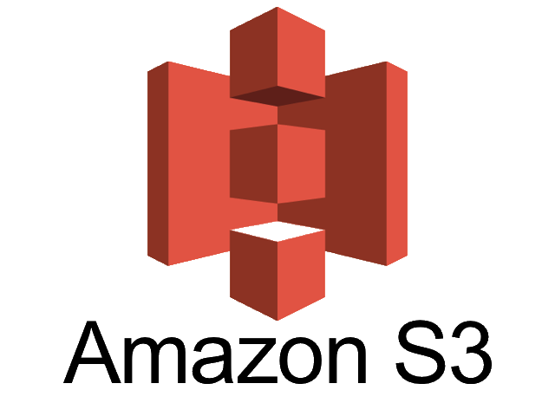
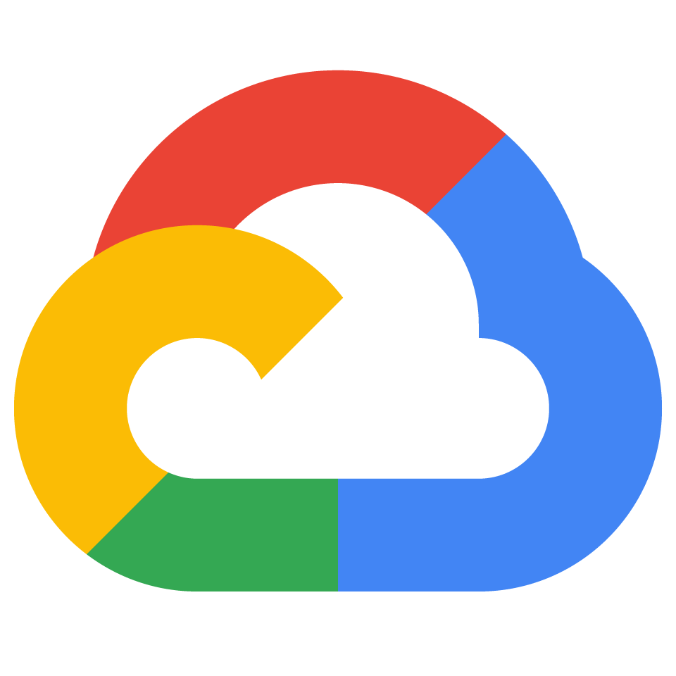

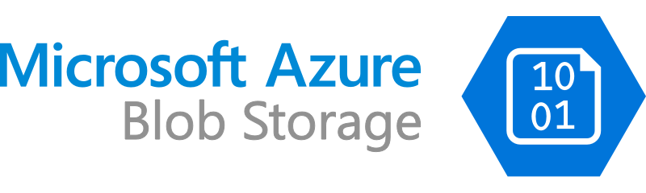
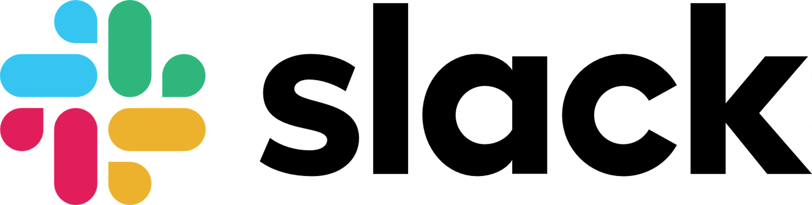

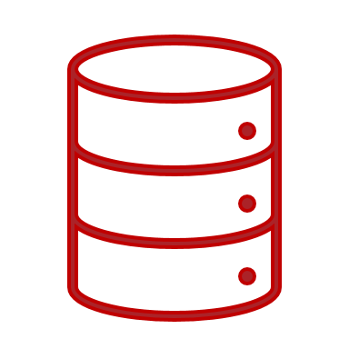
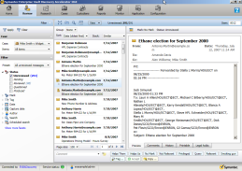

Veritas Enterprise Vault Architecture
SharePoint
Files
Collaboration Tools
Cloud Storage
ENTERPRISE
VAULT SERVER
Storage
eDiscovery & Compliance
SAN, NFS, CIFS, DAS, etc.
Copyright © 2022 Veritas Technologies, LLC
Notes:
Discuss the different archiving sources and options to store data.

Slide 10
Flexible Deployment

Slide 11


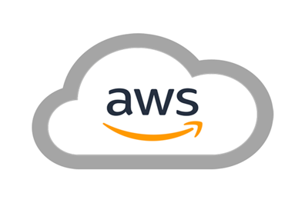
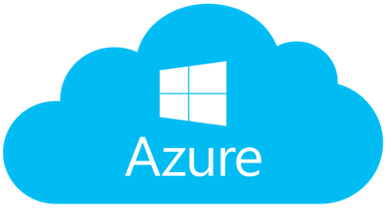


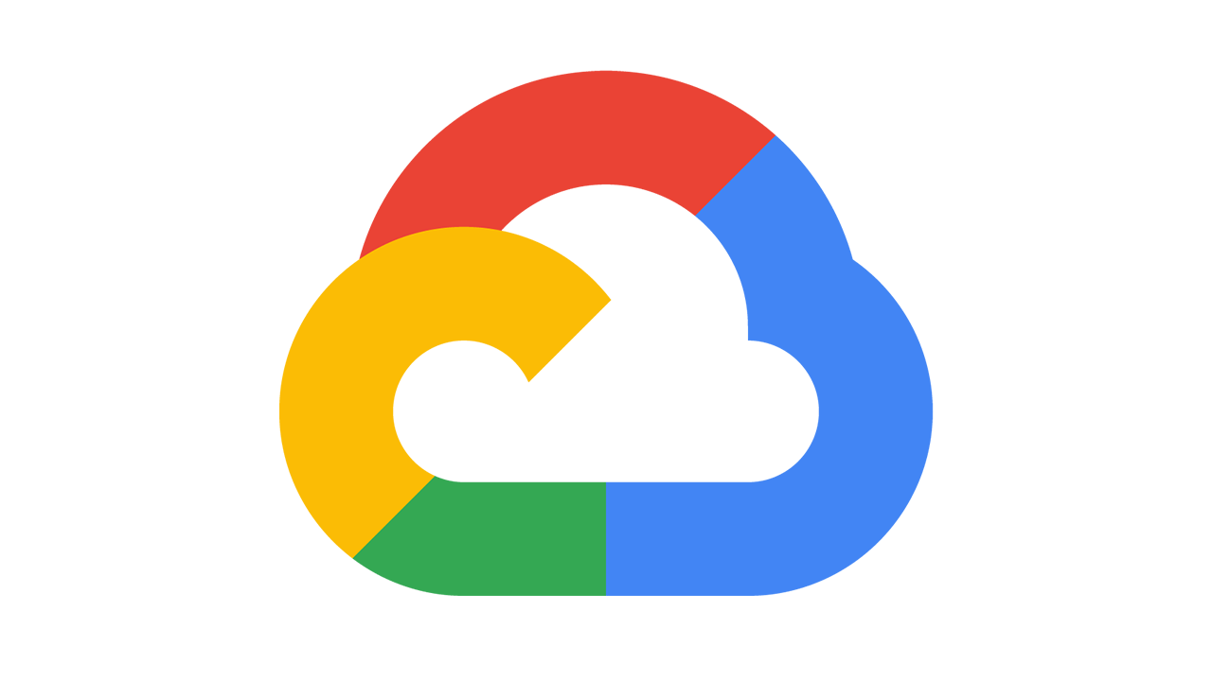
Flexible Deployment
Customer Tenant
SaaS
Fully Managed
On-Premises
Hybrid
On-Premises/Cloud
Highly secure; meet
data sovereignty
Enterprise Vault on-prem but leveraging cloud storage
Leverage Customer’s Cloud agreement/tenant; No retraining for EV users
No CapEx,
no infrastructure
IBM
Clean
15%
IBM
Dark Data
ROT
Enterprise Vault
Enterprise Vault
Enterprise Vault
Enterprise Vault.Cloud
Notes:
Enterprise Vault is very flexible when it comes to deployment
Can be deployed on-prem with customers own data center on a physical server or virtual machine
EV supports AWS EC2 and Azure VM for deployment
EV can be deployed in hybrid mode, on-prem EV leveraging AWS S3 or Azure Blob for Primary Storage (with caveats of performance and cost of retrieval)
EV can be managed by partners like Bluesource
EV.c our SaaS offering for customers who want to use software as a service.

Slide 12


Veritas
Information Classifier
Data Compliance & Governance Portfolio

Slide 13
Market Leading Automated Classification
Proximity
Searching
Regular
Expressions
Confidence
Based
Dispositions
Topic
Extraction
Coming Soon
Automated Unsupervised Classification
    1,100+ Built-in Patterns and AI combine into 250+ Policies
    Vetted by industry experts to address all major regulations
    More patterns than competition via quarterly proliferation
    New Transparent Policies expose policy logic for transparency and defensibility
    Easy to customize and caters to citizen data scientists
Keyword
Search
Sentiment
Analysis
Checksum
Validation
Voice
Analysis &
Transcription
Veritas
Information Classifier
Document
Similarity
Sensitive
Data
Detection
Min/Max
Count
Dispositions
Language
Detection
Notes:
Use Cases for Classification
I want to classify my information to
make better information retention decisions
make better eDiscovery decisions or investigations
include items for supervisory review
classify personally identifiable information (PII) and
make better information protection decisions
enable risk analysis and con
duct any necessary remediation
be compliant with industry regulations and avoid fines
I want to reclassify for all the above reasons
I want to reclassify when changing my policies
EV12 Classification Overview
EV12 offers Classification for any ingested content: Email, Files, API (e.g. Exchange, Domino, PST’s, NSF’s, FSA, SharePoint, API)
Define your policies for items to be automatically classified
Decide if an item should be archived or discarded
Assign a retention category based on metadata or content
Assign searchable Tags to help refine end-user, discovery or
supervision searches or review
Override all retention categories for a given archive via Retention Plans
Classification Test Mode
During configuration testing Classification can be run in test mode. When an archice is in test mode, items will behave as if they did not have classification enabled. During user deletion or automatic expiry, items will be deleted as normal but the test mode report would indicate if the item would have been blocked from user deletion or automatic expiry based on the classification results.
Can also be used without a Classification license to show how Classification can be used

Slide 14





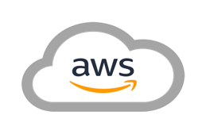

Classification-Defined Storage
Default Partition
Immutable
Partition Migration
Junk
Trade Comms
SP
Non-WORM
IBM
Business Plan
Migrate Smart Partition content to the cloud (compress and collect)
Enterprise Vault
Information Classifier
Primary Storage
Item archived, classified, and tagged
Retention applied
based on classification
Item stored in Smart Partition
according to its tag
Item migrated to the cloud
Notes:
- Based on classification tags you can define Retention as well as Storage
- Classification tags can also be used to reduce noise from eDiscovery and Supervision searches by excluding items with evtag.exclude index property.

Slide 15
Veritas
Merge1
Data Compliance & Governance Portfolio

Slide 16
Veritas Data
Compliance & Governance Portfolio
eDiscovery Platform / Advanced eDiscovery
CONTENT AGGREGATION
Capture ALL relevant communication and file content sources
ONE PLATFORM, COMPLETE DISCOVERY
Accelerate collection, processing and review for eDiscovery and FOIA/Subject access requests
Merge1
Discover
Capture
EFFICIENT REVIEW OF ALL CONTENT
Advanced Supervision provides monitoring of communications to ensure regulatory compliance
FILE VISIBILITY
Understand your content in place via monitoring, classification, usage analysis and PII detection
Advanced Supervision
Data Insight
Data Compliance & Governance Portfolio
Monitor
Visualize
Archive
CAPTURE & INDEXING
Efficiently store content with flexible deployment (on-prem, hybrid, customer cloud tenant; SaaS).
ENRICH METADATA
Surface relevant content and eliminate noise. Take proper action based on content analysis.
Enterprise Vault (On-prem/SaaS)
Classify
Information Classifier

Slide 17
Veritas Data
Compliance & Governance Portfolio
eDiscovery Platform / Advanced eDiscovery
CONTENT AGGREGATION
Capture ALL relevant communication and file content sources
ONE PLATFORM, COMPLETE DISCOVERY
Accelerate collection, processing and review for eDiscovery and FOIA/Subject access requests
Merge1
Discover
Capture
EFFICIENT REVIEW OF ALL CONTENT
Advanced Supervision provides monitoring of communications to ensure regulatory compliance
FILE VISIBILITY
Understand your content in place via monitoring, classification, usage analysis and PII detection
Advanced Supervision
Data Insight
Data Compliance & Governance Portfolio
Monitor
Visualize
Archive
CAPTURE & INDEXING
Efficiently store content with flexible deployment (on-prem, hybrid, customer cloud tenant; SaaS).
ENRICH METADATA
Surface relevant content and eliminate noise. Take proper action based on content analysis.
Enterprise Vault (On-prem/SaaS)
Classify
Information Classifier

Slide 18



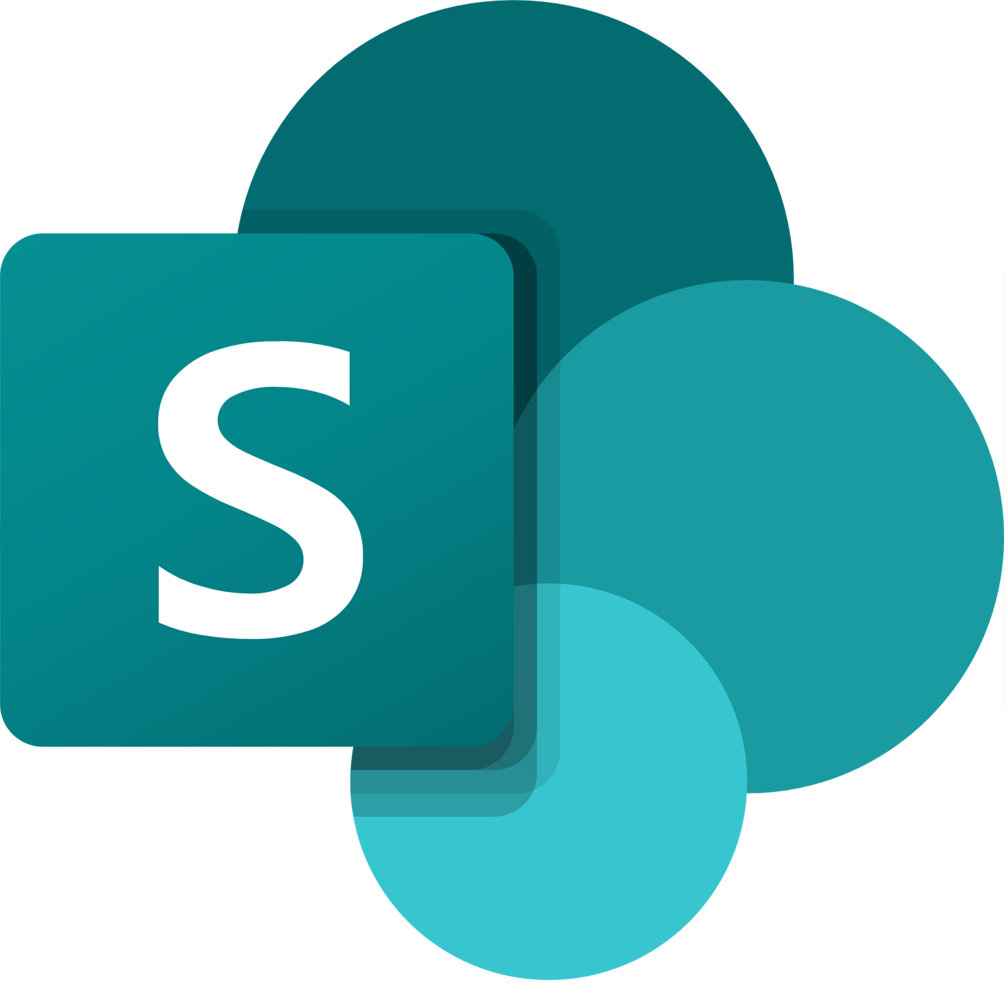



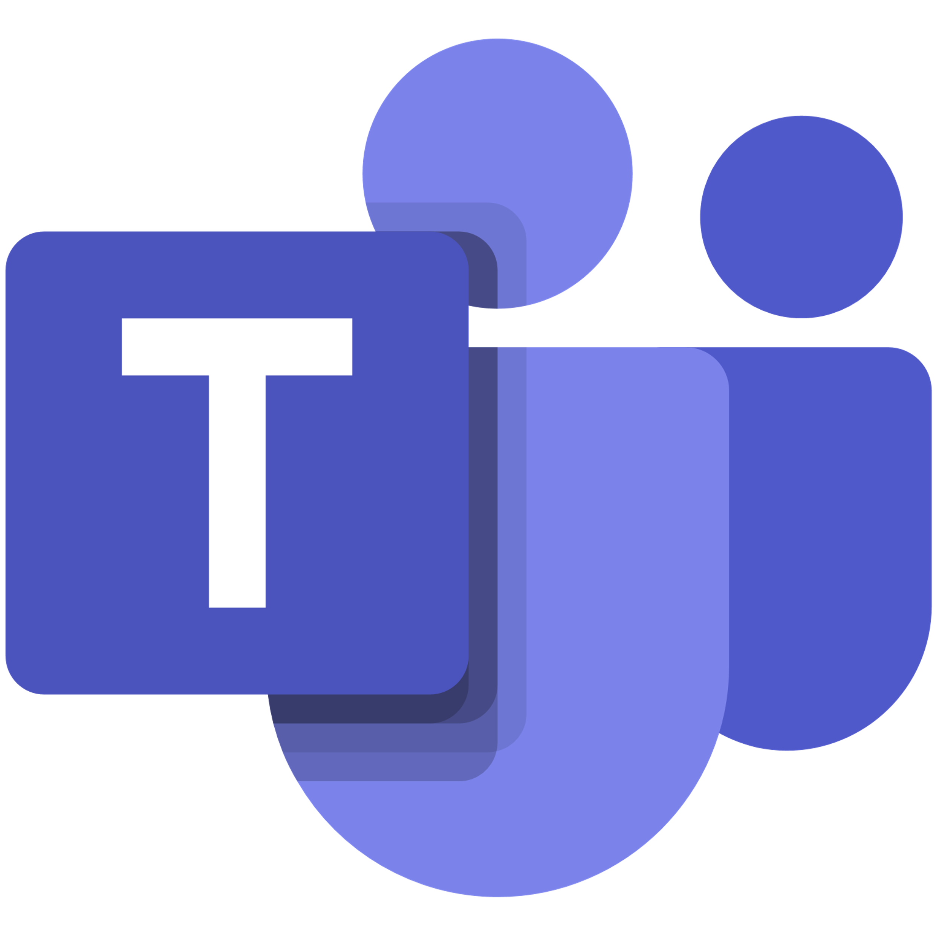





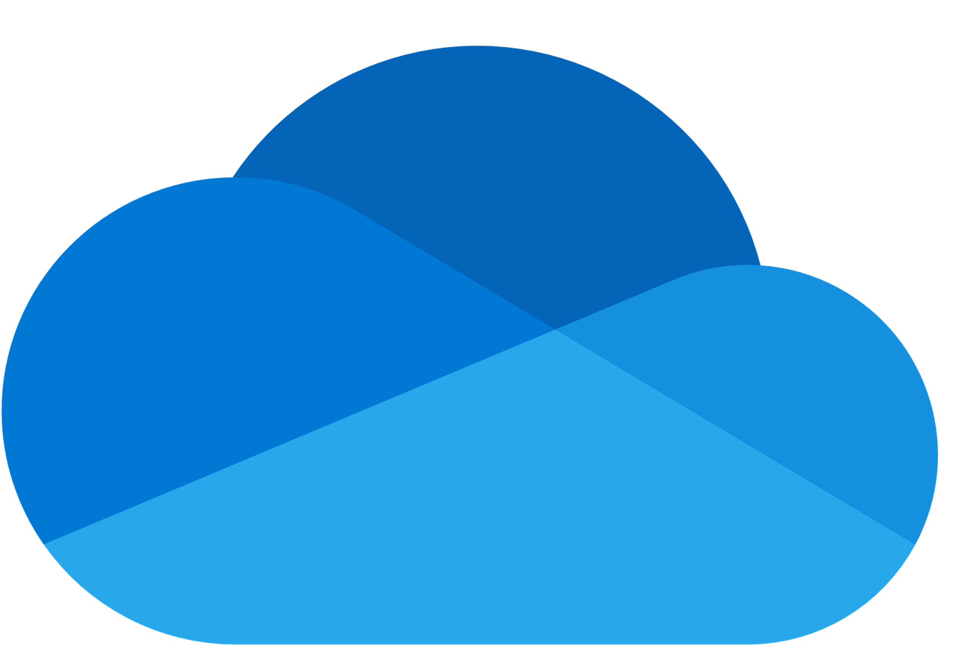
Merge1
Over 120 Content Sources Now Supported Natively
COLLABORATION
Slack
Microsoft Teams
Yammer
Skype for Business
SharePoint
Salesforce Chatter
Chatter Cipher Cloud
Twitter
Jabber Enterprise
Jabber
Cisco WebEx Teams
Crowd Compass
Zoom Meetings
Workplace
DOCUMENT COLLABORATION
Box
OneDrive for Business
Dropbox
Google Drive
Citrix ShareFile
AWS
FINANCIAL PLATFORMS
Bloomberg
Symphony
UBS
XIP
Refinitiv Eikon
FXConnect
IceChat
Yieldbroker
Redtail Speak
ENTERPRISE TOOLS
ServiceNow
Webpage
Pivot
OTHER
EML
Exchange Mailbox
Exchange Mailbox Online
Text-Delimited
XSLT/XML
DB

Slide 19
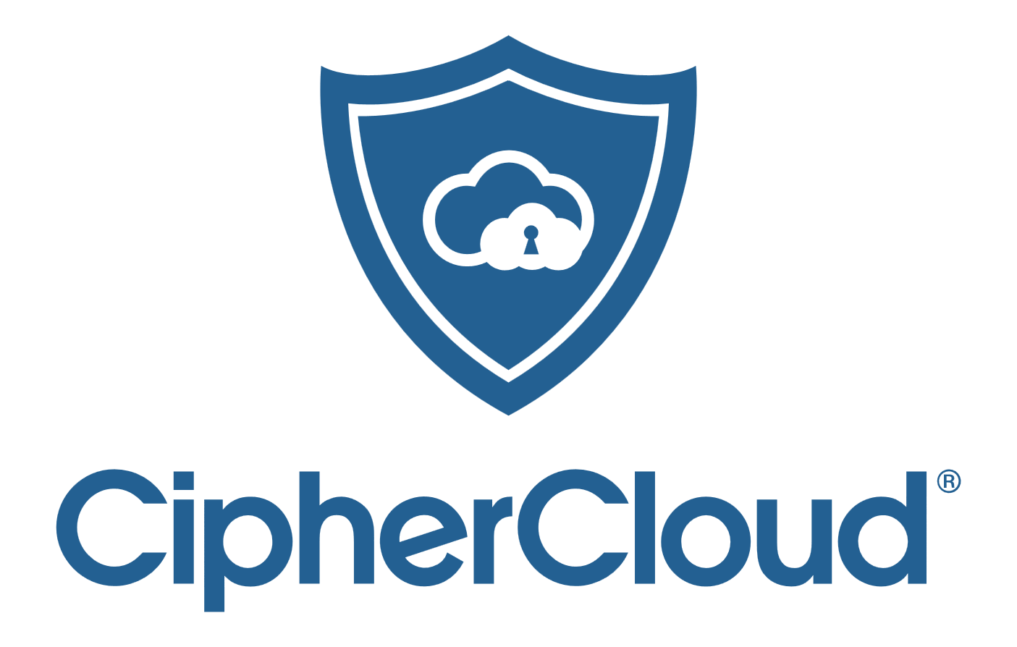

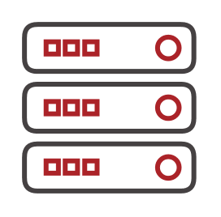



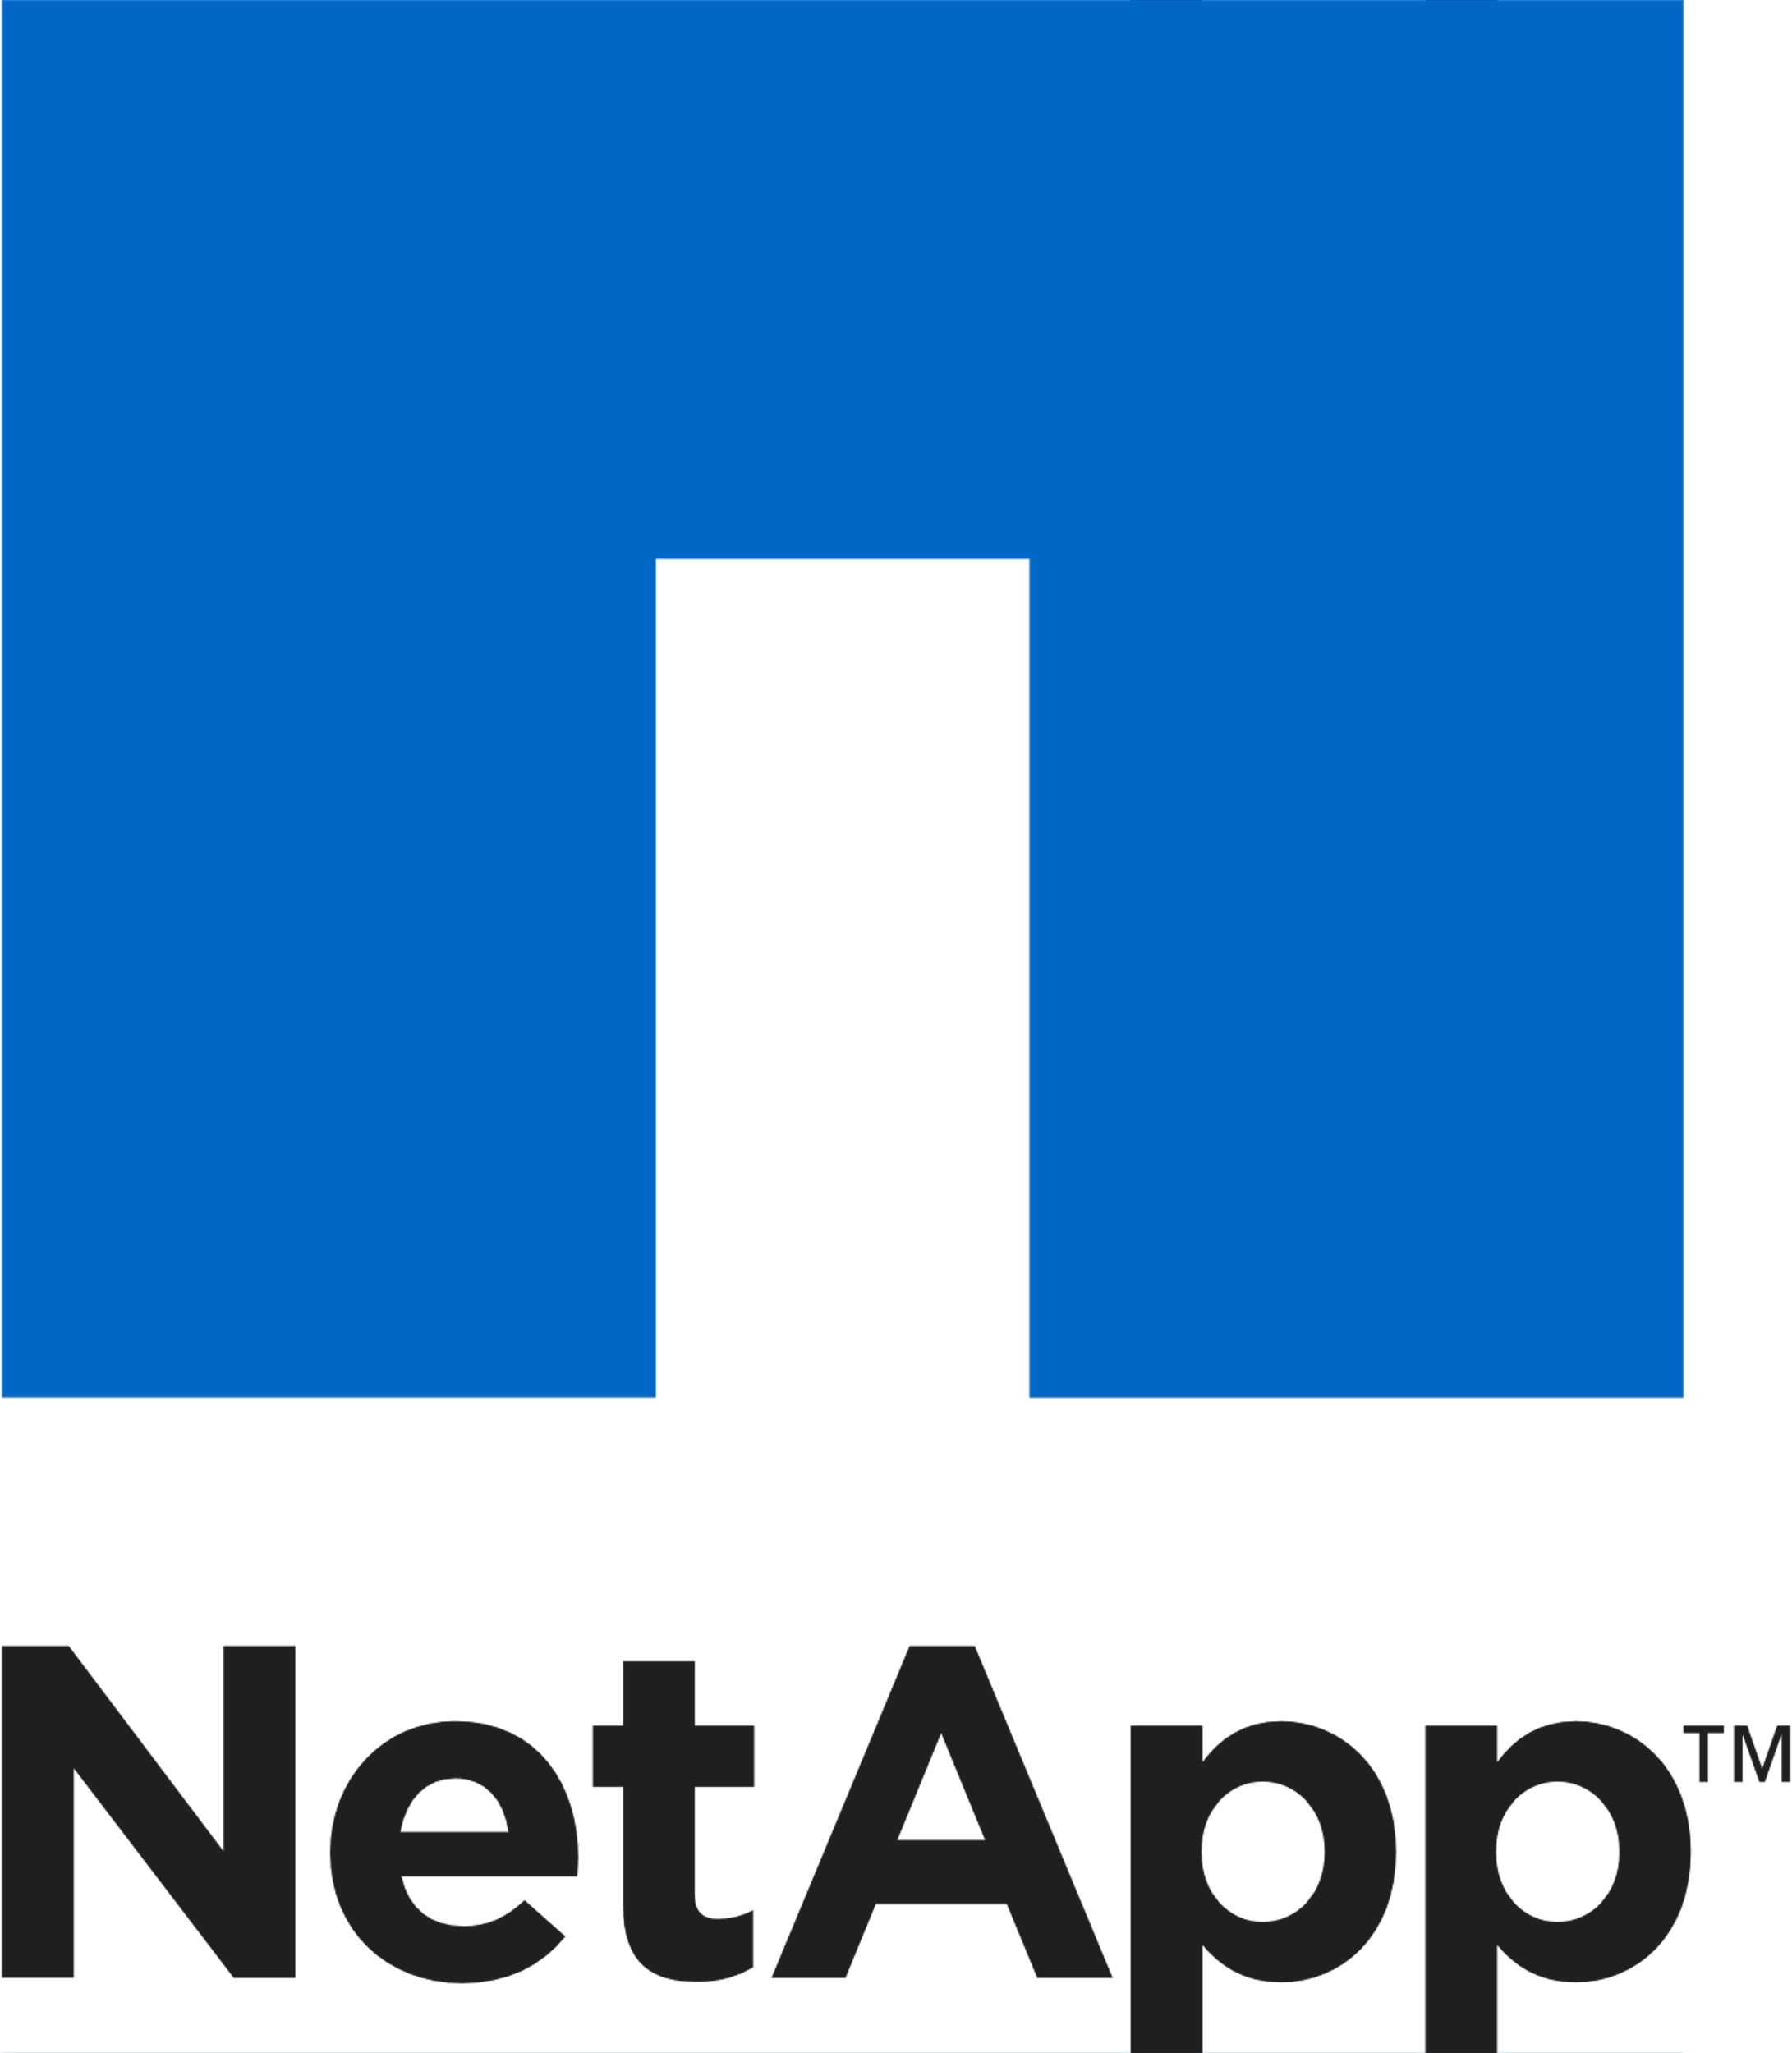

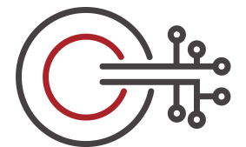
Proactive Supervision
Archive & Capture
PLUS
MORE…
DISCOVERY & COMPLIANCE
eDiscovery Platform & Advanced Supervision enable discovery of archived data
MERGE1
EDISCOVERY PLATFORM / ADVANCED SUPERVISION
CAPTURE
Merge1 captures Instant Message, Social Media & Compliance Data
DATA INSIGHT
EMAIL
ENTERPRISE VAULT / CLOUD
CLIENTS
SCAN & CLASSIFY
Multi-Dimensional Classification of Unstructured On-Premises & Cloud Data Stores
ARCHIVE & MANAGE
Surface data via indexing and classification to manage retention & deletion by policy

Slide 20
File System Archiving

Slide 21

Veritas
Data Compliance & Governance Portfolio
eDiscovery Platform / Advanced eDiscovery
ONE PLATFORM, COMPLETE DISCOVERY
Accelerate collection, processing and review for eDiscovery and FOIA/Subject access requests
Merge1
CONTENT AGGREGATION
Capture ALL relevant communication and file content sources
Discover
Capture
Advanced Supervision
EFFICIENT REVIEW OF ALL CONTENT
Advanced Supervision provides monitoring of communications to ensure regulatory compliance
Data Insight
FILE VISIBILITY
Understand your content in place via monitoring, classification, usage analysis and PII detection
Data Compliance & Governance Portfolio
Monitor
Visualize
Data Insight
Enterprise Vault (On-prem/SaaS)
CAPTURE & INDEXING
Efficiently store content with flexible deployment (on-prem, hybrid, customer cloud tenant; SaaS).
Archive
Information Classifier
ENRICH METADATA
Surface relevant content and eliminate noise. Take proper action based on content analysis.
Classify

Slide 22

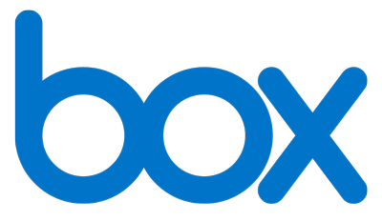
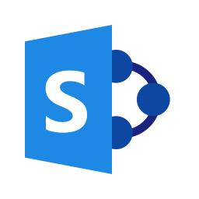
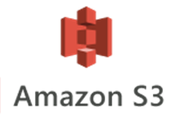



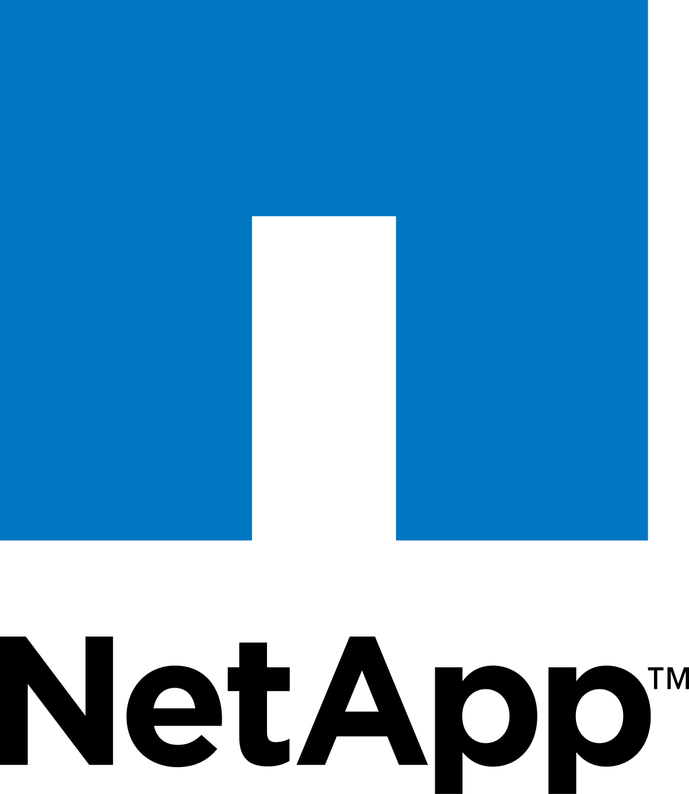

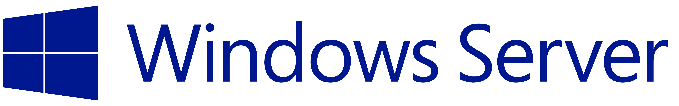

Content with Context
True ownership, content, and context enables effective remediation
Write
Read
ACTIONABLE
INSIGHTS
Risk
Scoring and
Advanced
Analytics
DATA INSIGHT
Permission
Change
User
Activity
Size
FILE OWNERSHIP
Size
On
Disk
Protect
Bit
Allows
Modify
Date
File
Metadata
SECURITY RISKS
ACL
Denies
STALE, NON- BUSINESS,
ORPHAN
Access
Date
Effective
Permissions
Share
Create
Date
BUSINESS USE
User
SIDS
VALUE AND SENSITIVITY
Group
Structure
Creator
Business
Context
Content
Classification
Nested
Groups
Business
Unit
PII
Credit
Card
Citizenship
User
Credentials
Confidential

Slide 23
Veritas Data Insight
Veritas Data Insight is a file analysis and classification tool that identifies information risk hazards and delivers integrated remediation capabilities to ensure successful execution of an organization’s Data Governance strategy.
Metadata, Ownerships and permissions
Data Usage/
Activity
User/Groups (Directory Services)
Content
Classification
Scan for metadata information and access permission
Track file access/ usage activity across your infrastructure
Understands users and attributes from Active Directory/LDAP
Content Classification with 250+ policies and nearly 1,100 patterns
Notes:
Veritas Data Insight provides actionable intelligence into data ownership, usage and access controls to improve unstructured data governance to reduce costs, reduce risk and achieve compliance through
Veritas developed Data Insight leveraging expertise across storage & security product groups. The technology essentially tracks file access/usage activity across NAS devices, File Servers and SharePoint. Data Insight also scans the data source for metadata information and access permissions. Data Insight understands users/groups and attributes from Active Directory or LDAP as well as content classification via Veritas DLP integration.
Data Insight offers a user interface and reports to discover, analyze and monitor data using metadata, permissions, owners, usage, audit logs, content classification…
Example of the analytics is Data owner identification
Data Insight enables rule-based inference of data owners based on actual usage. Data owner information may not reflect the responsible party. The responsible party or data owner can be a line manager in the business unit, the head of a department, or an information security officer. Veritas Data Insight provides information to tie the most active user of a file to a manager or responsible party for remediation steps
This becomes the basis to improve data governance. These capabilities have broad applications for risk reduction, compliance and cost reduction efforts
From the start, we’ve treated Data Insight as an integrated solution. Single technology that collects the usage context/ownership data, this intelligence can be leveraged for several broad initiatives. Our goal has been to minimize operational complexity and not create just another point tool.
DLP integration: Discover your risk, understand data usage/owners and drive remediation of risk
EV integration: Discover/analyze your data to make informed archiving decisions for cost savings and for retention/compliance – basically giving you that end-to-end data lifecycle management process.
Additionally, there are some integrations with 3rd party access governance vendors thru reporting interfaces.
One of the other important design goals was scalability. Data Insight is based on Big Data architecture (on general purpose HW) exhibiting scale-out and proprietary optimizations to support very large data sets with high velocity usage/activity (PBs of data, billions of events)

Slide 24
Market Leading Automated Classification
Proximity
Searching
Regular
Expressions
Confidence
Based
Dispositions
Exact Data
Match
Automated Unsupervised Classification
    1,100+ Built-in Patterns and AI combine into 250+ Policies
    Vetted by industry experts to address all major regulations
    New features, patterns and policies via quarterly releases
    Embedded across Digital Compliance Portfolio
    Simple to follow UI allows for easy customization
Keyword
Search
Sentiment
Analysis
Checksum
Validation
Named
Entity
Recognition
Veritas
Information Classifier
Document
Similarity
Sensitive
Data
Detection
Min/Max
Count
Dispositions
Language
Detection
Notes:
Veritas Information Classifier or VIC is our expert trained engine that leverages a variety of pattern-based & AI-based techniques to classify information.
Techniques such as simple keyword-based search, with proximity & Boolean logic, with checksums & lunh validation for numbers like credits cards, to regex, document similarity & min/max counts as well as a variety of AI based techniques like NER using NLP, language detection & sentiment analysis.
All these techniques all available for customization or to be simply used via our pre-built policies.
While most competing classification engines focus on patterns such as the identification of PII like credit card numbers, out of the box VIC supports over 1000 prebuilt patterns such as credit card number, genetic data, as well as behaviors like bribery or harassment. Additionally, we combine these patterns form over 200 policies that directly address regulations and standards found across the world all vetted by experts in each industry.
(AI/NLP based features: Sentiment Analysis, Language Detection, Named entity recognition and Topic Extraction)

Slide 25
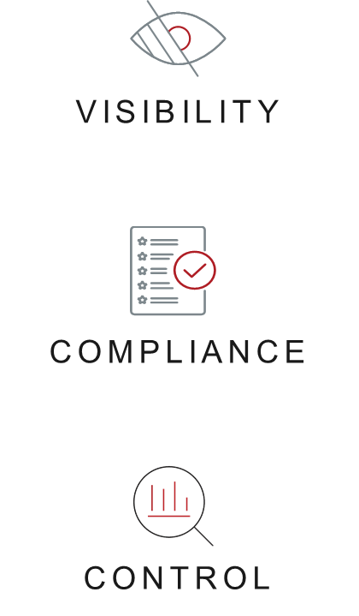
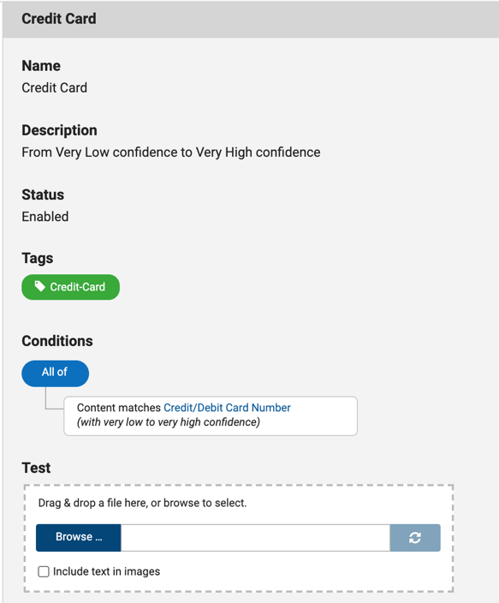
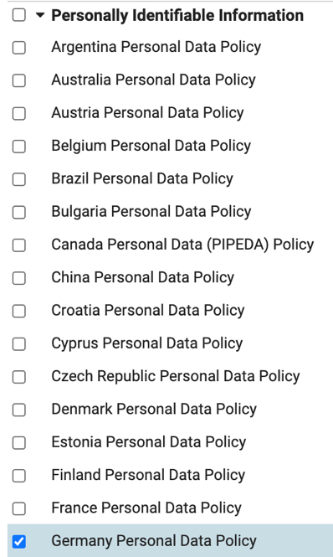





Data Insight – Top Use Cases
Addressing Data Privacy
Personal Data Detection
Detect Highly
Sensitive Content
Take Corrective Action
and Ensure Compliance
Sexual Orientation
Political Affiliation
Change ACLs
Delete Sensitive Data
Religion
Change Storage location
PII detection for most countries
Content with greater restrictions under GDPR and other Data Privacy Regs.
Take corrective action and ensure compliant steady-state

Slide 26
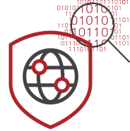
Data Insight – Top Use Cases
Data Security
Understand Data Content, Ownership and Usage
Detect Malware and
Suspicious Behavior
Take Corrective Action
and Ensure Compliance
Audit access to data
Identify data owners and automate entitlement reviews
Discover over-exposed data, including sensitive data
Comprehensive user activity monitoring
Detect compromised accounts through abnormal behavior alerts
Ransomware reporting based on user access patterns
Detect ransom notes to help prevent schedule-based malware attacks
Remediate sensitive data and integrate with Symantec Data Loss Prevention
Audit historical access and monitor sensitive data usage and anomalous behavior
Discover open shares and
Ensure protection by collecting MIP labels

Slide 27
Data Insight – Top Use Cases
Ransomware Detection
Early Ransomware Detection Based
on Behavior
Detection of Ransom Notes and File Types
Take Action
    Monitor file activity (accessed, modified and renamed) for early detection of a ransomware attack
  Anomaly Detection templates to detect compromised account behavior in near real time
  Use built-in ransomware templates to find and review impacted files and compromised accounts
  Built-in detection of 3200+ ransomware extensions
  Find and alert on ransom notes within the monitored data set
    Detect Ransom notes in files and images
  Lock-down suspicious accounts
  Restore data from NBU and other backup vendors using custom integrations

Slide 28
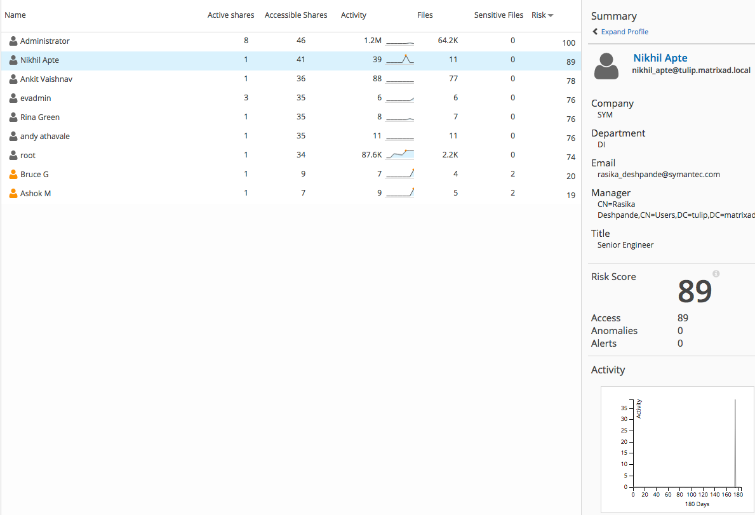
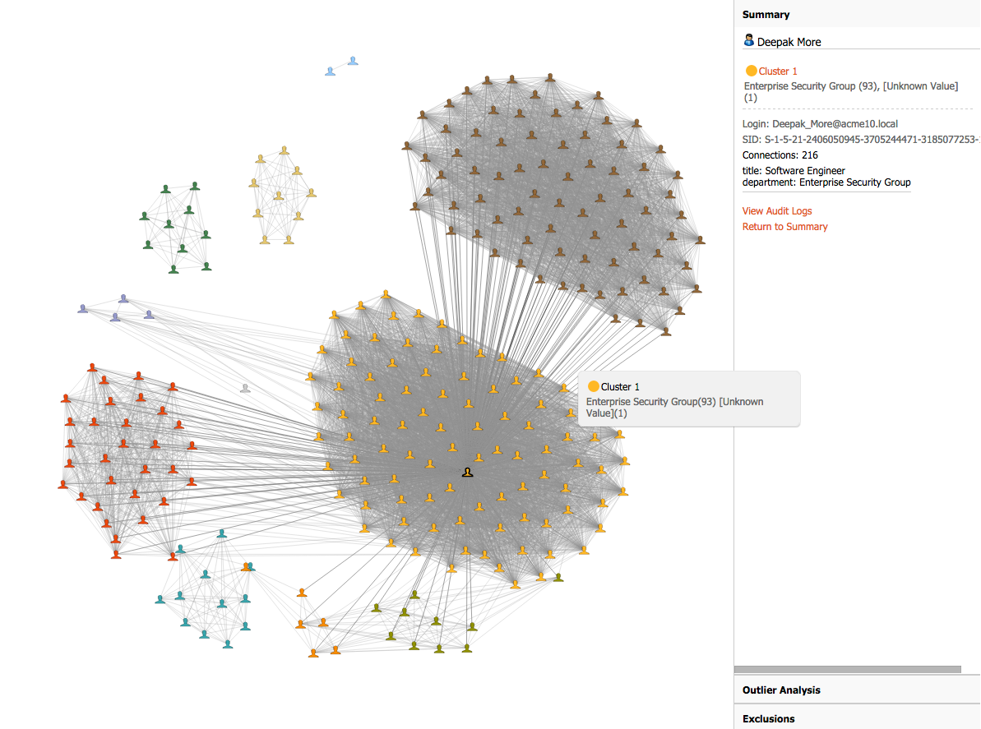
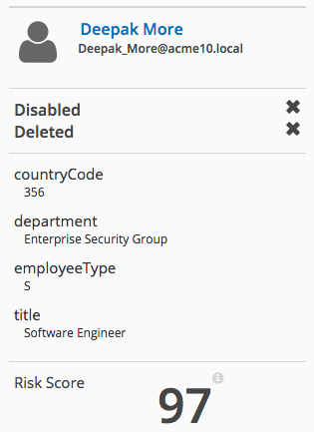
Data Insight – Top Use Cases
User Risk Visualization
User Risk Visualization
Social Map
Understand High Risk User accounts and
the data they interact with
Find the Risky Behavior Before it’s a Problem

Slide 29
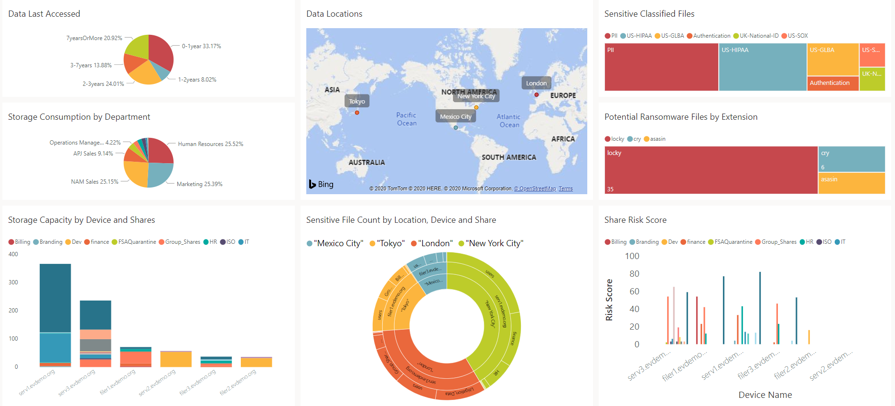
Intelligent Reporting with PowerBI
Actionable insights of your environment

Slide 30
Veritas: Industry Leader for 30+ Years
for Enterprise Backup and Recovery Software Solutions
for Enterprise Information Archiving
17x
95%
15x
LEADER
of the Fortune 100 Trust Veritas
LEADER
6,000+
Employees
Worldwide
20,000+
Global
Partners
80,000+
Global
Customers
2,000+
Developers
Worldwide
2,200+
Global
Patents
800+
Supported
Workloads
100+ EB
Data Under
Management
Gartner is a registered trademark and service mark of Gartner, Inc. and/or its affiliates in the U.S. and internationally,and is used herein with permission. All rights reserved. *Fortune Global 500 and Fortune 100, June 2022
Notes:
We allow customers to get access to their data where and when they want it. ​
We do this at scale for the worlds largest and most complex environments, ​including 95% of the Fortune 100.
For decades, Veritas has been leading in data protection, and no company in the industry can match this record.
17x leader in Gartner’s Magic Quadrant, over 2,000 global patents and over 100 exabytes under management.
We protect the world’s most important asset—data.

Slide 31


Slide 32
Introducing NetBackup

Slide 33






Today’s Challenges
“I need to protect everything.”
“I need to protect against ransomware.”
“I need to orchestrate and automate.”
Challenges:
Inconsistent protection
Limited multi-cloud visibility
Lack of scalability
Challenges:
Multiple attack surfaces
Point solutions
Risk of downtime
Challenges:
Operational complexity
Increasing costs
Inefficient usage
Notes:
[WHAT WE HEAR FROM OUR CUSTOMERS]
I need to protect everything. On premises physical, virtual, public, private cloud. Virtually every organization now has some of its data in the cloud – or has plans to do so. But with so many different cloud providers, organizations some time struggle to maintain consistent protection of all of their data – and lack visibility and the ability to scale.
I need solutions to orchestrate and automate to reduce complexity & OpEx. Increased challenges such as the operational complexity of managing data across the multi-cloud, along with the increasing costs resulting from massive data growth, and the problem of inefficient use of resources / overprovisioning all play a role in the need for today’s data management solutions to better orchestrate and automate.
I need my data secure and recoverable. Average downtime from a ransomware attack is 5 days, and point solutions provide limited coverage for only portions of an environment. With an organization’s data now residing in multiple locations, this gives attackers multiple locations to target – and an increased risk of a successful attack and resulting downtime.,
But, by design, NetBackup solves for these customer needs and more.

Slide 34
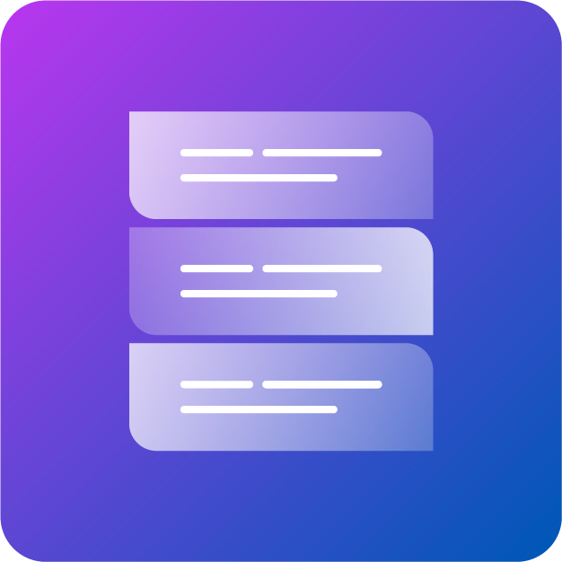
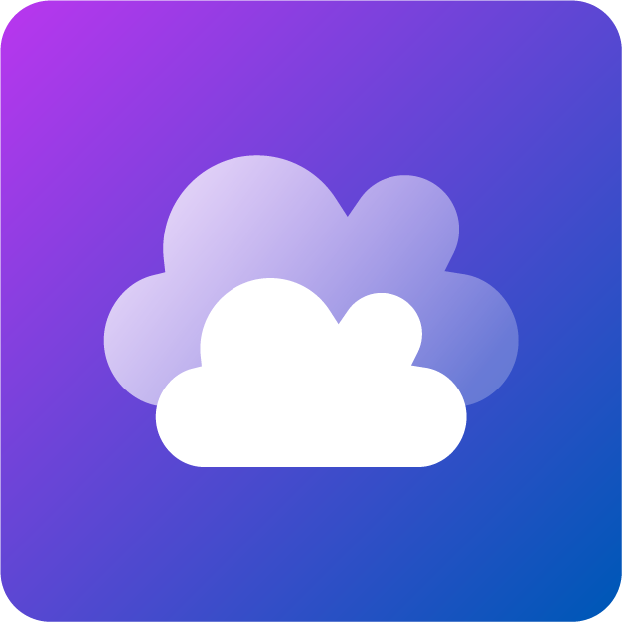


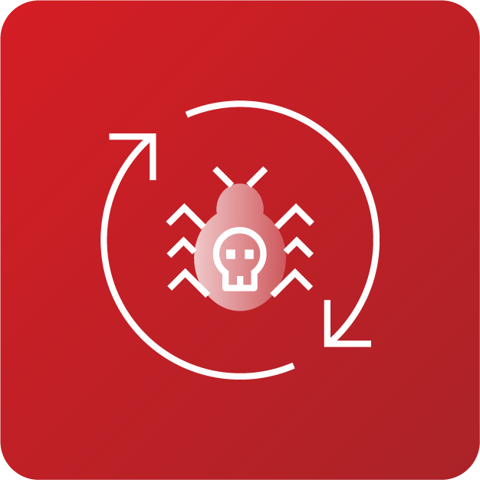
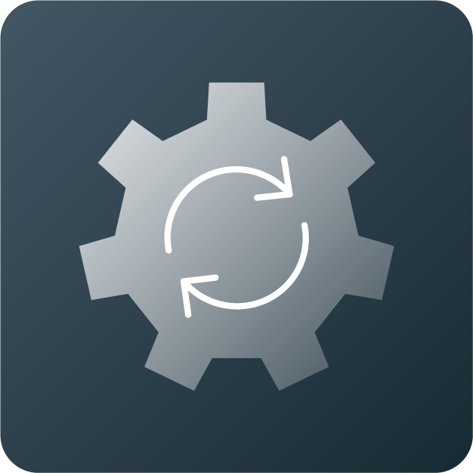

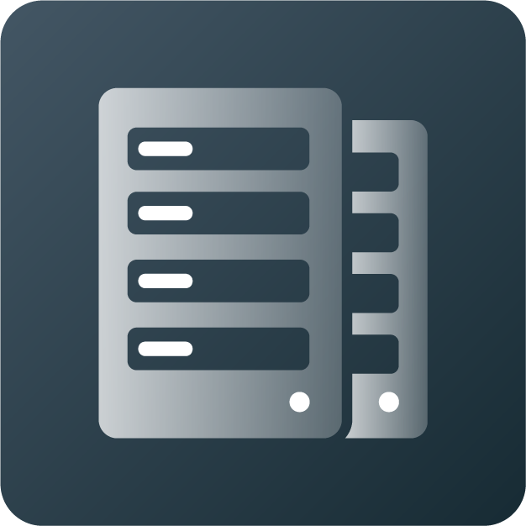
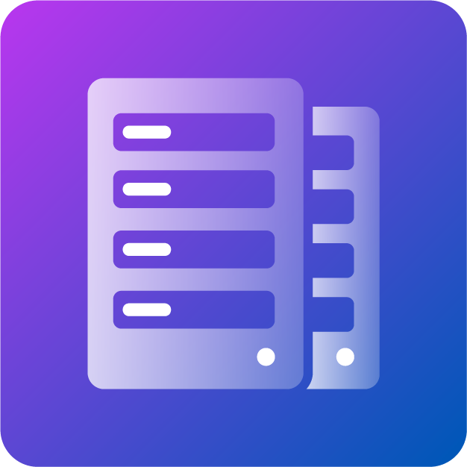
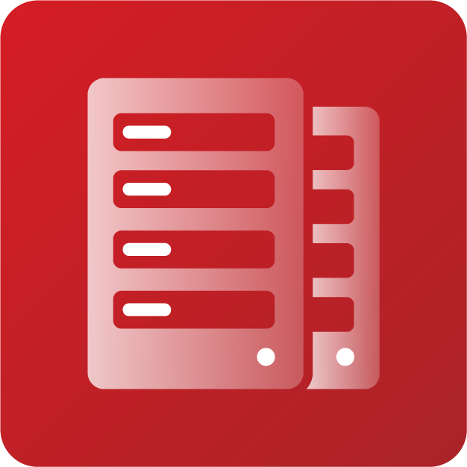
Veritas NetBackup
Powered by Cloud Scale Technology
Cloud Optimized
Cyber Resilience
Automated Operation
Any cloud
Any workload
Any deployment model
Multi-cloud visibility
Comprehensive protection
Active cyber defenses
Zero-ransom recovery
Any RPO or RTO
Event-driven automation
Elastic resource utilization
Reduced cost
Reduced carbon footprint
Notes:
Veritas NetBackup enables enterprises to address these challenges, protecting the world’s most valuable data regardless of where it resides—from edge to core to cloud. It does this in three key areas:
1. Cloud Optimized
2. Automated Operation
3. Cyber Resilience
NetBackup delivers
1. Cloud Optimized – with features that provide customers flexibility and choice across any cloud, any workload, any data source and now any deployment architecture – with integrated visibility across multi-cloud environments.
Cyber Resilience - ensuring reliable [and rapid] recovery at any scale from a potential ransomware attack – with comprehensive ransomware protection features on-premises and in the cloud – with active detection capabilities and automated malware scanning – ensuring organizations pay zero ransom and are able to quickly recover their data in the event of an attack, with the ability to achieve any RPO or RTO that is required.
3 . Automated Operation - features that further reinforce Veritas’ focus on abstracting the complexity of enterprise IT—streamlining management through orchestrated automation of discovery, protection and recovery. And with features that optimize the use of cloud resources through elastic utilization – resulting in reduced costs and a reduced carbon footprint.

Slide 35
NetBackup
Powered by Cloud Scale Technology
Cloud Optimized
Cyber Resilience
Automated Operation
Cloud Optimized
Any cloud
Any workload
Any deployment model
Multi-cloud visibility
Comprehensive protection
Active cyber defenses
Zero-ransom recovery
Any RPO or RTO
Event-driven automation
Elastic resource utilization
Reduced cost
Reduced carbon footprint
Get control of your data.
Notes:
Veritas NetBackup enables enterprises to address these challenges, protecting the world’s most valuable data regardless of where it resides—from edge to core to cloud. It does this in three key areas:
1. Cloud Optimized
2. Automated Operation
3. Cyber Resilience
NetBackup delivers
1. Cloud Optimized – with features that provide customers flexibility and choice across any cloud, any workload, any data source and now any deployment architecture – with integrated visibility across multi-cloud environments.
Cyber Resilience - ensuring reliable [and rapid] recovery at any scale from a potential ransomware attack – with comprehensive ransomware protection features on-premises and in the cloud – with active detection capabilities and automated malware scanning – ensuring organizations pay zero ransom and are able to quickly recover their data in the event of an attack, with the ability to achieve any RPO or RTO that is required.
3 . Automated Operation - features that further reinforce Veritas’ focus on abstracting the complexity of enterprise IT—streamlining management through orchestrated automation of discovery, protection and recovery. And with features that optimize the use of cloud resources through elastic utilization – resulting in reduced costs and a reduced carbon footprint.

Slide 36
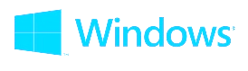

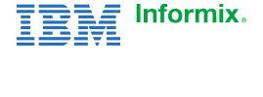
































Unmatched Flexibility
Operating Systems
Virtual Systems
Databases and Applications
Storage Systems
Cloud and SaaS
PaaS
Next-Gen
Containers
Notes:
You may not need all of these workloads protected today. But we think about tomorrow, so you can get results of your data today. Giving you the flexibility to decide what technologies you use to further your business without having to worry about data protection.
A few examples below:
VMware workload scale and performance. When you have customers with many tens of thousands of VMs, our solutions improve every-day tasks such as discovery and made our data movement more efficient.
Microsoft SQL Self-Service as an example. This allows the SQL DBA to be fully self-sufficient in managing...data protection for the thing they care about most, the database. Instant Access for SQL and Intelligent policies for Oracle, Oracle RAC, MS-SQL, NAS are all supported as well.
We also feature growing support for Nutanix, including adding support for their NAS solution, Nutanix files.
No other solution in the market can offer what NetBackup can! NetBackup provides more flexibility and choice to meet your business needs, because we know that most environments have a mixture of old and new innovative technologies. It is rare to have rip and replace models. Therefore, our solution can do it all!
[CLICK]
Another big engineering effort in NetBackup has been scale out – with NetBackup Flex Scale.

Slide 37












NetBackup: Optimized for the Multi-Cloud
Automated and AI-powered intelligent data storage
NetBackup 10 – Available today
Future: AI-powered Intelligent Data Storage
New instance provisioned
Apps or VMs in
AWS, Azure, or GCP
Elastic Cloud Autoscaling dynamically adjusts cloud resources as required
Intelligent Cloud Policy Engine performs automated discovery
Public cloud
On-premises
Cloud-based snapshots in AWS or Azure
Multi-tier replication replicates backups to any target
NetBackup Recovery Vault
Containerized dedupe engine simplifies deployment and optimizes data footprint
Notes:
The automatic discovery of new assets and intelligent filtering drastically reduces the effort required to automate data protection for cloud assets and stay compliant as enterprises continuously adopt multicloud applications and infrastructure. NetBackup has all your resources across multiple clouds protected—No cloud data left behind!
Reduce cloud compute costs as much as 40 percent using elastic snapshots and backups. NetBackup automatically scales compute and memory resources to meet increasing demand during snapshot and backup operations and then releases those resources when demand subsides.
In the future, this capability will be further augmented by the addition of AI-powered Intelligent Data Storage… this is part of our Autonomous Data Management vision (more to come on this later in the deck).

Slide 38














NetBackup for Kubernetes
Granular recoverability
Single
interface
Leading the Industry
Any workload
On-premises to cloud K8s backup
DISTRIBUTION MOBILITY
PLATFORM INDEPENDENCE
Agentless With Native Tools Integration
Automated Namespace Protection
Cross Distribution Recovery
Intelligent Resource Throttling
RBAC Support
Operational Simplicity with WebUI
NEW – Backup Storage Tiering to Multiple Storage Targets (AIR Support)
Centralized
Management
Protection
at scale
Disaster recovery
Private cloud
Hybrid cloud
Public cloud
Notes:
Discovery and protection of all components that make up an application in a namespace gives you the confidence to know that all objects required to run your business logical applications can be recovered quickly, easily, and correctly
The key pillar of our design is a solution that can span across any Kubernetes distribution, on prem or in the cloud, for backup and recovery .
NetBackup for Kubernetes is designed to be cloud-native, using Kubernetes custom operators and APIs
It allows the container architect or the NetBackup admin the control to quickly and simply build protection for their K8s environment using native tools.
NetBackup for Kubernetes gives you the integrated data protection and resiliency you require by utilizing the portable and elasticity of Kubernetes.
Our solution is platform and storage agnostic, while leveraging cloud-native attributes that is designed to provide cross-platform portable integration with any distribution of K8s including: VMware Tanzu, RedHat OpenShift and Google GKE. Our K8s solution provides centralized management to protect cloud-native apps using the intuitive NetBackup web UI or restful APIs to streamline data protection.
We provide you with the foundation to accelerate your adoption of the distributed cloud with the confidence to know we have you protected. As the cloud market evolves, we will continue to invest in our data management solutions for Kubernetes.

Slide 39








Integrated SaaS Protection
NetBackup SaaS Protection is a complete SaaS backup solution. Integrated into NetBackup.
Full SaaS Data Protection
Microsoft 365: Exchange Online, SharePoint Online, OneDrive for Business, Teams, and the M365 Audit Log
Google Workspace: Gmail, Google Drive, Docs, Sheets, Slides, and more
Slack, Box, and more!
End-user self-service
restores
Enterprise-grade Security
Global datacenters for data sovereignty
Enterprise-ready
Performance and scalability
Security hardening
End-user self-service restore
Single-tenant architecture
Comprehensive eDiscovery searches
High performance and scalability
eDiscovery
search
Notes:
Veritas NetBackup SaaS Protection is itself a SaaS-based solution. It provides Backup-as-a-Service (BaaS) for data stored in SaaS applications and platforms-as-a-service (PaaS). NetBackup SaaS Protection is able to address the challenges that come with SaaS data, as well as data from platforms-as-a-service (PaaS) that you might be using. It provides secure cloud data management for all your SaaS and PaaS data.
NetBackup SaaS Protection provides full data protection for a number of SaaS applications, including
Microsoft 365 and all its components: Exchange Online, SharePoint Online, OneDrive for Business, Teams, and the Microsoft 365 Audit Log.
Google Workspace and its components: Gmail, Google Drive, Docs, Sheets, Slides, and more.
Slack
And Box
NetBackup SaaS Protection also provides data protection for the most-used PaaS platforms:
Azure Blob Storage
Azure Files Storage
And Amazon S3.
NetBackup SaaS Protection
Has the performance and scalability to grow as your organization and your data grows.
Has the security hardening you need to keep your private data private.
Includes another nice feature that lets you give your users the ability to perform self-service restores of their own data.
NetBackup SaaS Protection is hosted on Microsoft Azure and can store your data in any of Azure’s data centers around the world, making it easy to comply with data sovereignty regulations.
Lastly, it provides blazingly fast and comprehensive eDiscovery searches. It allows you to perform a single federated search across all of your SaaS application data in all regions and across all domains.
<CLICK>

Slide 40








NetBackup Recovery Vault
Seamless cloud storage-as-a-service
Choice of providers
BETB
1 or 3 years
Includes
data transfer
NetBackup
Recovery Vault
IaaS PaaS SaaS
Comprehensive NetBackup protection
On-premises or cloud-based workloads
NetBackup cloud storage-as-a-service
Provisioned securely in NetBackup
  RBAC authentication
  Subscription-based
  Consumption reporting
Automated resiliency
  Recover to cloud or data center
Air-Gapped ransomware protection
Immutable cloud storage
Limitless scale
Predictable costs
Powered by and Azure
Notes:
In a few short years, the adoption of public cloud-based data protection as-a-service has grown significantly. This trend is placing the responsibility on data owners to deliver on data protection SLAs (Service Level Agreements), data sovereignty, security, and ransomware resiliency.
Traditional approaches to cloud data protection are not keeping pace with IT complexity, growing threats, or economic expectations.
NetBackup Recovery Vault provides a fully managed cloud data protection tier that is seamlessly integrated in NetBackup. With NetBackup Recovery Vault, Veritas customers can be confident that their data is secure in the cloud and protected from ransomware, is disaster recovery ready, and able to meet compliance and governance requirements.
NetBackup Recovery Vault is the right technology at the right time. Recovery Vault not only simplifies the process of provisioning new storage in the cloud, but it also reduces risks. All storage as-a-service resources are provisioned and managed
from within NetBackup’s locked-down security and role-based authentication policies. Eliminating separate accounts and user interfaces across cloud providers helps ensure that security and compliance policies are in check. And because Recovery Vault is an integral feature of NetBackup, customer cloud storage benefits from all its capabilities.
With NetBackup Recovery Vault you can:
Reduce Risks - Crucial cloud security, retention and compliance managed within NetBackup
Scale Limitlessly – Efficiently manage data growth without compromising manageability
Lower TCO (Total Cost of Ownership) – Predictable as-a-service subscription. Zero hidden costs
Automate Resiliency – Intelligent Cloud Policies and air-gapped multi-cloud isolation protects data from ransomware and other threats

Slide 41
NetBackup
Powered by Cloud Scale Technology
Cloud Optimized
Cyber Resilience
Automated Operation
Any cloud
Any workload
Any deployment model
Multi-cloud visibility
Comprehensive protection
Active cyber defenses
Zero-ransom recovery
Any RPO or RTO
Event-driven automation
Elastic resource utilization
Reduced cost
Reduced carbon footprint
Get control of your data.
Notes:
Veritas NetBackup enables enterprises to address these challenges, protecting the world’s most valuable data regardless of where it resides—from edge to core to cloud. It does this in three key areas:
1. Cloud Optimized
2. Automated Operation
3. Cyber Resilience
NetBackup delivers
1. Cloud Optimized – with features that provide customers flexibility and choice across any cloud, any workload, any data source and now any deployment architecture – with integrated visibility across multi-cloud environments.
Cyber Resilience - ensuring reliable [and rapid] recovery at any scale from a potential ransomware attack – with comprehensive ransomware protection features on-premises and in the cloud – with active detection capabilities and automated malware scanning – ensuring organizations pay zero ransom and are able to quickly recover their data in the event of an attack, with the ability to achieve any RPO or RTO that is required.
3 . Automated Operation - features that further reinforce Veritas’ focus on abstracting the complexity of enterprise IT—streamlining management through orchestrated automation of discovery, protection and recovery. And with features that optimize the use of cloud resources through elastic utilization – resulting in reduced costs and a reduced carbon footprint.

Slide 42



Cyber Resilience in 3 Steps
1
2
3
Protect
Detect
Recover
Safeguarding data integrity with system hardening and immutability
Monitoring and reporting on system activity to mitigate threats and vulnerabilities
Automating and orchestrating complete cross-system restoration
Notes:
Despite the challenges the enterprise is facing, Veritas has a plan to achieve ransomware resiliency in 3 steps.
[on click] Step 1: PROTECT. Safeguarding data integrity.
The first step in any ransomware resiliency plan should be ensuring complete protection. This includes making sure all parts of the environment from physical and virtual to cloud and containers are backed up to immutable storage. Critically this universal protection must be applied intelligently and managed automatically in order to scale properly. We provide multilayered solutions based on zero-trust principles.
[on click] Step 2: DETECT
Second, any plan is only as strong as the weakest link. Indeed, ransomware loves to target the dark vulnerable corners of an IT environment. In order to close these potential gaps universal visibility is required. Veritas can help ensure all systems are protected and anomalous behavior is identified before it becomes a critical situation.
[on click] Step 3: RECOVER.
Lastly, Recovery, automating and orchestrating complete cross-system restoration.
This is achieved by having as many options as possible including alternate recovery sites like secondary data centers, and even standing up an entire data center in the cloud on demand when needed from efficiently stored dormant data. We make restoring as simple as one click.

Slide 43

STEP 1:
Protect
43

Slide 44












Step 1: Protect
Protect 800+ Sources
To 1,400+ Storage Targets
NetBackup Primary Site
NetBackup Secondary Site
Deduped A.I.R.
Meta
Data
NetBackup Service(s)
Backup
Data
NetBackup Services(s)
Storage
Snapshots
NetBackup Appliances
3rd Party Hardware
Cloud
Tape
= Immutable/Encrypted Storage
= Detection Capabilities
= Dedupe
Notes:
Point of the slide:
Explain architecturally “how” it all works for Protect
Talk track:
Step 1 Protect:
Your environment is expansive and continuing to grow. Likely it includes some mix of the logos we see here if not all of them. It is important to be able to protect not just part—ideally in a way that will help to optimize recovery in a worst-case scenario. We find this works best when you are using fewer not more tools—ideally with just one platform! Veritas is able to extend ransomware protection to over 800 data sources with NetBackup.
[click] This protection can be simple to implement starting with a Primary Server that tracks all aspects of the environment and then extending to various NetBackup services that can be dispersed to handle the load of data being protected. This architecture means environments can scale to any size.
[click] The flexibility of NetBackup protection includes the ways in which we can provide immutable storage.
Immutability means that once written data can not be changed by any method, including ransomware, for the duration selected. Veritas doesn’t shoehorn a one-size-fits-all method, we provide options when it comes to immutability.
[click] For the most secure option, we provide immutable storage as part of our hardened purpose-built backup appliances where we store this data efficiently leveraging deduplication technology. Also, we can connect with third-party hardware that has immutability capabilities. We also extend immutable capabilities with support for AWS S3 Object Lock. Veritas is the only vendor that can write this data directly from on prem immutable storage to the AWS S3 immutable storage maintaining deduplicated efficiency throughout this life cycle of this data.
[click] Importantly, Veritas provides insurance, ensuring that there will be no single point of failure. Ensuring that your information, not only the meta data but the images themselves can be replicated off to secondary or tertiary domains, that of course are deduped and have all of the same storage options.

Slide 45


Immutable and Indelible Storage Your Way
BYO, Appliance, Cloud, and SaaS
Intrusion Prevention System (IPS)
Benefits
NetBackup
Appliances
Zero Trust Communications
(Digital certificates)
Reduced attack surface
Zero Trust Processes
(Access limited to trusted code)
No unauthorized access
Client Source Data (Objects)
Zero Trust Privileges
(Minimum admin access)
No unauthorized
call execution
Immutable and Indelible Storage
Notes:
Implement Immutable and Indelible Storage
A strong strategy to safeguard your data from tampering is to implement immutable and indelible storage, which ensures data cannot be changed, encrypted, or deleted for a determined length of time or at all. Strongest differentiator, we offer IMMUTABILITY YOUR WAY
IMMUTABILITY YOUR WAY
No one can claim the breadth and depth that we provide when it comes to immutable options and flexibility. BYO, Appliance, Cloud & SaaS
Importantly immutable targets can range from tape, to native NetBackup Flex Appliances, to third party hardware solutions, and even deduplicated data directly to immutable storage in the cloud. …. And our appliances are put through so much of multi-layered attack vector testing that we can pretty much guarantee that those will withstand any hacking or compromising attacks.
No matter if the attack comes on appliance directly, or, through network, or through a malicious code entered via compromised account, we have got built-in multi-layer defenses based on the zero trust principals. (We haven’t tried a hammer or a rocket-launcher.) Our appliances have never been compromised. (I'm talking about even before we had FLEX immutable storage just our appliances have literally been the last server standing after a ransomware attack).
But, if you want BYO option which is fully integrated, that too is supported unlike some of our competitors. If you want immutability for your primary backup copies in cloud, we have got that too. This is important because some competitors will tell you that they support it for archived backups and the fact is archived backups are hardly useful in case of Ransomware attacks. You want as much recent backups as possible for minimizing data loss. Finally, your SaaS workload backup copies are also immutable with us. Bottom line, to secure your backups against Ransomware, you don’t need to look for multiple data protection solutions. Veritas is enough.

Slide 46





Immutable Storage
Compliance Clock
Independent of OS Time
Flex Appliance
NetBackup Catalog
(Backup metadata)
Immutability Mode
Compliance or Enterprise
S3 Object Lock
MSDP Plugin (OST)
Target Dedupe
WORM
Storage Server(s)
Flex Container Storage
Client Source Data (Objects)
NetBackup Services
Choice of Immutable Storage
Controlled by the Backup Team
Controlled by the Security Team
Sets protection plans
Defines policies
Decides when images can be deleted
Data cannot be deleted by NetBackup
Notes:
Point of the slide:
Illuminate the advanced security and differentiating capabilities of the immutability characteristics built into the Flex Appliances
Talk track:
Let's zoom in on one piece of the bigger picture we just saw, namely the native immutability provided by NetBackup Flex Appliances. As I mentioned on the previous slide, this is the most secure option. It’s important to note that everything on the left-hand side of the slide is the responsibility of the backup team. They build protection plans and set retention levels. Via our MSDP OST plugin, NetBackup can automate the storing of backup images on immutable storage.
On the right side, we see the various components of our immutable storage—mind you everything on this side of the slide is the responsibility of the security team. We sometime joke that this is our “4 eyes” approach. Meaning, no one admin level account is ever credentialed to do everything. You will always need four eyes (or two people, minimum). You immediately notice two key capabilities in the little grey box. The first is an independent compliance clock. Meaning that altering the OS's clock to expire images (common, though rudimentary technique) can't happen for data stored immutability here. Second is two modes of immutability. First is Compliance Mode which is very locked down, no matter which credentials you have you will not be able to expire any images until the normal expiration date set for this storage. The second, Enterprise Mode, provides some flexibility allowing for image expiration ahead of schedule for reasons like reclaiming storage. Even though Enterprise Mode allows for expiring images it does require two admin level accounts working together to achieve this and so there is still no single point of failure for the immutability.

Slide 47

STEP 2:
Detect
47
Notes:
STEP 2: DETECT

Slide 48

Step 2: Detect
Protect 800+ Sources
To 1,400+ Storage Targets
NetBackup Primary Site
NetBackup Secondary Site
Deduped A.I.R.
Meta
Data
NetBackup Service(s)
Backup
Data
NetBackup Services(s)
Storage
Snapshots
NetBackup Appliances
3rd Party Hardware
Cloud
Tape
= Immutable/Encrypted Storage
= Detection Capabilities
= Dedupe
Notes:
Point of the slide:
Layout our detection story architecturally and setup for a discussion around anomaly detection and malware scanning.
Talk track:
It can be hard to protect all your data, especially if you don’t even know all of the systems out there to protect. This is where Veritas can provide powerful detect capabilities to ensure there are zero gaps in your ransomware resilience.
[click] First, our unique capabilities for reporting across production and backup environments cross reporting to ensure no production systems are left unprotected. Veritas is the only vendor capable of reporting in this way, not only within our own data protection products but across the wide spectrum of data protection solutions.
[click] Beyond visualizing the entire environment Veritas helps detect the telltale markers of anomalous behavior that may indicate a ransomware attack is underway. Backups are often a target of threat actors which is why we focus our AI/ML anomaly detection engine towards the backup process. Not only can these reports pinpoint when an attack happened, helping to confirm last known good, but it gets better with use as the engine learns from feedback.
[click] Files are the ultimate target of ransomware, and we can help detect unusual activity here as well. From unusual write activity that could indicate an attack, to detecting known ransomware file extensions even detecting unusual access activity based on individual use patterns. Collectively these powerful capabilities ensure no corner of your environment stays in the dark and helps keep attack vectors cut off.

Slide 49


AI-Powered Anomaly Detection
Real-time detection of unexpected changes to production data
Ensure Data is
Always Recoverable
Machine Learning-based approach
Leverages trend data for classification and decision trees
Immediate detection and alerting on unexpected changes to backup data
Undertake preventative measures before an event can occur
Included at no additional cost
Notes:
Artificial intelligence (AI) powered anomaly detection —Strengthening our comprehensive ransomware resiliency strategy, introduced in NetBackup 9.1, NetBackup AI powered anomaly detection detects and alerts of suspect behavior at the time of backups. This ensures that your data is always recoverable and enables businesses to take immediate action when ransomware strikes, isolating backups with malware and limiting its impact.
Trend data
Classification and decision trees
Detection and alerting on unexpected changes to backup data
File count
Dedupe rate
Backup size
Change in wall-clock time
Ensure data is always recoverable
Undertake preventative measures before an event can occur

Slide 50
Understanding Anomaly Detection
AI-Powered Anomaly Detection Engine in NetBackup
Mine enormous amounts of data
Automate monitoring and reporting
Gain actionable insights
Report based on several criteria
Establish early warning of an attack
Events that occur outside of the established normal are captured and backup teams are notified in near real time.
Machine learning helps to reduce false positives.
AI-powered* detection engine calculates parameters of what constitutes ‘normal’ based on backup job metadata patterns over time and auto-adjusts for custom backup policies.
The greater the distance from the cluster, the more severe the reported ‘anomaly score’ will be.
*
Machine learning model takes advantage of data pre-seeding using nbdeployutil. AI is powered by DBSCAN algorithm.
Notes:
Point of the slide:
Illustrate our anomaly detection graphically
Talk track:
[click] A good way to think about how this works is to envision a polygraph. When you take a polygraph test, the examiner will begin with pre-screening where they ask a series of questions to establish parameters that will constitute “normal”. When you lie, the physiological indicators of blood pressure, pulse, respiration, and skin conductivity will fluctuate, expectedly, outside of the normal parameters established. Similarly, NetBackup will leverage an AI-powered detection engine to calculate parameters of what constitutes ‘normal’ based on backup job metadata patterns over time and auto-adjusts for custom backup policies. We can pre-seed the model using nbdeployutil, which I know many of you are familiar with.
[click] Events that occur outside of the established normal are captured and backup teams are notified in near real time.
[click] Anomalies observed are assigned a score based on severity, which is calculated based on the observed distance from cluster. The farther the distance, the more severe the score.
[click] This is designed to help backup and security teams identify which insights are actionable and to reduce false positives.
[click] Overall, the AI-Powered Anomaly Detection Engine in NetBackup, helps you mine enormous amounts of data, automate monitoring and reporting, gain actionable insights, report based on several criteria, and importantly, establish early warning of an attack.

Slide 51


Anomaly Detection and Malware Scanning
During Backup
Post Backup
Before Restore
Cloud
Bare Metal
Original Source
Client Source Data (Objects)
NetBackup
Backup Storage
More cost efficient than storage scanning
Backups of internet-facing Windows clients
Anomaly detection in near real-time
Spot-checking of known high-risk areas
Scanning before restore to ensure clean data
New: Integration with Early Warning Systems
New: Automated Clean Recovery at Scale
Notes:
Anomaly detection happens in near real-time.
[click] After a backup occurs, we can spot check known high-risk areas. As I mentioned earlier about the recently published Threat Post article on how The Conti Gang exploits some of our competitors’ weaknesses and deletes their backups, spot-checking the backups of internet-facing Windows clients for instance would be an example of where we’d focus.
[click] Then finally when you need to restore from backup—as in following a successful ransomware attack, we can scan the backup to make sure you’re recovering from clean data. The process of scanning before restore is quite a bit more cost effective than scanning the entire storage. And as always, with Veritas, you have recovery options, be that to the cloud, bare metal, original source, secondary site, or what have you.

Slide 52

STEP 3:
Recover
52

Slide 53
Optimizing for Recovery, Not just Backup
✓
Enterprise Workloads
Copy of important data?
Optimized recovery experience?
✗
Multiple disparate backup solutions by design create a complicated recovery experience—especially when multiple systems are compromised.
Additional considerations:
Skills/training gaps
Lost storage dedupe efficiencies
No global data visibility/oversight
Notes:
Point of the slide:
Present the argument that organizations should be architecting for recovery optimization, not just checking the box that they have a restore point.
Talk track:
So, we’ve seen a version of this enterprise workload image on a couple of previous slides. The point was just to highlight that the heterogeneous nature of today’s enterprises, which are made up of generations of technology and both legacy and modern applications and infrastructures. And we’ve illustrated the protect and detect phases in a Veritas NetBackup world. However, the point ultimately of any backup, is restore. It’s the surety you gain from knowing you can recover that drives the backup behavior in the first place. With that understanding, and the understanding that hackers look for credentials to gain access to as many critical systems as possible—knowing that by doing so, they increase the pain on you and therefore the likelihood of you paying a ransom, what happens when we have a different backup product for each environment?
[click] Are we ensuring we have a copy and restore point of our important data? Yes!
[click] Are we creating an optimized recovery experience that will help us get back up and running quickly when we need to recover? I would argue, no.
[click] Multiple disparate backup solutions by design create a complicated recovery experience—especially when multiple systems are compromised. The point is to highlight that when we think of backup as a check box, it might seem perfectly normal to just use whatever works, even multiple point products. But this approach would fail to consider what the recovery experience would be if multiple systems were compromised. We advocate architecting and optimizing for recovery, not just checking the backup box. In addition to this, multiple disparate backup products also mean you have to train and maintain across multiple systems, you may lose some dedupe efficiencies, and you’ll by design, complicate your ability to enact global data visibility/oversight across all of these from a data protection/management standpoint. Veritas advocates standardizing on a platform to really optimize for recovery.

Slide 54






Automated Recovery to Anywhere
Protect All Data Sources
To All Storage Targets
Identify Last Known Good +
Recovery Orchestration at Scale
Recover to Anywhere
Recovery
NetBackup Primary Site
Isolated Recovery Area
Instant Access
Malware scan
Image
Data
NetBackup Services(s)
Recovery
Storage
Recovery Options
Granular File Recovery
Bare Metal Recovery
Bulk/Instant Recovery
Instant Rollback
Cloud Recovery
Snapshots
Snapshots
= Immutable/Encrypted Storage
= Detection Capabilities
= Dedupe

Slide 55

NetBackup IT Analytics: Risk Mitigation Analysis at Your Fingertips
Rapid detection of ransomware anomalies with simplified visibility and actionable insights
Out-of-the-Box Reports Rapidly Identify Risks
Baseline of known successful backups
Analytics software automatically spots false positives
Displays anomalies in high-level summary graphics to help you assess risks
Notes:
NetBackup with *NetBackup IT Analytics*
Creates a baseline of known successful backups and compares future backups to the discovered baseline.
The analytics software automatically spots false positives like job duration variations, image size variations and policy/configuration changes.
Then displays these anomalies in high-level summary graphs to help you assess the size of the risk or in more detailed, actionable tables to help you clean up the environment.
To make the process more efficient for you, automate the process of creating anomaly tickets. You can then review these tickets to pinpoint if, when and where an incorrect backup occurred, reducing the likelihood of experiencing a failed restore.

Slide 56
NetBackup
Powered by Cloud Scale Technology
Automated Operation
Cloud Optimized
Cyber Resilience
Automated Operation
Any cloud
Any workload
Any deployment model
Multi-cloud visibility
Comprehensive protection
Active cyber defenses
Zero-ransom recovery
Any RPO or RTO
Event-driven automation
Elastic resource utilization
Reduced cost
Reduced carbon footprint
Get control of your data.
Notes:
Veritas NetBackup enables enterprises to address these challenges, protecting the world’s most valuable data regardless of where it resides—from edge to core to cloud. It does this in three key areas:
1. Cloud Optimized
2. Automated Operation
3. Cyber Resilience
NetBackup delivers
1. Cloud Optimized – with features that provide customers flexibility and choice across any cloud, any workload, any data source and now any deployment architecture – with integrated visibility across multi-cloud environments.
Cyber Resilience - ensuring reliable [and rapid] recovery at any scale from a potential ransomware attack – with comprehensive ransomware protection features on-premises and in the cloud – with active detection capabilities and automated malware scanning – ensuring organizations pay zero ransom and are able to quickly recover their data in the event of an attack, with the ability to achieve any RPO or RTO that is required.
3 . Automated Operation - features that further reinforce Veritas’ focus on abstracting the complexity of enterprise IT—streamlining management through orchestrated automation of discovery, protection and recovery. And with features that optimize the use of cloud resources through elastic utilization – resulting in reduced costs and a reduced carbon footprint.

Slide 57





Automated and Simplified Management
Single
source of truth
Policy-driven automation
API support
One single place to go
Protecting everything
Monitor backups across SaaS, public cloud, and on-premises targets
RBAC - Grant the right people access to the right things
Optimize resources
Utilize intelligent policies to automate backups
Automate all the things that you need
Focus on more high value work-engineering vs. operations
Notes:
The launch of NetBackup 10 further reinforces Veritas’ focus on abstracting the complexity of enterprise IT.
Single source of truth
Vital to have one, single place to have to go.
Veritas protects everything (obviously through simple ETU-web interface)
APIs
Automate all the things that you need
Make sure that you do as little manual work as possible- least amount of work. Focus on more high value work- engineering vs. operations
Protecting everything.
By delivering unified protection from edge to core to cloud, NetBackup streamlines management of the most dynamic environments through orchestrated automation of discovery, protection, and recovery. This latest release adds:
Advanced, policy-driven automation to manage all aspects of deployment, provisioning, scaling, load-balancing, cloud integration and recovery operations.
Auto discovery of workloads to accelerate time-to-value for data protection services, eliminate gaps in protection and reduce risk.
API-first focus that expands and deepens integrations into enterprises existing toolchains and cloud-based workflows.
Simplified enterprise data protection for mission-critical OpenStack environments.

Slide 58
Veritas NetBackup Flex Appliance
Secure. Simple. Cost-effective.

Slide 59



Colonial Pipeline: May 7, 2021
6 Days
45%
$4M
Operations
shutdown
US east coast
supply affected
Ransom paid
to hackers
https://en.wikipedia.org/wiki/Colonial_Pipeline_ransomware_attack
Notes:
May 7, 2021 was an important date. A ransomware attack took place & it’s impact made everyone sit back and take notice.
Colonial pipeline was hit by the attack which crippled the pipeline for 6 days. All operations had to be shut down.
That shutdown affected 45% of the east coast that depended on colonial pipeline to supply gas.
Colonial pipeline had to pay the $4M ransom to get their data back & start the recovery process.
It took months to get everything operational again.
Business continuity was broken & many were left with gas shortage for days & weeks.

Slide 60


In 2022, a business falls victim to a cyber attack every 11 seconds
Past 3 Years
84%
Organizations have experienced an attack
89%
Suffered a successful attack
56%
Reported an unrecoverable data event
Source: IDC data
Notes:
Over the past 3 years, cyber events are on a rise. IDC estimates that a business falls victim to a cyber attack every 11 seconds.
In fact, 84% of organizations worldwide have experienced an attack, out of which 89% have been of successfully breached.
Out of these successful breaches, 56% have had cases of corrupt or unrecoverable data.

Slide 61



How do I not become another statistic?
Guard against cyber attacks and maintain business continuity
Recover with confidence and get business back online without delays
Notes:
So, essentially, you as a customer, is thinking about not only how to protect against the cyber events so that your daily activities or business is not interrupted, but at the same time, in case of a successful breach, how do you confidently recover your data, identifying your last known good & get your business back online with minimum or no delays.

Slide 62



Multi-layered security to significantly reduce risk of a successful cyberattack
Platform hardening with zero trust principles
Immutable and
indelible storage
Notes:
Multi-layered security with NetBackup Flex
- With NetBackup Flex, you get an end-end multi-layered approach to security.
The outermost layer, which is the WORM storage server that stores your data, is immutable & indelible. It cannot be modified whatsoever & can only be deleted once the retention period expires.
The WORM storage server is governed by a compliance clock which cannot be tampered with. It is not based on system time, but it acts like a timer or ticker which starts when data is written to the WORM storage.
The next layer on top of your all-important locker or storage, is the container or the application layer.
We were able to separate out the storage/WORM function from the NetBackup/management functions so that only the storage services like spad/spoold have access to the immutable storage to do their work & NetBackup services/processes cannot access the storage directly.
By putting NetBackup & Storage services in different containers, we are able to segregate the functions, restrict access on a need to know/access basis & provide natural isolation between the containers, thus also reducing the attack surface.
Then at the next layer, which is communication between the different components for data protection, you have hardened APIs, encrypted communications & limited access based on zero trust principles. We make this possible with SELinux based IDS/IPS, IAM & SECCOMP security profiles.
We have also disabled root access & access to any resource is zero trust based which means that there is no unauthorized access or privileges to run unauthorized calls.
And at all the layers, we have FIPS140-2 compliance, which means that all encryption is done with latest industry standard crypto modules & we also have STIG compliance to latest standards preventing any breaches or cyber security events.

Slide 63
Recover confidently from a successful cyber attack
TOTAL ISOLATION WITH AN
AIR GAPPED SOLUTION
IDENTIFY CLEAN DATA WITH MALWARE SCANNING
RECOVER INSTANTLY ANYWHERE
Neutralize threat of a cyber attack with NetBackup Isolated Recovery Environment
Notes:
It’s not enough that you are preventing the cyber events from happening. You want to be in a place, where, if a successful cyber attack does happen, you have an environment which can be used to recover fast & get your business up & running in no time.
With NetBackup & Flex enabled Isolated Recovery Environment solution, you not only get an isolated, air gapped solution which is not discoverable from outside, but at the same time you always know your clean data with malware scanning, so that when the time comes, you can recover instantly & anywhere, whether it’s in the same environment, different data center or in cloud.

Slide 64












Investing for future:
NetBackup Flex is based on container architecture, establishing an excellent foundation
for modernizing data protection in your data center
NetBackup Domain 1
Container instances
NetBackup Domain 2
Container instances
Data & Network
Segregation
NetBackup Master Server
Administration
NetBackup Media Server
MSDP Cloud
NetBackup Master Server
Administration
NetBackup Media Server
Deduplication (MSDP)
NetBackup Media Server
Deduplication
NetBackup Storage Server
MSDP WORM
NetBackup Flex Software Platform
Immutable container images
NetBackup Flex Hardware Platform
Notes:
With NetBackup Flex, we separated out the platform layer with application layer, thus forming the base for deploying NetBackup in a container on Flex. This allows us to deploy various NetBackup roles or services such as Primary, Media, or Immutable storage servers in containers on Flex.
The Flex platform acts as the glue which holds together and manages the appliance stack which includes the hardware layer, RHEL based VxOS (Veritas Operating System), InfoScale storage management, container management & orchestration & the application layer which is essentially NetBackup containers.
With the platform & application separation, you can now put various NetBackup roles or services on the Flex platform and at the same time also achieve data & network segregation in your environment.
And on the security front, along with platform hardening, you get container isolation which means that the services inside the container do not have access to anything outside that container space.
To summarize, we provide a way to secure the containers & at the same time abstract all the complexities of managing the ecosystem with our simple, integrated, turn-key Flex platform.

Slide 65






Quickly adapt to a changing business environment
Bring new business online in minutes
Provision multiple NetBackup deployments
Customize deployments to individual business unit or department needs
New Business
NetBackup
Service
NetBackup
Service
New Project
NetBackup
Service
NetBackup
Service
Acquisition
NetBackup Flex Platform
New Department
On-Demand Customized Protection for Multiple Users With a Single Platform

Slide 66



Multi-layered security with NetBackup Flex in a nutshell
NetBackup Anomaly Detection
Malware Scanning
Policy-based Retention
Notes:
To edit text:
Click inside a text box, scroll over (with your mouse) to select all text and begin typing

Slide 67

History – a different look
40 years of history.
1
2
3
NetBackup
First NetBackup ever
In 1987, a backup software solution was written by a small group of engineers at Control Data for Chrysler Corporation, and later adopted by other customers of Control Data.
Facts
In 1990, Control Data formed the Automated Workstation Backup System (AWBUS) business unit.
In 1993, Control Data renamed the product to BackupPlus 1.0. (This is why many NetBackup commands have a 'bp' prefix.)
In 1993, the product and Control Data’s Storage Management team were acquired by Openvision. This is why, on UNIX platforms, NetBackup installs into /usr/openv.
During this time, Open Vision renamed Backup Plus to NetBackup.
On May 6, 1997, Veritas acquired Openvision, NetBackup formally became a Veritas product.
Part of our life
Veritas
OEM
For many years Veritas File System – VxFS and Veritas Volume Manager – VxVM software were embedded for several systems (HP-UX, Oracle, SUN, etc.)
Company history
The company was founded by Eli Alon and Dale Shipley (both from Intel) as Tolerant Systems in 1983 to build fault-tolerant computer systems based on a UNIX system called TX.
The TX software gained a level of fault-tolerance through check-pointing technology.
Tolerant also developed a forerunner of today's RAID systems and a virtual disk management for the AT&T UNIX platform

Slide 68
Thank You

