Slide 1
High Performance Data Storage Solutions with Open-E JovianDSS and Maguay
Date: October 25th, 2023

Slide 2
High Performance Solutions with Open-E and Maguay
About Us
Open-E JovianDSS Data Storage System
Maguay PowerStor All-Flash Single-Node System
Maguay & Open-E System for Romanian Ministry of Health
Features & Benefits of Open-E JovianDSS

Slide 3
High Performance Solutions with Open-E and Maguay
About Us
Open-E JovianDSS Data Storage System
Maguay PowerStor All-Flash Single-Node System
Maguay & Open-E System for Romanian Ministry of Health
Features & Benefits of Open-E JovianDSS

Slide 4
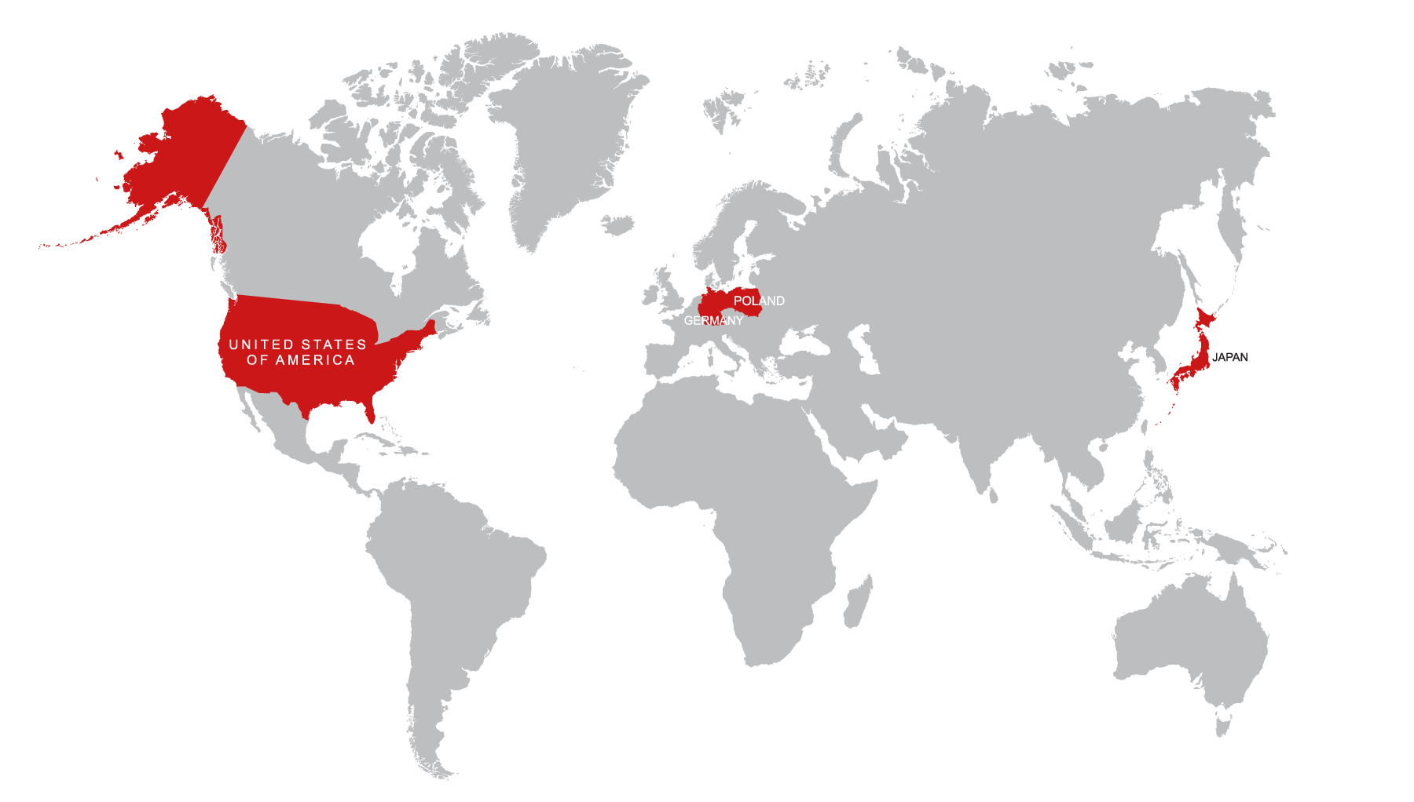
Open-E Data Storage Software Worldwide
Open-E Data Storage Software
40 000+ installations of Open-E JovianDSS in over 100 countries around the world
With more than a 25-year history in the global IT market, we have a solid track record of happy customers and business partners
Open-E works exclusively with our Channel and Technology Partners
Offices in
United States (HQ), Germany, Poland and Japan

Slide 5
Technology Alliances

Slide 6
High Performance Solutions with Open-E and Maguay
About Us
Open-E JovianDSS Data Storage System
Maguay PowerStor All-Flash Single-Node System
Maguay & Open-E System for Romanian Ministry of Health
Features & Benefits of Open-E JovianDSS

Slide 7
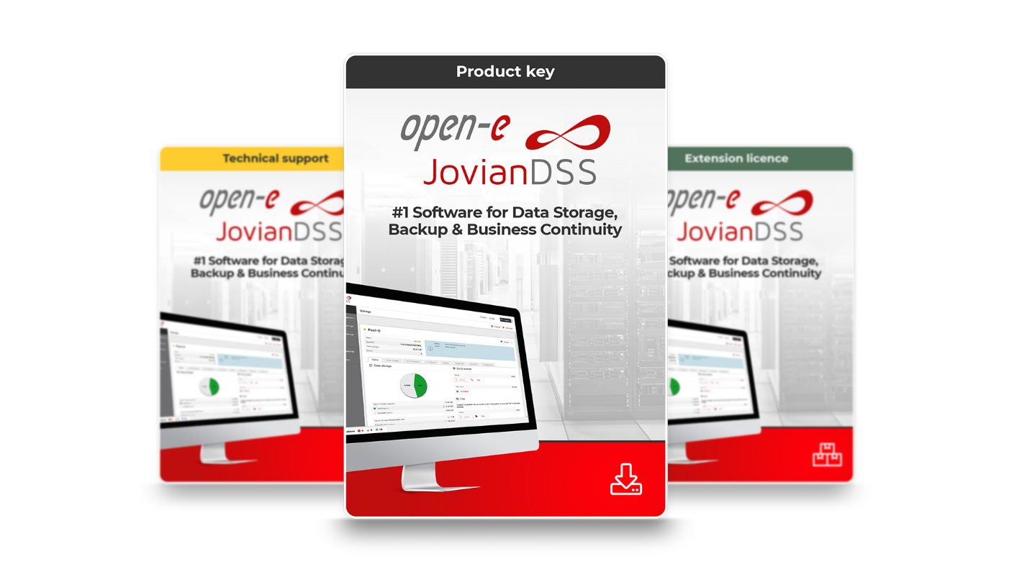
Flagship Product: Open-E JovianDSS
Open-E JovianDSS is a ZFS- and Linux-based Data Storage Software designed for businesses of any size, especially for Enterprise Software Defined Storage environments.
Notes:
Functionality, including features and benefits(live demo webgui)

Slide 8
Open-E JovianDSS Benefits
Why use Open-E JovianDSS?
A very stable and robust storage application Linux-based, High Availability, easy monitoring
Compatibility with all industry standards Supports legacy and the latest hardware
Easy to use and manage Easy licensing, wizards, intuitive WebGUI
The best support in the hardware space and service. Qualified developers, extensive testing, experienced support
Leader in price-performance ratio Advanced features are included with Open-E JovianDSS at a great price point.

Slide 9
High Performance Solutions with Open-E and Maguay
About Us
Open-E JovianDSS Data Storage System
Maguay PowerStor All-Flash Single-Node System
Maguay & Open-E System for Romanian Ministry of Health
Features & Benefits of Open-E JovianDSS

Slide 10
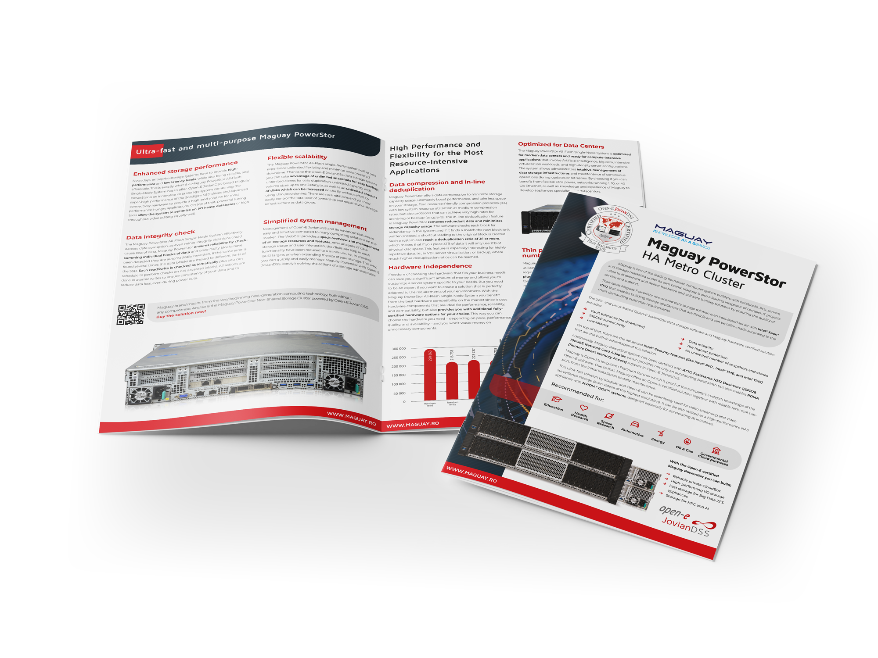
Maguay and Open-E Business Relationship
Partners since 2015
7 years of cooperation
Platinium Partnership Level

Slide 11
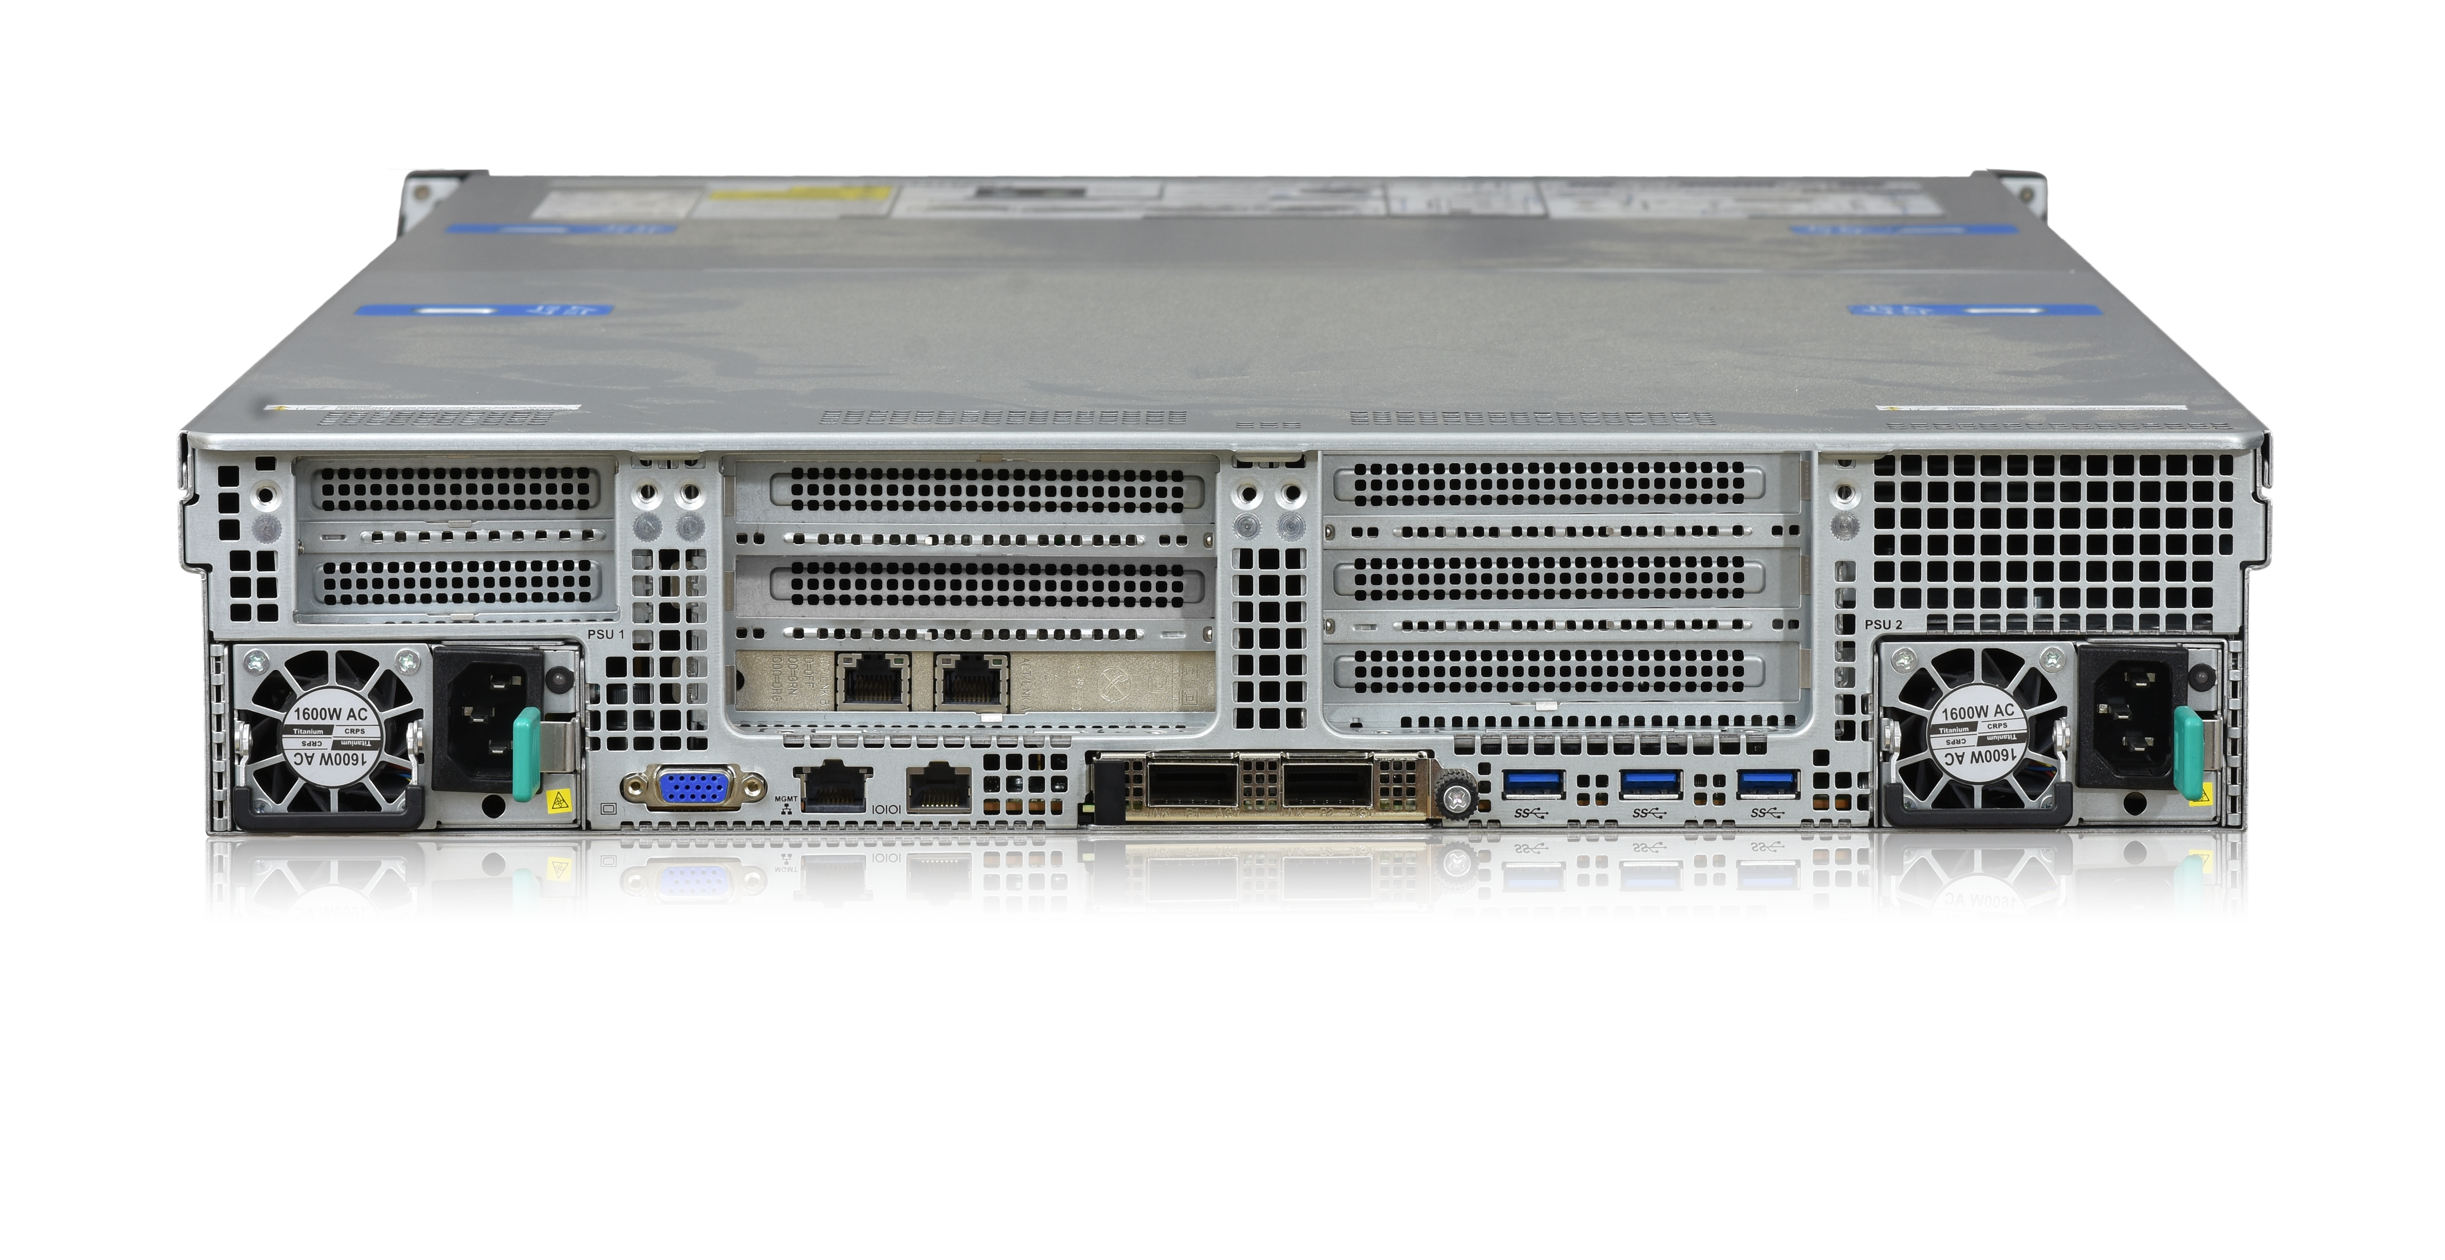
Maguay PowerStor Server Powered by Open-E JovianDSS
Maguay PowerStor All-Flash Single-Node System
All-Flash Single-Node Data Storage System is an Intel-based server with Intel® Xeon® CPU that enables building high-performance data storage infrastructure that is flexible and can be customized according to the most demanding business needs and requirements.
Reliable private CloudBox
High-performing I/O data storage
Fast data storage for Big Data ZFS appliances
Storage for High Preforming Computing and AI
Recommended for:
Gov & Public
Research Institutes
Energy, Gas & Oil
Automotive
Check it now

Slide 12
High Performance Solutions with Open-E and Maguay
About Us
Open-E JovianDSS Data Storage System
Maguay PowerStor All-Flash Single-Node System
Maguay & Open-E System for Romanian Ministry of Health
Features & Benefits of Open-E JovianDSS

Slide 13
Data Storage for Romanian Ministry of Health with Maguay
The Romanian Ministry of Health needs to manage and process large amounts of data, such as medical records, health statistics, research findings, and more. To improve its public administration and data management capabilities, the ministry decided to implement a solution based on the Open-E JovianDSS software that consists of a data storage cluster of fast and reliable flash drives, with a total raw capacity of 1 PB. The cluster was able to handle any workload and data volume with ease, while ensuring data security and integrity. The ministry also received 3 years of Premium Support.

Slide 14
High Performance Solutions with Open-E and Maguay
About Us
Open-E JovianDSS Data Storage System
Maguay PowerStor All-Flash Single-Node System
Maguay & Open-E System for Romanian Ministry of Health
Features & Benefits of Open-E JovianDSS

Slide 15
Why High Availability matters?
Uninterrupted access to data is an absolute must in modern business!
In a world of businesses running 24 hours a day, 365 days a year having a constant, uninterrupted access to data is an absolute must.
Your clients are located all around the world and accessing your data (online store, web application, shared resources) is often the only way they communicate with you.
Access to data and ability to work with it at any time is taken for granted. Any interruptions are considered as grave incompetence and could cause your clients or partners stop doing business with you!

Slide 16
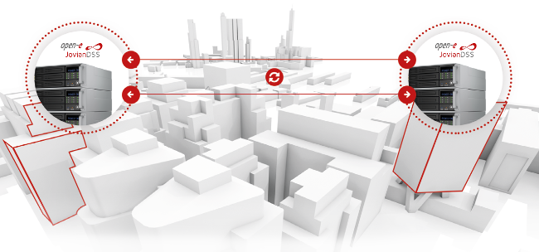
High Availability (HA) Cluster with Open-E JovianDSS
High Availability data storage solution based on Open-E JovianDSS
Open-E JovianDSS offers flexible options for architecting HA environments with all major access protocols.
It allows to build solutions that ensure reliability and redundancy through failover in case of a server crash.

Slide 17
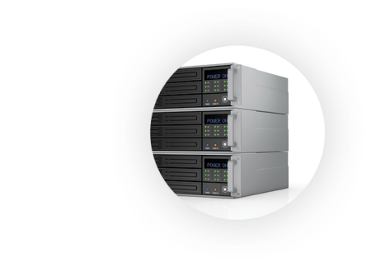
Open-E JovianDSS On- & Off-site Data Protection
ON-SITE
DATA PROTECTION
OFF-SITE
DATA PROTECTION
PRODUCTION SERVER
LOCAL BACKUP SERVER
OFF-SITE BACKUP SERVER
Set up another Open-E JovianDSS backup server in another building, city or even country!
Send your backups to the most remote location using a public network (using asynchronous replication functionality) – for enhanced protection of your data, and ensuring it's secure even when all local servers are completely unavailable, for example as a result of fire or theft.
You can have multiple off-site backup servers in multiple locations at the same time.

Slide 18
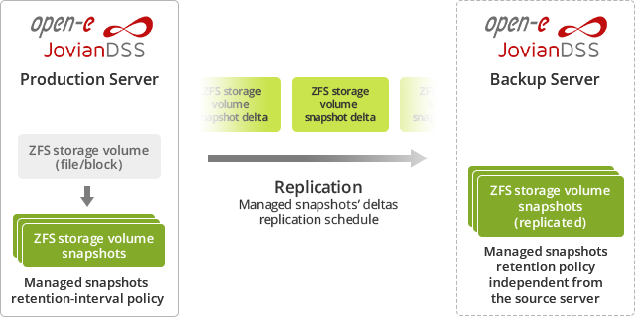
Off-site Data Protection – How it works
Asynchronous Replication of snapshot deltas to the off-site server.
Server at off-site location.
Independent snapshots retention-interval policy, usually covering longer period than on main server.
Main server used for day-to-day work with automated snapshots.

Slide 19
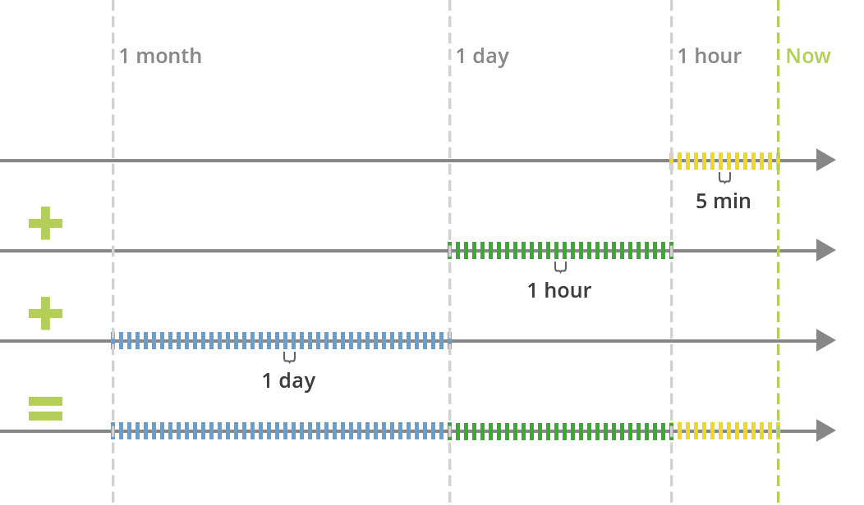
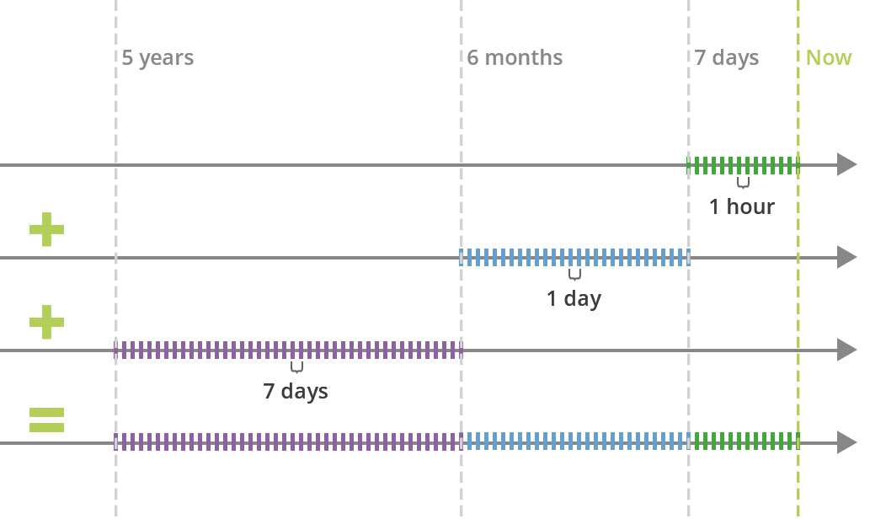
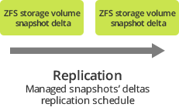
Off-site Data Protection – How it works
On both local and off-site locations there are independent snapshots retention policies for:
Making new snapshots as often as 5 minutes.
Keeping snapshots even for years without running out of space

Slide 20
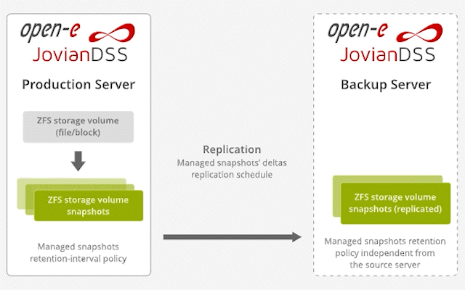
Open-E JovianDSS Features in Detail: Snapshots
Notes:
One of the most useful options of our software is the snapshot backup.
Snapshots allow the ZFS filesystem to create lightweight read-only copies of the current state of the file system. They can be seen as a form of backup as they allow you to revert to a previous state of the system. Let me show you how they work and how they can be adjusted.
I will start by showing how to configure snapshots on the source server.
Enter the Backup and Recovery and enter the backup task wizard. Here we have to choose the source of the data for our snapshots. You can also set how often the snapshot should be created and how long it should be kept on source.
Once the snapshot task has been configured, go to the zpool options and right now you can see the snapshots being created according to the plan you’ve set up. Now we can delete all the data from our zvol to simulate a real-life issue. The data is now gone and I want to use the recently-created snapshot to retrieve my data. In order to do it, I have to click on the snapshot options where I have two possibilities to choose from. I can either carry out a rollback (which means that the remaining snapshots that are more recent than the one I am using will be deleted) or I can clone it first, which is a recommendable procedure, especially if you want to see what is inside of a given snapshot. The clone will be attached to a new a target and a new volume will be created so that we compare the empty volume and the one which we have cloned. Yes, our data is there.
You can set the destination as a remote server - in this case we will use our local backup zvol. Here you can also adjust how long the snapshots should be kept on the destination server to avoid congestion. As snapshots can be kept locally or can be sent over very long distances, even over the ocean, they work as a great backup tool and are a crucial part of our On- & Off-site Data Protection solution. They allow you to retain the access and integrity of your data even in extreme cases, like a lightning strike or server theft.

Slide 21
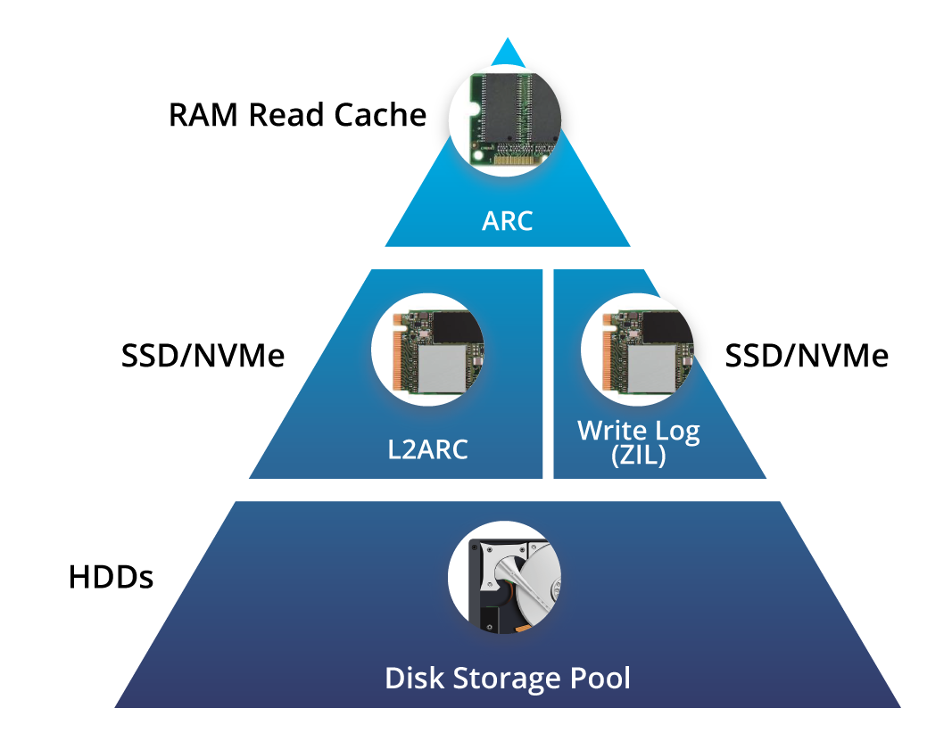
Open-E JovianDSS features in detail
Data Acceleration
Acceleration of random writes with Write Log (ZIL: ZFS Intent Log) on SSD (SATA/SAS/NVMe)
Hybrid Read Cache
First level in RAM (ARC - Adaptive Replacement Cache)
Second Read Cache level (L2ARC) on an SSD (SATA/SAS/NVMe)

Slide 22
Ask Anytime
Patryk Jurkiewicz
Sales Specialist at Open-E Email: patryk.jurkiewicz@open-e.com
Phone: +49 89 800 777 23

Slide 23
THANK YOU!
Open-E Team

