Slide 1
Smart Computing for Smart Businesses: Intel in Client and Data Center
Łukasz Chrzanowski

Slide 2
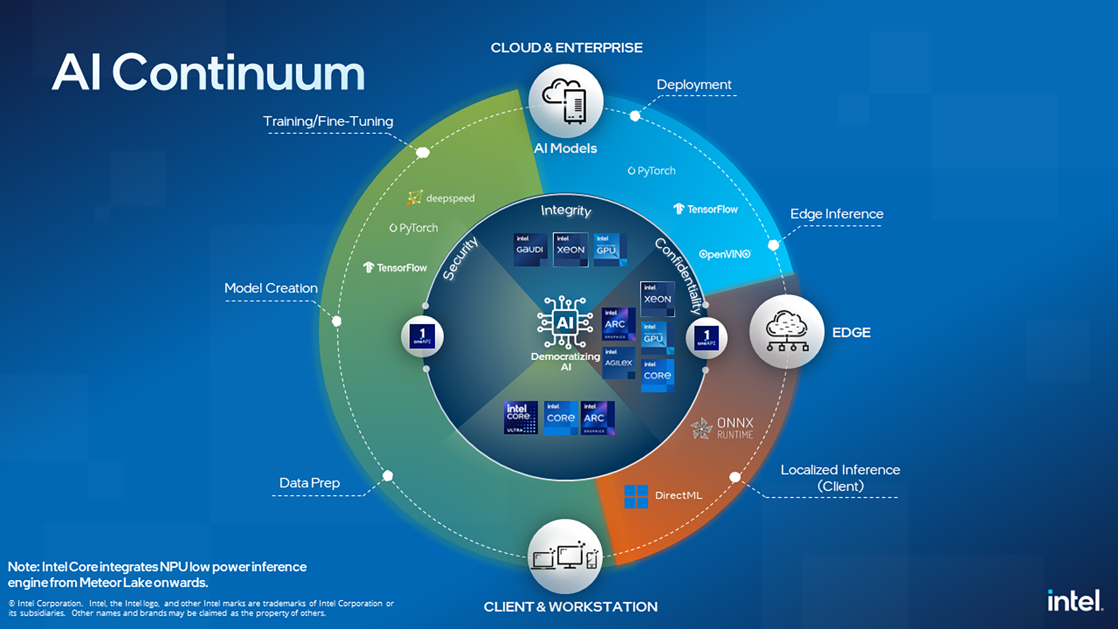

Slide 3
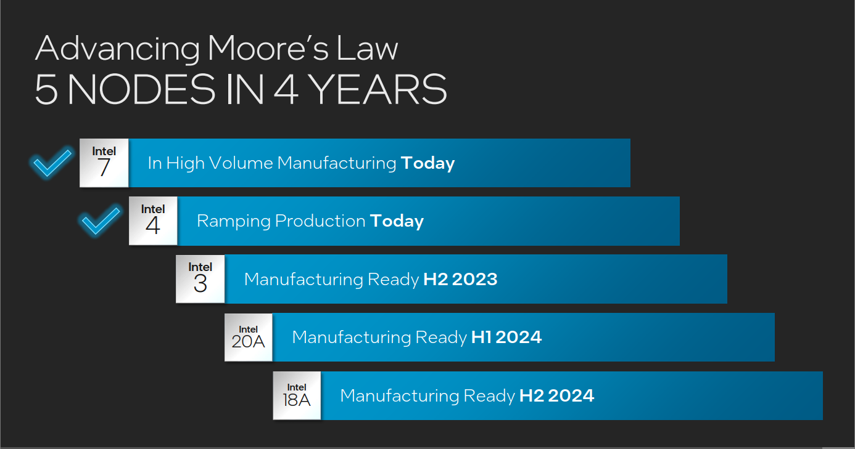

Slide 9
Intel vPro® Platform value proposition
Hybrid architecture offers performance cores and efficient cores
Optimized for business productivity and multitasking
Intel® Iris® Xe graphics
Intel Thunderbolt™ 4
Wi-Fi 6 and 6E
PERFORMANCE
SECURITY
Suite of technologies to help protect the full computing stack
Supports Microsoft Secured-core PC
Ready for the next wave of OS virtualization
Intelligent workload optimization
Reduced attack surface
Enhanced validation and assurance
Intel® Core™ vPro Processors for Business
(i5/i7/i9)
Modern lifecycle management
Intel® Active Management Technology Full suite of life cycle management capabilities
Cloud manageability with Intel® Endpoint Management Assistant
5-quarter stability for Intel platform ingredients
Support for Windows 10 and Windows 11
Reliable firmware updates
Enterprise desktops, notebooks and entry workstations
STABILITY
MANAGEABILITY
Features only on Intel vPro Enterprise
Features may vary by platform, operating system, and OEM system design

Slide 11
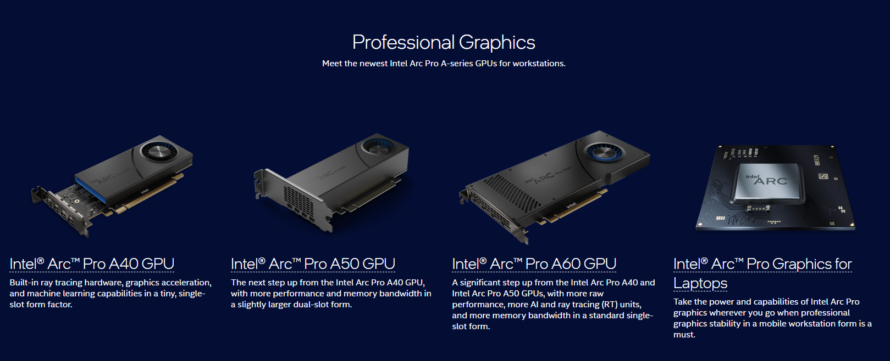
Notes:
AV1
Ray Tracing
SW validation

Slide 12
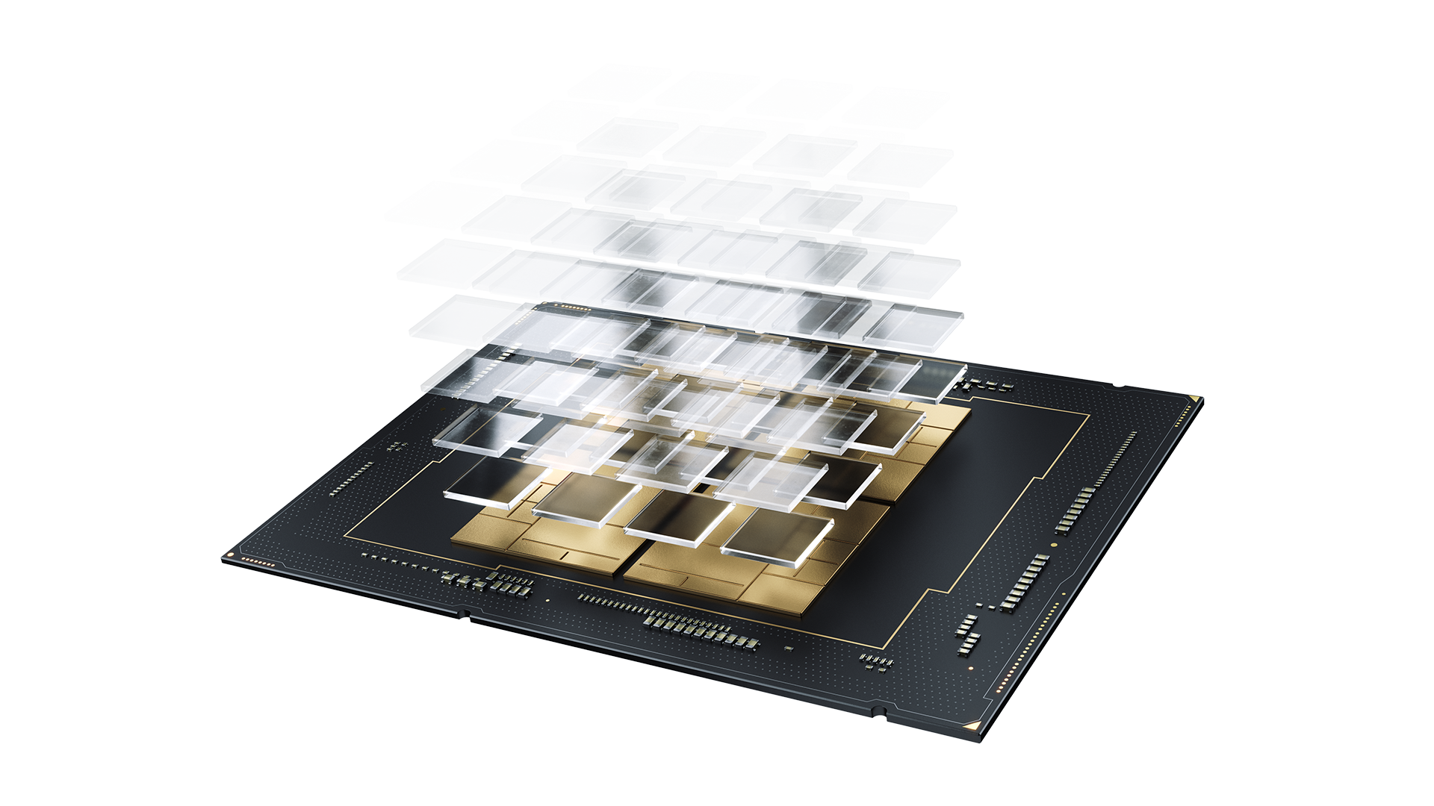
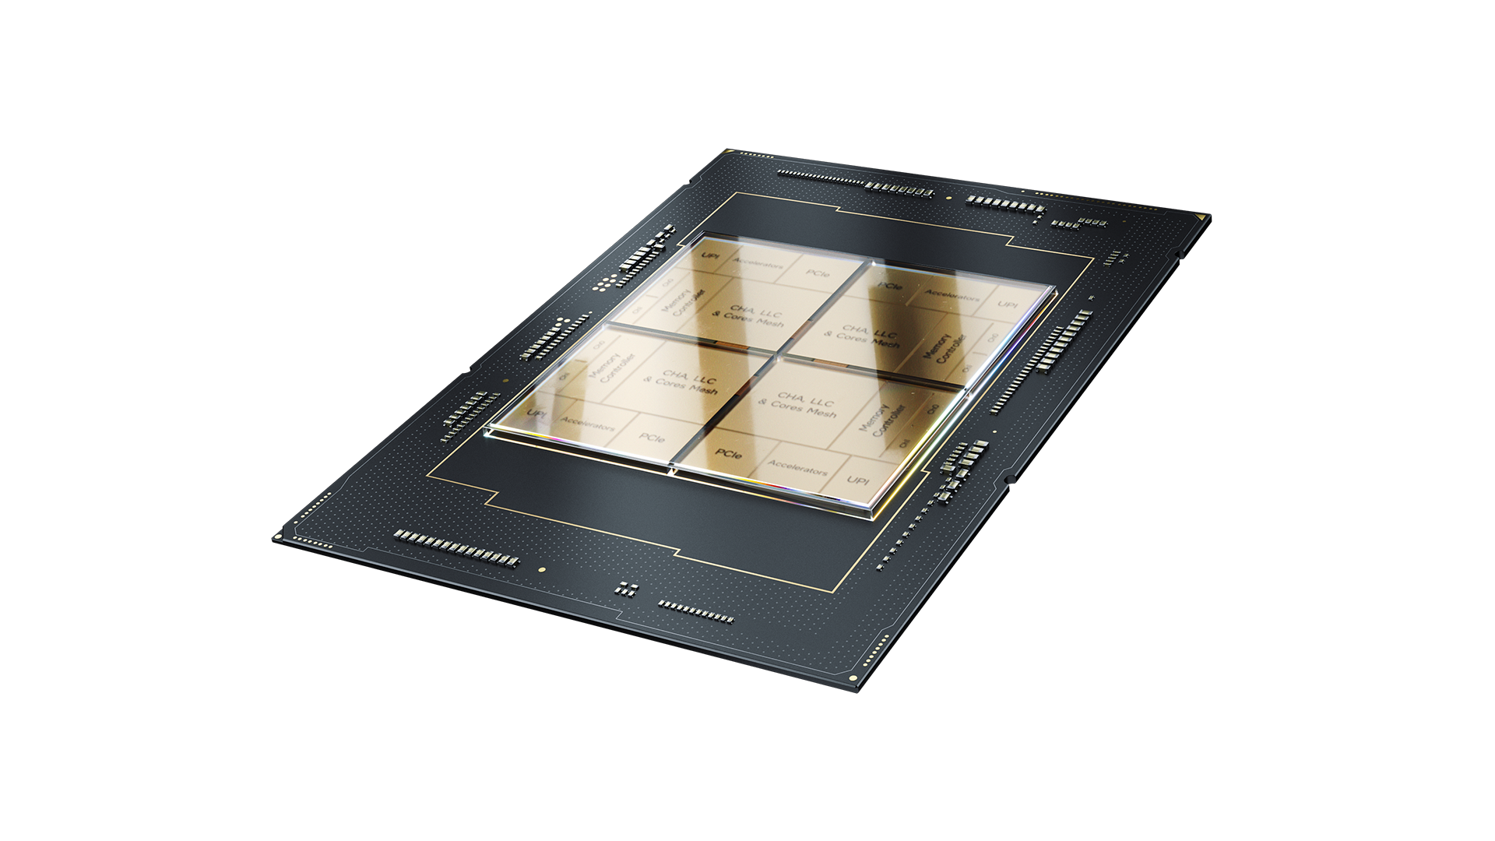
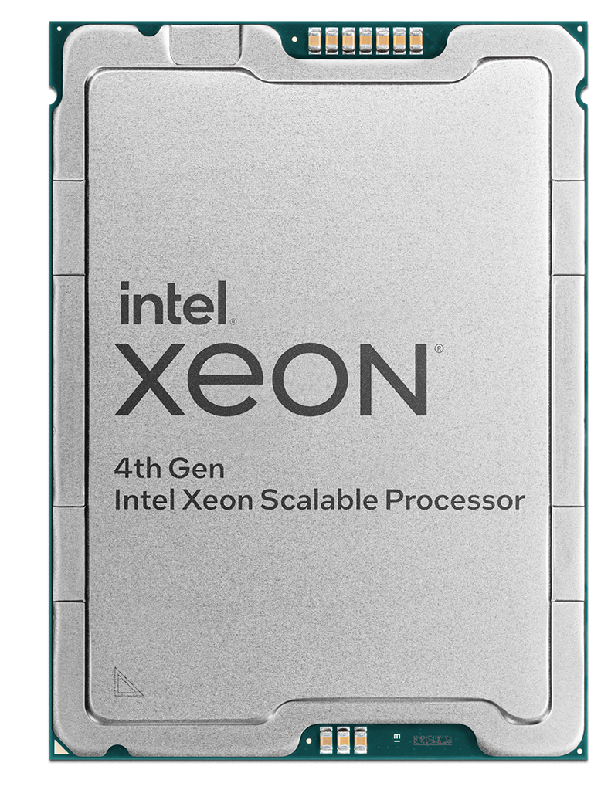
Smart Solutions for Smart Data Center

Slide 13
Intel’s Differentiated Approach
Workload-First
CPU Cores + Built-In Accelerators Wins
Open Software Ecosystem + oneAPI & AI Tools
Higher Performance
Increased Efficiency
Optimal TCO
Notes:
Key Message: The industry is choosing Intel’s differentiated approach – today, for taking on and solving computing challenges at scale. Intel’s strategy of aligning CPU cores with built-in accelerators, alongside optimized software optimized for specific workloads delivers superior performance at higher efficiency for optimal total cost of ownership.
We have a differentiated strategy
That strategy is that cores + accelerators win (vs just adding more cores).
CPU Cores + accelerators optimized for specific workloads deliver: 1) superior performance, 2) at higher efficiency, 3) at better TCO
This strategy takes advantage of our ability to optimize software at scale through an open software approach that delivers choice, flexibility, performance and productivity that drives innovation in the ecosystem. This is a significant strategic moat.
Intel SW enables taking advantage of our HW accelerators.
Intel’s software investments are driven across the software stack – including optimizations in AI frameworks, contributions to open source projects, and Intel’s oneAPI & AI tools (AI Analytics and OpenVINO toolkits) bring multiarchitecture performance and productivity

Slide 14
4th Gen Intel® Xeon® Scalable Processors
1 to 8 socket scalability
Up to 60 cores
per processor
Most built-in accelerators of any CPU
Increased memory bandwidth with DDR5
Increased I/O bandwidth with PCIe 5
80 lanes
Increased inter-socket bandwidth with UPI 2.0
Compute Express Link (CXL) 1.1
Hardware enhanced security
Notes:
Flexibility with 1s to 8s scalability to meet individual customer needs
Increased core counts from previous generation
Introducing the most built in accelerators in the market today to address customers real workloads
Inclusion and introduction of DDR5, PCIe 5, and CXL

Slide 15
Intel® Accelerator Engines
Most Built-in Accelerators of any CPU on the market providing customers with increased performance, costs savings and sustainability advantages for the biggest and fastest-growing workloads
Intel® AI Engines
Intel® Security Engines
Intel® HPC Engines
Intel® Network Engines
Intel® Analytics Engines
Intel® Storage Engines
Intel® Advanced Matrix Extensions (Intel® AMX)
Intel® Advanced Vector Extensions 512 (Intel® AVX-512)
Intel® Deep Learning Boost (Intel® DL Boost)
Intel® Control-Flow Enforcement Technology (Intel® CET)
Intel® Crypto Acceleration
Intel® Software Guard Extensions (Intel® SGX)
Intel® Trust Domain Extensions (Intel® TDX)
Intel® QuickAssist Technology (Intel® QAT)
Intel® Advanced Vector Extensions 512 (Intel® AVX-512)
Intel® Advanced Matrix Extensions (Intel® AMX)
Intel® Data Streaming Accelerator (Intel® DSA)
Intel® QuickAssist Technology (Intel® QAT)
Intel® QuickAssist Technology (Intel® QAT)
Intel® Dynamic Load Balancer (Intel® DLB)
Intel® Data Streaming Accelerator (Intel® DSA)
Intel® Advanced Vector Extensions (Intel® AVX) for vRAN
Intel® Speed Select Technology (Intel® SST)
Intel® In-memory Analytics Accelerator (Intel® IAA)
Intel® Data Streaming Accelerator (Intel® DSA)
Intel® Advanced Vector Extensions 512 (Intel® AVX-512)
Intel® QuickAssist Technology (Intel® QAT)
Intel® Data Streaming Accelerator (Intel® DSA)
Intel® QuickAssist Technology (Intel® QAT)
Intel® In-memory Analytics Accelerator (Intel® IAA)
Intel® Data Direct I/O (Intel® DDIO)
Intel® Advanced Vector Extensions 512 (Intel® AVX-512)
Intel® Crypto Acceleration
Supported in 4th Gen Intel® Xeon® Scalable processors and Intel® Xeon® CPU Max Series processors. Many features are enabled through Intel® oneAPI Tools and Intel-optimized AI frameworks.
Notes:
4th Gen Intel Xeon SP offers the most accelerators of any CPU in the the market today
Learning from our customers, Intel is targeting real world workloads to provide better performance and efficiency
Many features are enabled through Intel® oneAPI Tools & Intel-optimized AI frameworks.

Slide 16
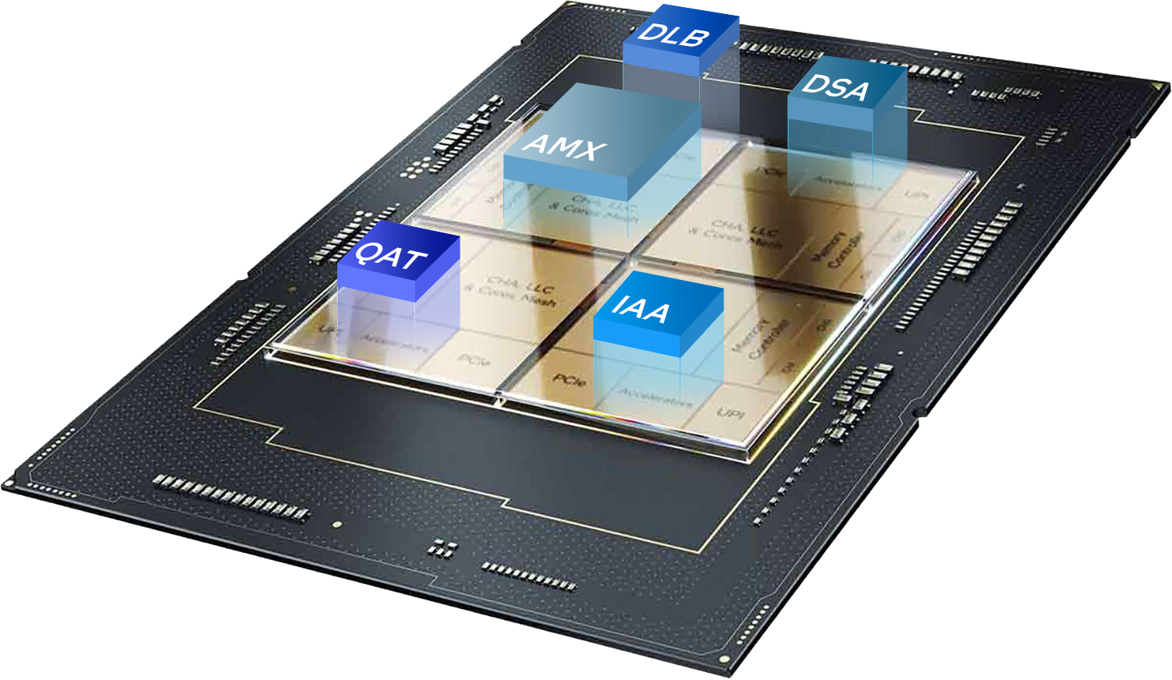
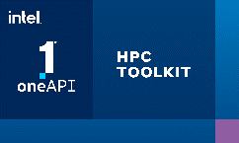
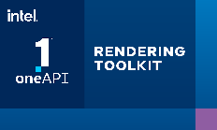
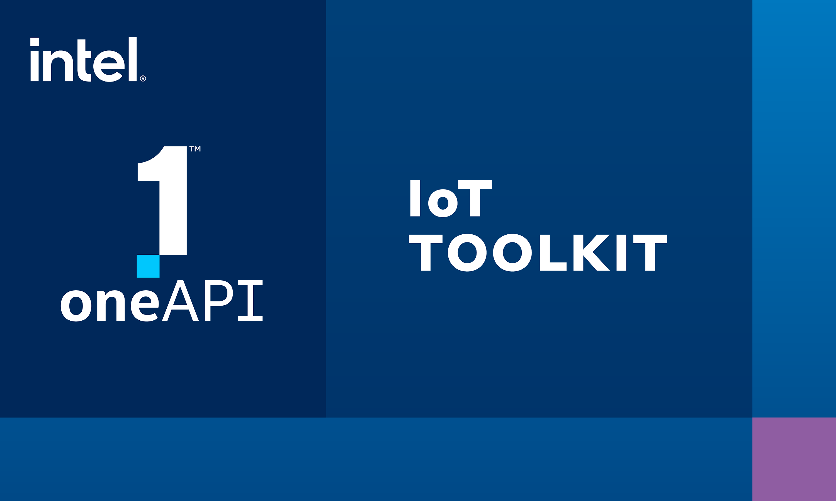
Developer Tools for 4th Gen Intel® Xeon® Scalable Processors
Intel ® oneAPI, AI tools and optimized AI frameworks help developers maximize application performance by activating advanced capabilities of 4th Gen Intel® Xeon® Scalable processors and Intel® Max Series processors. In multiarchitecture systems with Intel Xeon processors and Intel GPUs, using a single codebase through oneAPI delivers productivity and performance.
Compilers, libraries & analysis tools support built-in accelerators to unleash performance, and fast training and inference for AI workloads.
Intel® oneAPI Math Kernel Library for HPC and technical compute
Intel® oneAPI Deep Neural Network Library for deep learning training + inference
Intel® Query Processing & Intel® Data Mover Library* for query processing, compression and data movement
Intel® VTune™ Profiler helps locate time-consuming parts of code and identify significant issues affecting application performance
Learn more: Software for 4th Gen Intel Xeon & Max Series Processors
Intel® DLB
For efficient load balancing across CPU cores
Intel® AMX
Built-in AI acceleration engine
Intel® DSA
Optimizes streaming
data movement &
transformation operations
Intel® QAT
Accelerates cryptography
Intel® IAA
Increases queries per
second & reduces memory footprint for analytics workloads
*Intel® QPL is open source . Open source Intel® DML in beta, v1 coming soon
Powered by oneAPI
Notes:
The 4th Gen Intel Xeon scalable processors – formerly code-named Sapphire Rapids – has the most built-in accelerators of any CPU on the market.
Developers can realize the value of new built-in accelerator features on Intel® 4th Gen Xeon® Scalable Processors with Intel® oneAPI and AI tools. The latest Intel® Accelerator Engines and software optimizations improve performance per watt by 2.9x (See [E1] at intel.com/processorclaims: 4th Gen Intel® Xeon® Scalable processors. Results may vary.) on average across targeted workloads in AI, data analytics, networking, storage and HPC. Intel® oneAPI toolkits offer a complete set of advanced compilers, libraries, analysis and debug tools, and optimized frameworks that simplify the development and deployment of accelerated solutions. Efficiently harness the full potential of Intel® hardware accelerator instruction sets, including Intel® Advanced Matrix Extensions (Intel® AMX), Intel® QuickAssist Technology (Intel® QAT), Intel® Data Streaming Accelerator (Intel® DSA), and Intel® In-Memory Analytics Accelerator (Intel® IAA).
The Advanced Matrix Extensions take a lot of advantage of Math Kernel Library for matrix calculations and the Deep Neural Network library.
And we've also got this this In-Memory Analytics Accelerator which take advantage of Intel Query Processing Library, and the Data Streaming Accelerator, which takes advantage of Intel Data Mover Library. We also take advantage of the Data Streaming Accelerator with MPI for some fast chip to chip communications.
Accelerate machine learning and data science pipelines using the Intel® oneAPI Base and AI Analytics toolkits. Intel oneAPI libraries (oneDNN, oneDAL, oneCCL) activate Intel AMX and support for INT8 and BFloat16 datatypes. Drive optimizations on orders of magnitude into industry-leading deep learning AI frameworks, including TensorFlow and PyTorch, and the OpenVINO™ toolkit powered by oneAPI for inference acceleration.
Deliver fast HPC applications that scale with techniques in vectorization, multithreading, multi-node parallelization, and memory optimization using Intel® oneAPI Base and HPC toolkits. Drive productivity with advanced analysis tools, the Intel® Fortran Compiler, Intel® Math Kernel Library (oneMKL), and Intel® VTune™ Profiler.
Accelerate high-fidelity visualization applications for scientific and medical research, motion picture production, and more using advanced libraries in the Intel® oneAPI Rendering Toolkit. Access all system memory space for even the largest data sets. Enable deep learning-based denoising. And efficiently deploy across parallel processing architectures and platforms.
Notes for QPL/DML:
DML and QPL not part of oneAPI, Intel® Query Processing Library (Intel® QPL)- https://intel.github.io/qpl/documentation/introduction_docs/introduction.html
and Intel® Data Mover Library (Intel® DML) - https://intel.github.io/DML/documentation/introduction_docs/introduction.html

Slide 18
CPU + Accelerators: Differentiated Performance On Real Workloads
4th Gen Intel® Xeon® Scalable processors
Intel® Xeon® CPU Max Series
General
Purpose
Compute
Artificial Intelligence
Network 5G vRAN
Networking & Storage
Data Analytics
HPC
53%
Up to 10x
Up to 2x
Up to 2x
Up to 3x
Up to 3.7x
average performance gain*
higher inference and training performance*
capacity for vRAN workloads at same power envelope*
higher data compression with 95% fewer cores*
higher performance*
on memory-bound workloads**
See [G1, A17, N10, N16, D1] at intel.com/processorclaims: 4th Gen Intel Xeon Scalable processors. Results may vary
*4th Gen Intel Scalable Processor vs. 3rd Gen Intel Xeon Scalable processors
** Intel Xeon CPU Max Series vs. Intel Xeon 8380
Notes:
Intel’s focus is on real world workloads and bringing differentiated performance
We partnered with many customers across the ecosystem to learn about their needs
Intel offers broad platform of advanced technologies that incorporates both hardware and software offerings that help customer reach these performance numbers

Slide 19
A More Energy Efficient Server Architecture Intel® Accelerator Engines Raise Performance Per Watt Ceilings
28.85
14.21
13.53
8
9.76
Relative Perf/W
Higher is Better
Baseline is
4th Gen Intel Xeon processor with
No Acceleration
IAA
AVX-512
DSA
AMX
QAT
See backup for workloads and configurations. Results may vary​.

Slide 20
A More Cost-Efficient Server Architecture Benefits of Workload Optimized Products
When considering new purchases for the data center, deploy fewer 4th Gen Intel® Xeon® processor-based servers or Intel® Xeon® CPU Max processor-based servers to meet the same performance requirement
Comparisons to deploying 50 servers with 3rd Gen Intel Xeon processor | Artificial Intelligence (Real time Inferencing, RSN50 w/ Intel® AMX) | Database (Rocks DB w/Intel® IAA) | Large Media File Requests (SPDK w/Intel® DSA) | HPC (OpenFOAM)
Number of Intel Xeon processor-based servers | 17 servers with 4th Gen Intel® Xeon processors | 18 servers with 4th Gen Intel® Xeon processors | 15 servers With 4th gen Intel® Xeon processors | 16 servers with Intel® Xeon® CPU Max Series
Lower Fleet Power (kilowatts) | 22.1 kW | 15.4 kW | 8.6 kW | 25.7 kW
Reduced CO2 emissions (kg)* | 524,000 kg | 366,000 kg | 206,577 kg | 611,000 kg
TCO savings ($)* | $1.3M | $1.2M | 1.4M | $1.5M
 | 55% Lower TCO | 52% Lower TCO | 60% Lower TCO | 66% Lower TCO
* Estimated over 4 years
See backup for workloads and configurations. Results may vary.
This offering is not approved or endorsed by OpenCFD Limited, producer and distributor of the OpenFOAM software via www.openfoam.com, and owner of the OPENFOAM® and OpenCFD® trademark
Notes:
The combination of the improved performance and power efficiency combine to offer compelling opportunity to improve TCO by purchasing 4th Gen Xeon
Comparison here is situation where user is buying for specific overall performance capability on a workload needing to deploy a new fleet of servers
Instead of deploying 50 3rd Gen Intel Xeon servers to meet a target performance, you can deploy fewer 4th Gen Intel Xeon based servers with built in accelerators and save money, save power and reduce carbon footprint.
Shown 3 buying situations . One for AI, one for Database and one for HPC su.
TCO savings is result of Capex, Opex and Power savings.

Slide 21
Intel Offers a Range of Protection Options
Any malicious insiders and software across the stack could have access to data in use
Without Confidential Computing
Cloud
Admin
BIOS
Platform
Firmware
Host OS/ Hypervisor
Guest VM
Admin
Guest OS
App
Confidential
Data
Intel TME limits what you have to trust
Protected with Intel® Total Memory Encryption
Cloud
Admin
BIOS
Platform Firmware
Host OS/ Hypervisor
Guest VM
Admin
Guest OS
App
Confidential
Data
Intel TDX further limits what you have to trust
Protected with Intel® TDX
Cloud
Admin
BIOS
Platform Firmware
Host OS/
Hypervisor
Guest VM
Admin
Guest OS
App
Confidential
Data
Intel SGX has the least software with potential access to confidential data and vulnerability window limits trust
Protected with Intel® SGX
Cloud
Admin
BIOS
Platform Firmware
Host OS/
Hypervisor
Guest VM
Admin
Guest OS
App
Enclave
Confidential
Data
Notes:
Key Point: Intel will offer customers the widest range of data protection options to fit the wide range of customer needs.
With the addition of TDX to our data protection technology line-up, Intel will offer customers an unmatched range of options on which to deploy confidential computing solutions. Each solution offers unique security properties and balances data protection with ease-of-deployment.
Intel TME encrypts all the memory on the system with a master key. It is very simple to deploy with just a BIOS switch and provides effective protection against physical attacks on memory, such as cold-boot attack and purpose-built memory probes. TME requires the user to trust all the software in the stack.
Intel TDX encrypts each VM with a tenant-specific key and can be configured with just a few clicks during VM stet-up. With TDX, only the Guest OS and the applications inside the VM are inside the trust boundary. For cloud providers seeking software config uniformity across their fleet, TDX will be the most straight-forward Confidential Computing technology to deploy.
For cloud providers looking for high-security differentiation today and tomorrow, Intel SGX offers the tightest trust boundary and greatest data isolation of any solution in the market, with only the SGX enclave inside the trust boundary. No other software can gain access to the data. Deploying SGX does take more planning and enabling than TME or TDX, but is not the excruciatingly difficult task the competition claims. Several SGX-compatible library OS’s are available today that enable deployment of unmodified apps in SGX enclaves, including Gramine (open source), “Scone” from Scontain, and “Runtime Encryption” from Fortanix.
With these three options, you now have the ability to open up detailed conversations with customers about which best fits their needs.
With Intel, you will have the most comprehensive line-up of confidential computing solutions to sell -- More than AMD and more than AWS’ Graviton & Nitro products.

Slide 24
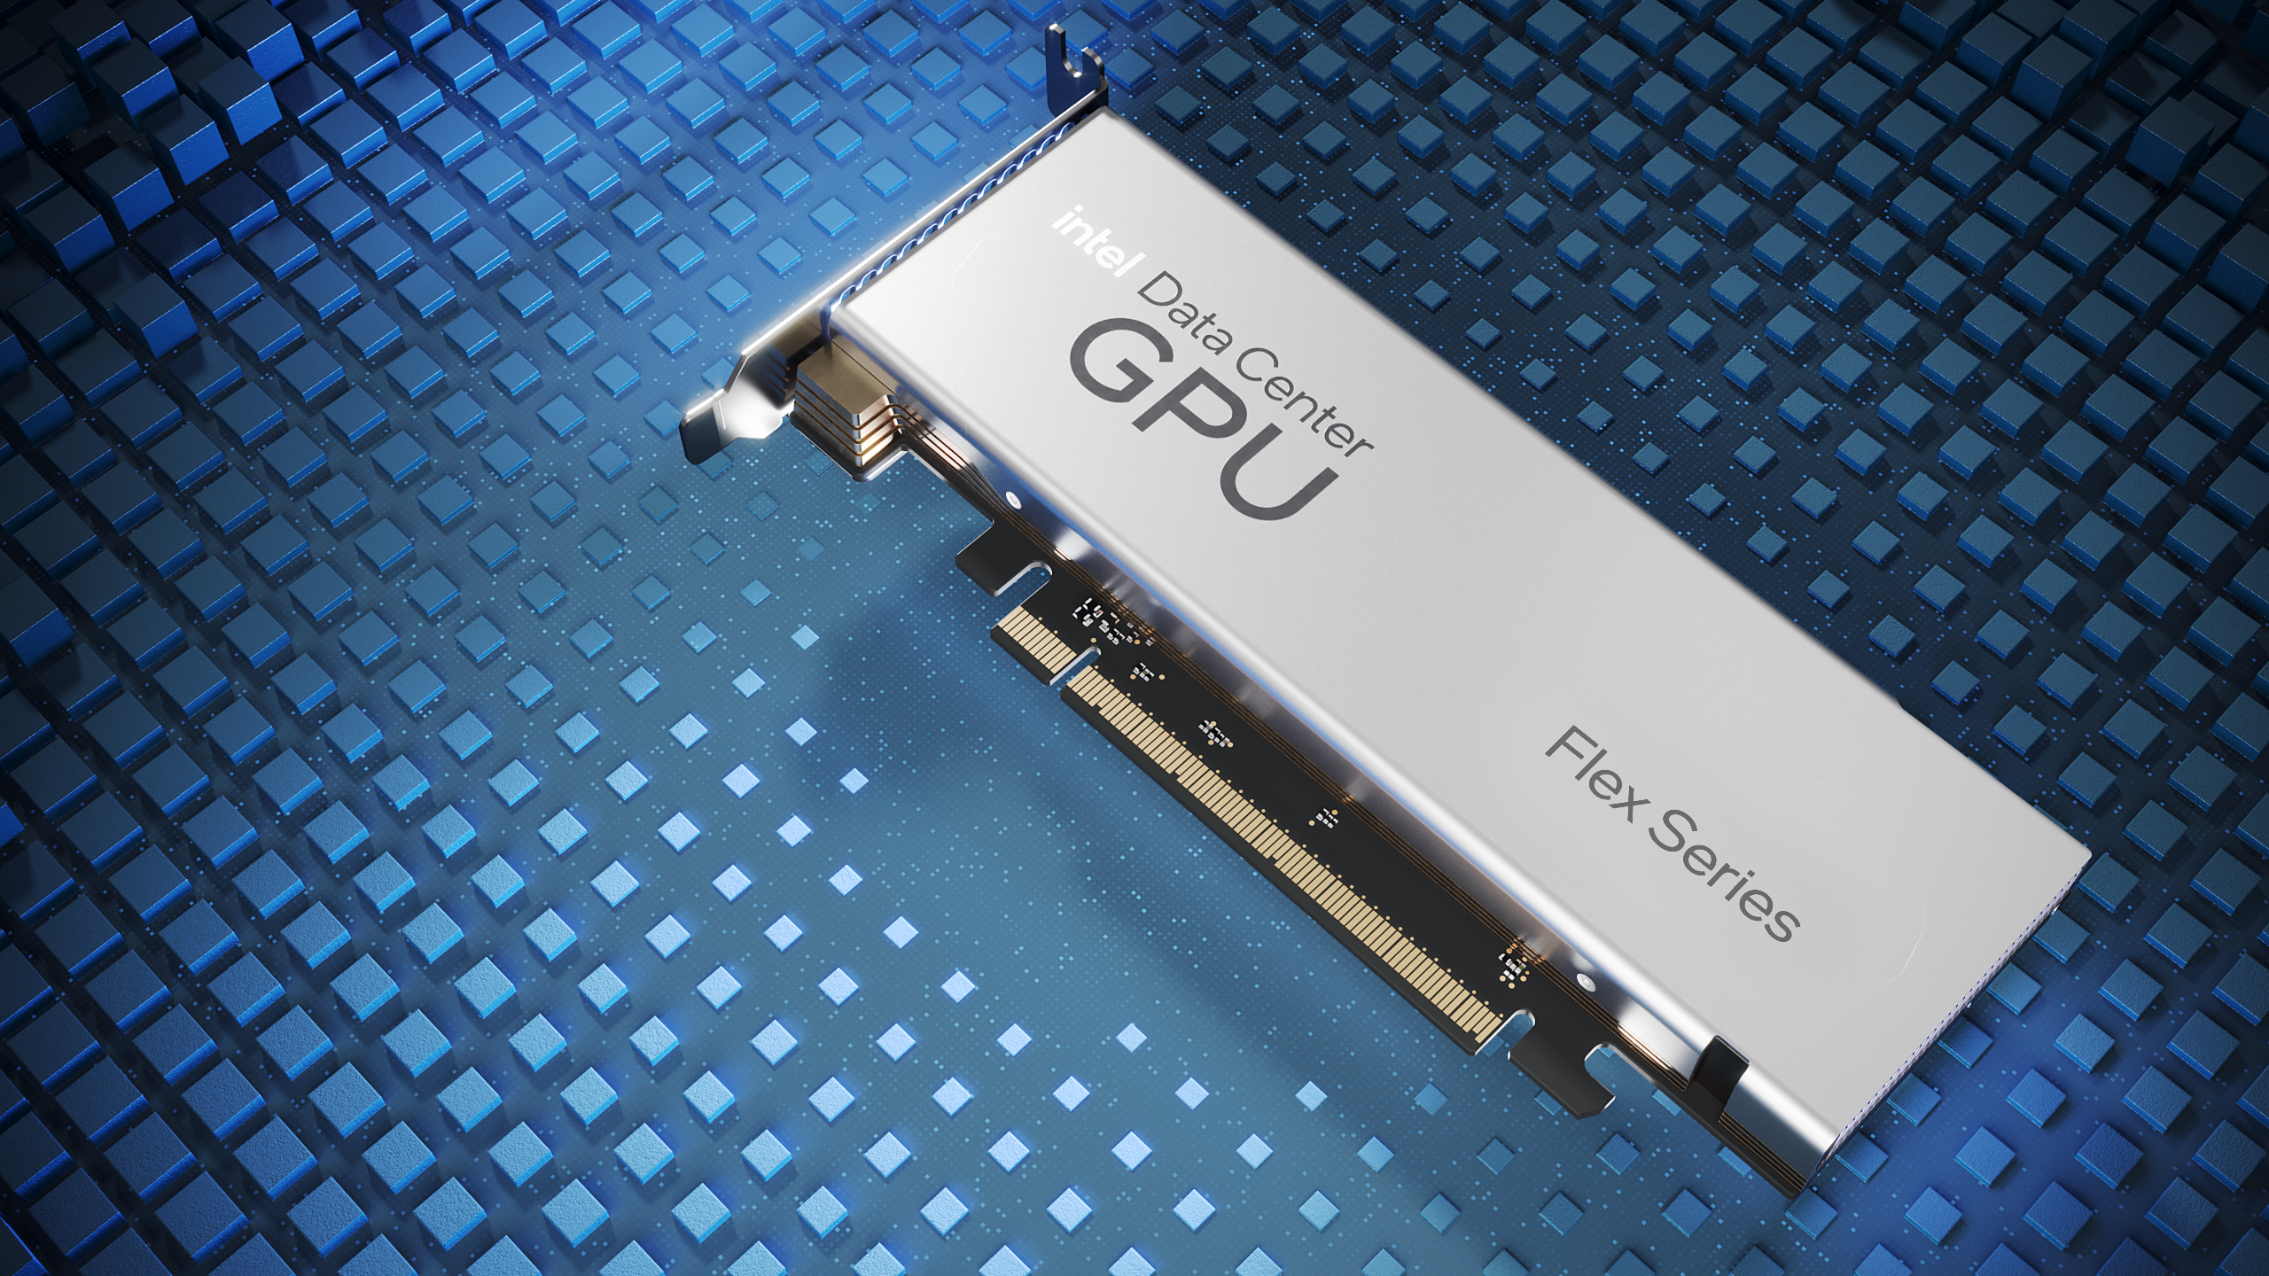
Media Delivery
30+
1080p 60fps Streams
Cloud Gaming
40+
720p 30fps Game Streams
FLEX SERIES
140
4 Media Engines
75W Power Envelope
16 Ray Tracing Units
Optimized for lower TCO
Architecture
Half Height PCIe
16 Xe cores
5X
Media transcode throughput at half the power ! Intel Flex 140 GPU compared to NVIDIA A10
See performance claims https://edc.intel.com/content/www/us/en/products/performance/benchmarks/intel-data-center-gpu-flex-series/

Slide 25
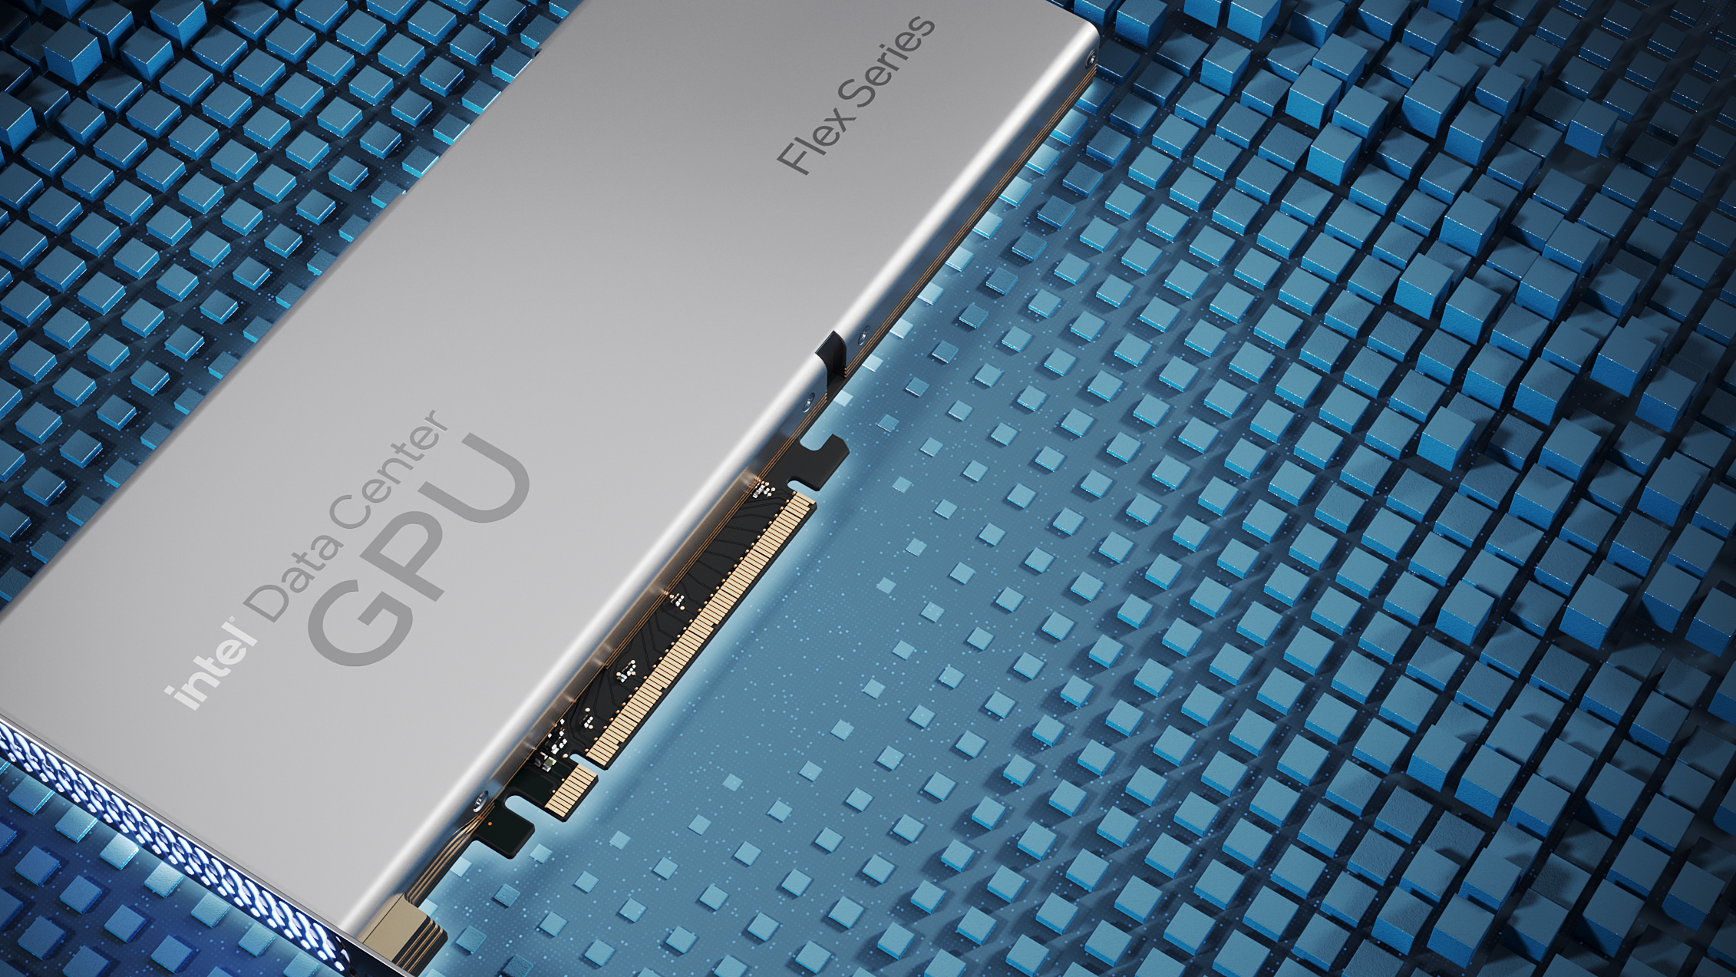
Media Delivery
18
1080p 60fps Streams
Cloud Gaming
60
720p 30fps Game Streams
FLEX SERIES
170
2 Media Engines
150W Power Envelope
32 Ray Tracing Units
Architecture
Full Height PCIe
32 Xe cores
See performance claims https://edc.intel.com/content/www/us/en/products/performance/benchmarks/intel-data-center-gpu-flex-series/

Slide 27
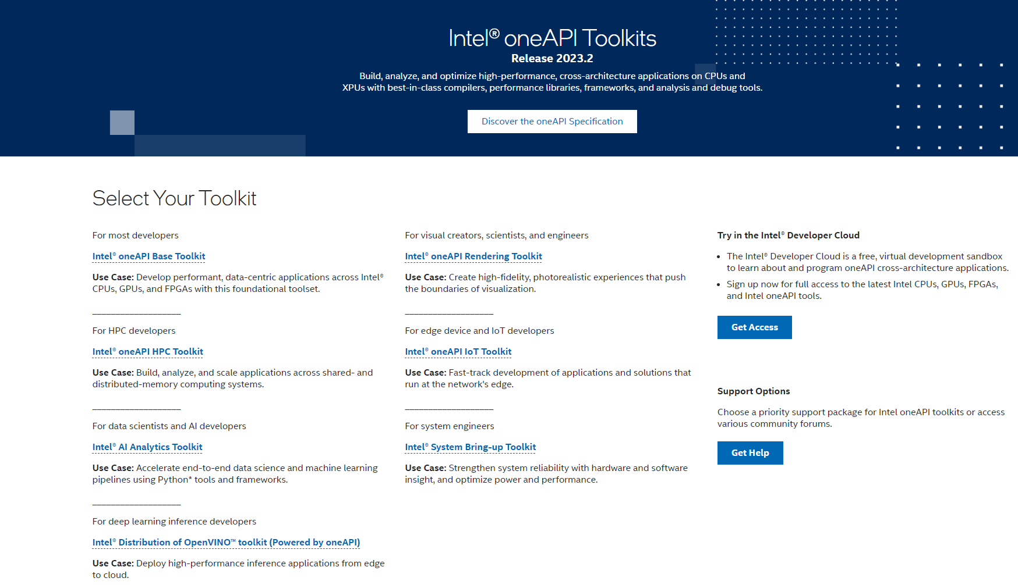
Notes:
Wow, that was really impressive! If you’re wondering what about the software related to GPU Flex and Max series, Intel oneAPI is here for ease of adoption for software developers and includes a complete set of advanced compliers, libraries, and a code migration with SYCL along with analysis and debugger tools. Developers can be confident that existing applications will work seamlessly with oneAPI due to its interoperability with existing programming models and code bases like C++, Fortran, Python, OpenMP, etc.. The transition to CPUs, GPUs, FPGAs, and AI accelerators using a single code base in Data Parallel C++ helps to optimize a developer’s time. A good place to begin for application developers is the workflow guide focused on the GPU and the Intel® oneAPI Base Toolkit.
The Intel oneAPI Base Toolkit provides a set of high-performance tools for building C++ and Data Parallel C++ applications. While domain specific toolkits are available for specific workloads. Intel oneAPI Tools for HPC provides support for scalability of Fortran, OpenMP and MPI applications. Intel oneAPI Tools for IoT is designed to help developers that are designing solutions at the edge of the network. Intel oneAPI AI Analytics Toolkit provides support for optimization of Deep Learning frameworks and Python libraries to assist with machine learning and data science pipelines. Intel oneAPI Rendering Toolkit focuses on visualization applications. Intel Distribution of OpenVINO Toolkit assists developers working with inference and applications from the edge to the cloud. Lastly for guidance on code optimization see the oneAPI GPU Optimization Guide.
If you are focused on AI and work with PyTorch or the Tensor Flow Frameworks, the latest versions are compatible with the Intel® Data Center GPU Max Series.

Slide 28
Introduction Intel® Gaudi®2 AI Accelerator

Slide 29
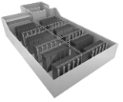
Intel® Gaudi® AI Accelerator Roadmap
Available Now
Available Now
In Development
Started development
Gaudi
Gaudi2 (7nm)
Gaudi3 (5nm)
Falcon-Shores-One
Native RoCE Scaleup & out
Native RoCE Scaleup & out
Native RoCE Scaleup & out
Native RoCE Scaleup & out
Available via:
HLS-1 Server (x8)
SMC Server (x8)
SDSC
Public Cloud: EC2
Available via:
HLS-Gaudi2 Server (x8)
OxM x8 servers: SMC, Inspur systems, Wiwynn, Others
Intel Dev Cloud
2024
2025

Slide 30
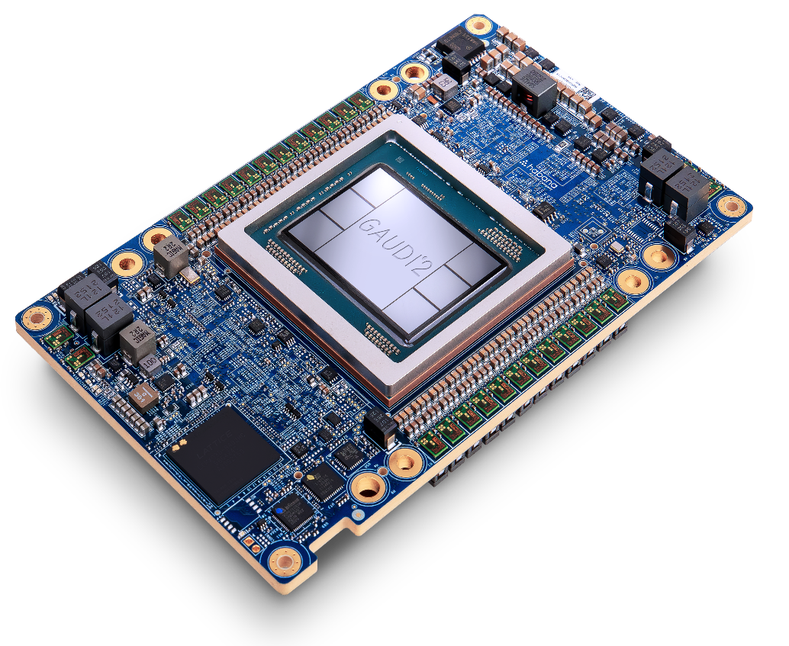
Architected for deep learning performance and efficiency
Matrix Multiplication Engine &
24
96 GB
Tensor Processor Cores
On-Board HBM2e
7nm
24
48 MB
Process Technology
Integrated 100G Ethernet ports
SRAM
Purpose Built for
Deep Learning Acceleration
at Scale

Slide 31
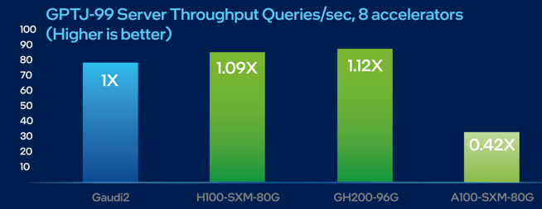
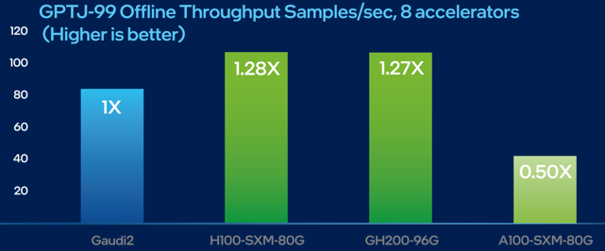
Outstanding Intel®Gaudi®2 AI Accelerator performance on MLPerf Inference Benchmark
Intel Gaudi2 Accelerator with FP8:
near-parity performance
on GPT-J with H100
Gaudi 2 inference performance on GPT-J: -9% (server) and -28% (offline) vs H100
Gaudi 2 outperformed A100 by 2.4x (Server) and 2x (Offline)
Gaudi 2 employed FP8 and reached 99.9% accuracy
Visit www.intel.com/performanceindex for workloads and configurations. Results may vary https://habana.ai/habana-claims-validation
.

Slide 33
800 series adapters sku stack

Slide 34
Full range of Optics connectors

Slide 35
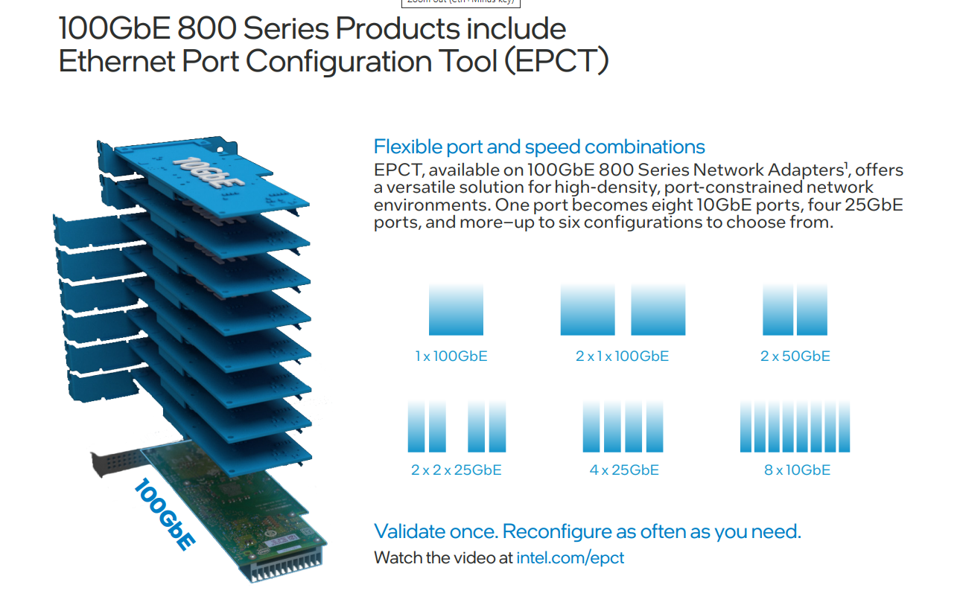
Flexibility of Ethernet solution

Slide 36
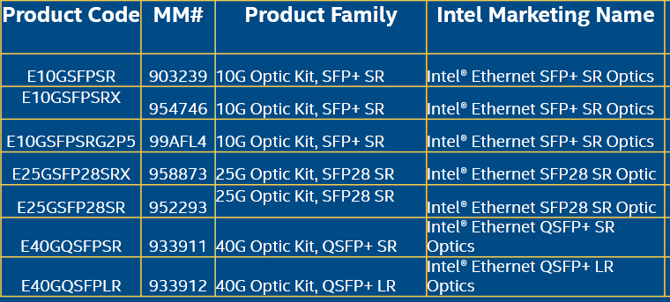
Promotions

Slide 37
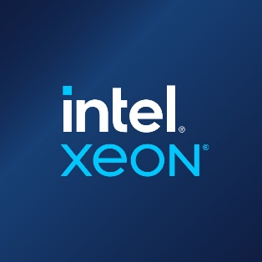
Thank you!

Slide 39
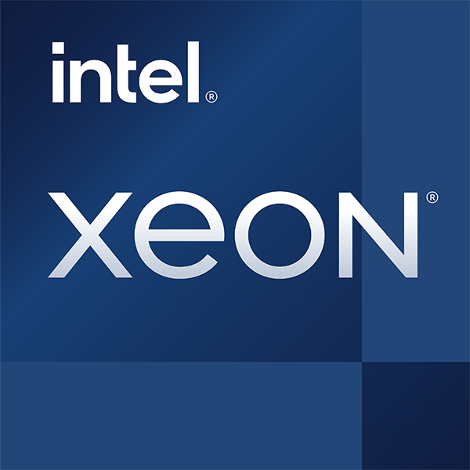
INTRODUCING
Intel’s Most Feature Rich Server Platform
4th Gen Intel® Xeon® Scalable Processors and Intel® Xeon® CPU Max Series Processors
New Integrated IP Accelerators
Intel® In-Memory Analytics Accelerator (Intel® IAA)
Intel® Data Streaming Accelerator
(Intel® DSA)
Intel® Dynamic Load Balancer (Intel® DLB)
Intel® QuickAssist Technology (Intel® QAT)
New Integrated ISA Accelerators
Intel® Advanced Matrix Extensions (AMX)
Increased I/O Bandwidth
with PCIe 5.0
Accelerating Interfacing Architecture (AiA)
HW-Enhanced
Security
Intel® Advanced Vector Extensions for vRAN
PCIe 5.0/4.0 80 Lanes
Enhanced Intel® Software Guard Extensions
Compute Express
Link (CXL) 1.1
Increased Memory Bandwidth
with DDR5
1 to 8 Socket Support
8 Channel DDR5 Up To 4800 MT/s (1DPC)
Up To 4400 MT/s (2DPC)
16 DIMMS per Socket
New RAS features (Enhanced ECC, Error Check & Scrub)
8 DMI 4.0 LINKS
Intel® In-field Scan **
Intel® Seamless Firmware Update
Intel® C741 Chipset
4th Gen Intel Xeon Scalable Processor
Intel Xeon CPU Max Series
Increased Inter-Socket Bandwidth
with UPI 2.0
Intel® Virtual RAID on CPU (Intel® VROC)
Intel® Ultra Path Interconnect (Up to 4 Links @ 16 GT/s)
High Bandwidth Memory Support
Optimized Power Mode
Intel® Optane™ SSDs
Intel® Agilex™ FPGAs
Intel® Data Center GPU Max Series
Intel® Data Center GPU Flex Series
Intel® Infrastructure Processing Unit
(Intel® IPU)
* Enabled for WorkStation + vPro SKUs ONLY
** Intel In-Filed Scan is a new capability available through select providers in 2023
Notes:
This is the biggest platform transition in years for Intel given new connectivity, I/O and memory technologies: DDR5, PCIe Gen 5, and CXL 1.1​
One of the most feature rich products to represent the breadth of workloads from general purpose to the fastest growing emergent workloads

Slide 41
Resources & Configurations

Slide 42
Resources and Configurations
Architecting to Accelerate Customer Workloads
Leading Performance with the most built – in accelerators
Up to 3.7x on memory-bound workloads - Intel® Xeon® 8380: Test by Intel as of 10/7/2022. 1-node, 2x Intel® Xeon® 8380 CPU, HT On, Turbo On, Total Memory 256 GB (16x16GB 3200MT/s DDR4), BIOS Version SE5C620.86B.01.01.0006.2207150335, ucode revision=0xd000375, Rocky Linux 8.6, Linux version 4.18.0-372.26.1.el8_6.crt1.x86_64, Stream v5.10; Intel® Xeon® CPU Max Series: Test by Intel as of 9/2/2022. 1-node, 2x Intel® Xeon® CPU Max Series, HT On, Turbo On, SNC4, Total Memory 128 GB (8x16GB HBM2 3200MT/s), BIOS Version SE5C7411.86B.8424.D03.2208100444, ucode revision=0x2c000020, CentOS Stream 8, Linux version 5.19.0-rc6.0712.intel_next.1.x86_64+server, Stream v5.10

Slide 43
Resources and Configurations
Bringing the Architecture to Life (1 of 3)
Get up to 53% faster results for life and material sciences for more effective research and Meet tight timelines with up to 45% faster results for options pricing
DeePMD (Multi-Instance Training)
8480+: Test by Intel as of 10/12/2022. 1-node, 2x Intel Xeon Platinum 8480+, Total Memory 512 GB, kernel 4.18.0-365.eI8_3x86_64, compiler gcc (GCC) 8.5.0 20210514 (Red Hat 8.5.0-10), https://github.com/deepmodeling/deepmd-kit, Tensorflow 2.9, Horovod 0.24.0, oneCCL-2021.5.2, Python 3.9
8380: Test by Intel as of 10/20/2022. 1-node, 2x Intel Xeon Platinum 8380 processor, Total Memory 256 GB, kernel 4.18.0-372.26.1.eI8_6.crt1.x86_64, compiler gcc (GCC) 8.5.0 20210514 (Red Hat 8.5.0-10), https://github.com/deepmodeling/deepmd-kit, Tensorflow 2.9, Horovod 0.24.0, oneCCL-2021.5.2, Python 3.9
LAMMPS
8480+: Test by Intel as of 9/29/2022. 1-node, 2x Intel Xeon Platinum 8480+, HT On, Turbo On, SNC4, Total Memory 512 GB (16x32GB 4800MT/s, DDR5), BIOS Version SE5C7411.86B.8713.D03.2209091345, ucode revision=0x2b000070, Rocky Linux 8.6, Linux version 4.18.0-372.26.1.el8_6.crt1.x86_64, LAMMPS v2021-09-29 cmkl:2022.1.0, icc:2021.6.0, impi:2021.6.0, tbb:2021.6.0; threads/core:; Turbo:off; BuildKnobs:-O3 -ip -xCORE-AVX512 -g -debug inline-debug-info -qopt-zmm-usage=high;
8380: Test by Intel as of 10/11/2022. 1-node, 2x Intel Xeon Platinum 8380 CPU, HT On, Turbo On, NUMA configuration SNC2, Total Memory 256 GB (16x16GB 3200MT/s, Dual-Rank), BIOS Version SE5C620.86B.01.01.0006.2207150335, ucode revision=0xd000375, Rocky Linux 8.6, Linux version 4.18.0-372.26.1.el8_6.crt1.x86_64, LAMMPS v2021-09-29 cmkl:2022.1.0, icc:2021.6.0, impi:2021.6.0, tbb:2021.6.0; threads/core:; Turbo:on; BuildKnobs:-O3 -ip -xCORE-AVX512 -g -debug inline-debug-info -qopt-zmm-usage=high;
LAMMPS (Atomic Fluid, Copper, DPD, Liquid_crystal, Polyethylene, Protein, Stillinger-Weber, Tersoff, Water)
Quantum Espresso (AUSURF112, Water_EXX)
8480+: Test by Intel as of 9/2/2022. 1-node, 2x Intel Xeon Platinum 8480+, HT On, Turbo On, Total Memory 512 GB (16x32GB 4800MT/s, Dual-Rank), ucode revision= 0x90000c0, Rocky Linux 8.6, Linux version 4.18.0-372.26.1.el8_6.crt1.x86_64, Quantum Espresso 7.0, AUSURF112, Water_EXX
8380: Test by Intel as of 9/30/2022. 1-node, 2x Intel Xeon Platinum 8380 CPU, HT On, Turbo On, Total Memory 256 GB (16x16GB 3200MT/s, Dual-Rank), ucode revision=0xd000375, Rocky Linux 8.6, Linux version 4.18.0-372.26.1.el8_6.crt1.x86_64, Quantum Espresso 7.0, AUSURF112, Water_EXX
VASP(Geomean: CuC, Si, PdO4, PdO4_k221)
8480+: Test by Intel as of 10/7/2022. 1-node, 2x 4th Gen Intel® Xeon® Platinum 8480+, HT On, Turbo On, SNC4, Total Memory 512 GB (16x32GB 4800MT/s, DDR5), BIOS Version SE5C7411.86B.8713.D03.2209091345, ucode revision=0x2b000070, Rocky Linux 8.6, Linux version 4.18.0-372.26.1.el8_6.crt1.x86_64, VASP6.3.2
8380: Test by Intel as of 10/7/2022. 1-node, 2x Intel® Xeon® 8380 CPU, HT On, Turbo On, NUMA configuration SNC2, Total Memory 256 GB (16x16GB 3200MT/s, Dual-Rank), BIOS Version SE5C620.86B.01.01.0006.2207150335, ucode revision=0xd000375, Rocky Linux 8.6, Linux version 4.18.0-372.26.1.el8_6.crt1.x86_64, VASP6.3.2
GROMACS (geomean: benchMEM​, benchPEP​, benchPEP-h, benchRIB​, hecbiosim-3m​, hecbiosim-465k​, hecbiosim-61k​, ion_channel_pme_large​, lignocellulose_rf_large​, rnase_cubic​, stmv​, water1.5M_pme_large​, water1.5M_rf_large)
8480+: Test by Intel as of 10/7/2022. 1-node, 2x 4th Gen Intel® Xeon® Scalable Processor, HT On, Turbo On, SNC4, Total Memory 512 GB (16x32GB 4800MT/s, DDR5), BIOS Version SE5C7411.86B.8713.D03.2209091345, ucode revision=0x2b000070, Rocky Linux 8.6, Linux version 4.18.0-372.26.1.el8_6.crt1.x86_64, GROMACS v2021.4_SP
8380: Test by Intel as of 10/7/2022. 1-node, 2x Intel® Xeon® 8380 CPU, HT On, Turbo On, NUMA configuration SNC2, Total Memory 256 GB (16x16GB 3200MT/s, Dual-Rank), BIOS Version SE5C620.86B.01.01.0006.2207150335, ucode revision=0xd000375, Rocky Linux 8.6, Linux version 4.18.0-372.26.1.el8_6.crt1.x86_64, Converge GROMACS v2021.4_SP

Slide 44
Resources and Configurations
Bringing the Architecture to Life (2 of 3)
Meet tight timelines with up to 45% faster results for options pricing
Binomial Options, Black Scholes, Monte Carlo
8480+: Test by Intel as of 10/7/2022. 1-node, 2x Intel Xeon Platinum 8480+, HT On, Turbo On, SNC4, Total Memory 512 GB (16x32GB 4800MT/s, DDR5), BIOS Version SE5C7411.86B.8713.D03.2209091345, ucode revision=0x2b000070, Rocky Linux 8.6, Linux version 4.18.0-372.26.1.el8_6.crt1.x86_64, Binomial Options v1.1, Black Scholes v1.4, Monte Carlo v1.2
8380: Test by Intel as of 10/7/2022. 1-node, 2x Intel Xeon Platinum 8380 CPU, HT On, Turbo On, Total Memory 256 GB (16x16GB 3200MT/s DDR4), BIOS Version SE5C620.86B.01.01.0006.2207150335, ucode revision=0xd000375, Rocky Linux 8.6, Linux version 4.18.0-372.26.1.el8_6.crt1.x86_64, Binomial Options v1.1, Black Scholes v1.4, Monte Carlo v1.2

Slide 45
Resources and Configurations
Bringing the Architecture to Life (3 of 3)
Run social network microservices up to 88% faster for better user experiences.
8480+:4 (1master, 3worker)-node, each-node, pre-production platform with 2x Intel(R) Xeon(R) Platinum 8480+ on QuantaGrid D54Q-2U with GB (16 slots/ 64GB/ DDR5 4800) total memory, ucode 0x2b000081 , HT on, Turbo on, CentOS Linux release 8.4.2105, 6.0.6, 1x 2.9T INTEL SSDPE2KE032T7, 1x 893.8G AVAGO JBOD, 2x Ethernet Controller X710 for 10GBASE-T, 2x Ethernet Controller E810-C for QSFP, DeathStarBench Social Network, wrk2 - load generator, ICE driver (CVL): 6.0.6, Cilium CNI - 1.11.4, Kubernetes - 1.21.14, ContainerD - 1.4.12, deathstarbench/social-network-microservices:0.0.8, nginx-thrift: yg397/openresty-thrift:xenial, memcached:1.6.7, mongo:4.4.6, redis 7.0.5, dataset: DeathStarBench/socialNetwork/datasets/social-graph/socfb-Reed98/ , test by Intel on 11/2/2022. \
8360Y:4 (1master, 3worker)-node, each-node, 2x Intel(R) Xeon(R) Platinum 8360Y on Intel Whitley with GB (16 slots/ 32GB/ DDR4 3200) total memory, ucode 0xd000375, HT on, Turbo on, CentOS Linux release 8.4.2105, 6.0.6, 1x 894.3G INTEL SSDSC2KG96, 2x Ethernet Controller X710 for 10GBASE-T, 1x Ethernet Controller E810-C for QSFP, DeathStarBench Social Network, wrk2 - load generator, ICE driver (CVL): 6.0.6, Cilium CNI - 1.11.4, Kubernetes - 1.21.14, ContainerD - 1.4.12, deathstarbench/social-network-microservices:0.0.8, nginx-thrift: yg397/openresty-thrift:xenial, memcached:1.6.7, mongo:4.4.6, redis 7.0.5, dataset: DeathStarBench/socialNetwork/datasets/social-graph/socfb-Reed98/ , test by Intel on 11/2/2022.
https://github.com/delimitrou/DeathStarBench#publications
Offer personalized product recommendations up to 6.3x faster for smoother e-commerce.
8480+: 1-node, pre-production platform with 2x Intel Xeon Platinum 8480+ on Archer City with 1024 GB (16 slots/ 64GB/ DDR5-4800) total memory, ucode 0x2b0000a1, HT on, Turbo on, CentOS Stream 8, 5.15.0, 1x INTEL SSDSC2KW256G8 (PT)/Samsung SSD 860 EVO 1TB (TF), DLRM, Inf: bs=n [1socket/instance], Inference: bs: fp32=128, amx bf16=128, amx int8=128, Training bs:fp32/amx bf16=32k [1 instance, 1socket], Criteo Terabyte Dataset, Framework: https://github.com/intel-innersource/frameworks.ai.pytorch.private-cpu/tree/d7607bdd983093396a70713344828a989b766a66; Modelzoo: https://github.com/IntelAI/models/tree/spr-launch-public, PT:1.13, IPEX: 1.13, OneDNN: v2.7, test by Intel on 10/24/2022.
8380: 1-node, 2x Intel Xeon Platinum 8380 on M50CYP2SBSTD with 1024 GB (16 slots/ 64GB/ DDR4-3200) total memory, ucode 0xd000375, HT on, Turbo on, Ubuntu 22.04 LTS, 5.15.0-27-generic, 1x INTEL SSDSC2KG960G8, DLRM, Inf: bs=n [1socket/instance], Inference: bs: fp32=128, int8=128, Training bs:fp32=32k [1 instance, 1socket], Criteo Terabyte Dataset, Framework: https://github.com/intel-innersource/frameworks.ai.pytorch.private-cpu/tree/d7607bdd983093396a70713344828a989b766a66; Modelzoo: https://github.com/IntelAI/models/tree/spr-launch-public, PT:1.13, IPEX: 1.13, OneDNN: v2.7, test by Intel on 10/24/2022.

Slide 46
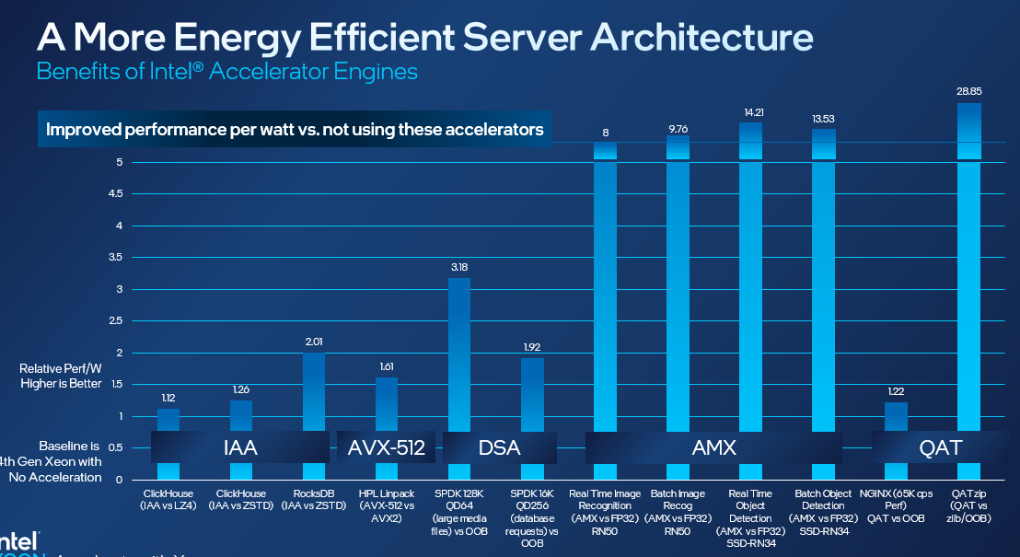
Resources and Configurations
A More Energy Efficient Server Architecture
Up to 1.12x and 1.26x higher performance/W using 4th Gen Xeon Scalable w/Intel Analytics Accelerator vs LZ4 and Zstd on ClickHouse
1-node, 2x pre-production 4th Gen Intel Xeon Scalable processor (60 cores) with integrated Intel In-Memory Analytics Accelerator (Intel IAA), Number of IAA device utilized=8(2 sockets active), on pre-production Intel platform and software, HT On, Turbo On, SNC off, Total Memory 1024GB (16x64GB DDR5 4800), microcode 0x2b0000a1, 1x3.84TB P5510 NVMe, 10GbE x540-AT2, Ubuntu 22.04.1 LTS, 5.18.12-051812-generic, QPL v0.1.21, accel-config-v3.4.6.4, gcc 11.2, Clickhouse 21.12, Star Schema Benchmark, tested by Intel November 2022.
Up to 2.01x higher performance/W using 4th Gen Xeon Scalable w/Intel Analytics Accelerator vs Zstd on RocksDB
1-node, 2x pre-production 4th Gen Intel Xeon Scalable Processor (60 cores) with integrated Intel In-Memory Analytics Accelerator (Intel IAA), on pre-production Intel platform and software, HT On, Turbo On, Total Memory 1024GB (16x64GB DDR5 4800), microcode 0x2b0000a1, 1x3.84TB P5510 NVMe, 10GbE x540-AT2, Ubuntu 22.04.1 LTS, 5.18.12-051812-generic, QPL v0.2.1,accel-config-v3.4.6.4, ZSTD v1.5.2, RocksDB v6.4.6 (db_bench), tested by Intel November 2022.
Up to 1.61 higher performance/W using 4th Gen Xeon Scalable w/AVX-512 vs AVX2 on Linpack
1-node, 2x pre-production 4th Gen Intel® Xeon® Scalable processor (60 core), on pre-production Supermicro SYS-221H-TNR and software with 1024GB DDR5 memory (16x64 GB), microcode 0x2b0000c0, HT On, Turbo On, SNC 4, Ubuntu 22.04.1 LTS, 5.15.0-52-generic, 1x3.84TB P5510 NVMe, 10GbE x540-AT2, One API BaseKit 2022.2.0.262, One API HPC 2022.2.0.191, Linpack ver 2.3, tested by Intel November 2022.
Up to 3.18x and 1.92x higher performance/W using 4th Gen Xeon Scalable w/Data Streaming Accelerator vs out-of-box OS software on SPDK NVMe TCP
1-node, 2x pre-production 4th Gen Intel Xeon Scalable processor (60 core) with integrated Intel Data Streaming Accelerator (Intel DSA), DSA device utilized=1(1 active socket), on pre-production Intel platform and software with 1024GB DDR5 memory (16x64 GB), microcode 0x2b0000a1, 1x3.84TB P5510 NVMe, 10GbE x540-AT2, Ubuntu 22.04.1 LTS, 5.15.0-52-generic, 1x 1.92TB Intel® SSDSC2KG01, 4x 1.92TB Samsung PM1733, 1x Intel® Ethernet Network Adapter E810-2CQDA2, 2x100GbE, FIO v3.30, SPDK 22.05, tested by Intel November 2022.
Up to 8x and 9.76x higher performance/W using 4th Gen Xeon Scalable w/Advanced Matrix Extensions using AMX vs VNNI instructions on ResNet50 Image Processing
1-node, 2x pre-production 4th Gen Intel® Xeon® Scalable processor (60 core) with Intel® Advanced Matrix Extensions (Intel AMX), on pre-production Supermicro SYS-221H-TNR with 1024GB DDR5 memory (16x64 GB), microcode 0x2b0000c0, HT On, Turbo On, SNC Off, CentOS Stream 8, 5.19.16-301.fc37.x86_64, 1x3.84TB P5510 NVMe, 10GbE x540-AT2, Intel TF 2.10, AI Model=Resnet 50 v1_5, best scores achieved: BS1 FP32 8 cores/instance (max. 15ms SLA), BS1 INT8 2 cores/instance (max. 15ms SLA), BS1 AMX 1 core/instance (max. 15ms SLA), BS16 FP32 5 cores/instance, BS16 INT8 5 cores/instance, BS16 AMX 5 cores/instance, using physical cores, tested by Intel November 2022.
Up to 14.21x and 13.53x higher performance/W using 4th Gen Intel Xeon Scalable w/Advanced Matrix Extensions using AMX vs VNNI instructions on SSD-ResNet34 on Object Detection
1-node, 2x pre-production 4th Gen Intel® Xeon® Scalable processor (60 core) with Intel® Advanced Matrix Extensions (Intel AMX), Intel platform with 1024GB DDR5 memory (16x64 GB), microcode 0x2b0000a1, HT On, Turbo On, SNC Off, CentOS Stream 8, 5.19.16-301.fc37.x86_64, 1x3.84TB P5510 NVMe, 10GbE x540-AT2, Intel TF 2.10, AI Model=SSD-ResNet34, best scores achieved: BS1 FP32 60 cores/instance (max. 100ms SLA), BS1 INT8 4 cores/instance (max. 100ms SLA), BS1 AMX 4 core/instance (max. 100ms SLA), BS8 FP32 8 cores/instance, BS2 INT8 1 cores/instance, BS2 AMX 1 cores/instance, using physical cores, tested by Intel November 2022.
Up to 1.22x higher performance/W using 4th Gen Intel Xeon Scalable w/QuickAssist Accelerator vs out-of-box software on NGINX TLS Handshake.
QAT Accelerator: 1-node, 2x pre-production 4th Gen Intel Xeon Scalable Processor (60 cores) with integrated Intel QuickAssist Accelerator (Intel QAT), Number of QAT device utilized=4(1 socket active), on pre-production Intel platform and software with DDR5 memory total 1024GB (16x64 GB), microcode 0x2b0000a1, HT On, Turbo Off, SNC Off, Ubuntu 22.04.1 LTS, 5.15.0-52-generic, 1x3.84TB P5510 NVMe, 10GbE x540-AT2, 1x Intel® Ethernet Network Adapter E810-2CQDA2, 1x100GbE, QAT engine v0.6.14, QAT v20.l.0.9.1, NGINX 1.20.1, OpenSSL 1.1.1l, IPP crypto v2021_5, IPSec v1.1 , TLS 1.3 AES_128_GCM_SHA256, ECDHE-X25519-RSA2K, 65K CPS target SLA, tested by Intel November 2022. Out of box configuration: 1-node, 2x pre-production 4th Gen Intel Xeon Scalable Processor (60 cores) with integrated Intel QuickAssist Accelerator (Intel QAT), Number of QAT device utilized=0, on pre-production Intel platform and software with DDR5 memory total 1024GB (16x64 GB), microcode 0x2b0000a1, HT On, Turbo Off, SNC Off, Ubuntu 22.04.1 LTS, 5.15.0-52-generic, 1x3.84TB P5510 NVMe, 10GbE x540-AT2, 1x Intel® Ethernet Network Adapter E810-2CQDA2, 1x100GbE, NGINX 1.20.1, OpenSSL 1.1.1l, TLS 1.3 AES_128_GCM_SHA256, ECDHE-X25519-RSA2K, 65K CPS target SLA, tested by Intel November 2022.
Up to 28.85x higher performance/W using 4th Gen Intel Xeon Scalable w/QuickAssist Accelerator vs out-of-box zlib on QATzip compression
1-node, 2x pre-production 4th Gen Intel® Xeon Scalable Processor (60 core) with integrated Intel QuickAssist Accelerator (Intel QAT), QAT device utilized=8(2 sockets active), on pre-production Intel platform and software with DDR5 memory Total 1024GB (16x64 GB), microcode 0x2b0000a1, HT On, Turbo Off, SNC Off, Ubuntu 22.04.1 LTS, 5.15.0-52-generic, 1x3.84TB P5510 NVMe, 10GbE x540-AT2, QAT v20.l.0.9.1 , QATzip v1.0.9, tested by Intel November 2022.

Slide 47
Resources and Configurations
A More Cost-Efficient Server Architecture
ResNet50 Image Classification
New Configuration: 1-node, 2x pre-production 4th Gen Intel® Xeon® Scalable 8490H processor (60 core) with Intel® Advanced Matrix Extensions (Intel AMX), on pre-production SuperMicro SYS-221H-TNR with 1024GB DDR5 memory (16x64 GB), microcode 0x2b0000c0, HT On, Turbo On, SNC Off, CentOS Stream 8, 5.19.16-301.fc37.x86_64, 1x3.84TB P5510 NVMe, 10GbE x540-AT2, Intel TF 2.10, AI Model=Resnet 50 v1_5, best scores achieved: BS1 AMX 1 core/instance (max. 15ms SLA), using physical cores, tested by Intel November 2022. Baseline: 1-node, 2x production 3rd Gen Intel Xeon Scalable 8380 Processor ( 40 cores) on SuperMicro SYS-220U-TNR , DDR4 memory total 1024GB (16x64 GB), microcode 0xd000375, HT On, Turbo On, SNC Off, CentOS Stream 8, 5.19.16-301.fc37.x86_64, 1x3.84TB P5510 NVMe, 10GbE x540-AT2, Intel TF 2.10, AI Model=Resnet 50 v1_5, best scores achieved: BS1 INT8 2 cores/instance (max. 15ms SLA), using physical cores, tested by Intel November 2022.
For a 50 server fleet of 3rd Gen Xeon 8380 (RN50 w/DLBoost), estimated as of November 2022:
CapEx costs: $1.64M
OpEx costs (4 year, includes power and cooling utility costs, infrastructure and hardware maintenance costs): $739.9K
Energy use in kWh (4 year, per server): 44627, PUE 1.6
Other assumptions: utility cost $0.1/kWh, kWh to kg CO2 factor 0.42394
For a 17 server fleet of 4th Gen Xeon 8490H (RN50 w/AMX), estimated as of November 2022:
CapEx costs: $799.4K
OpEx costs (4 year, includes power and cooling utility costs, infrastructure and hardware maintenance costs): $275.3K
Energy use in kWh (4 year, per server): 58581, PUE 1.6
Other assumptions: utility cost $0.1/kWh, kWh to kg CO2 factor 0.42394
RocksDB
New Configuration: 1-node, 2x pre-production 4th Gen Intel Xeon Scalable 8490H Processor (60 cores) with integrated Intel In-Memory Analytics Accelerator (Intel IAA), on pre-production Intel platform and software, HT On, Turbo On, Total Memory 1024GB (16x64GB DDR5 4800), microcode 0x2b0000a1, 1x3.84TB P5510 NVMe, 10GbE x540-AT2, Ubuntu 22.04.1 LTS, 5.18.12-051812-generic, QPL v0.2.1,accel-config-v3.4.6.4, ZSTD v1.5.2, RocksDB v6.4.6 (db_bench), tested by Intel November 2022. Baseline: 1-node, 2x production 3rd Gen Intel Xeon Scalable 8380 Processor ( 40 cores) on SuperMicro SYS-220U-TNR , HT On, Turbo On, SNC Off, Total Memory 1024GB (16x64GB DDR4 3200), microcode 0xd000375, 1x3.84TB P5510 NVMe, 10GbE x540-AT2, Ubuntu 22.04.1 LTS, 5.18.12-051812-generic, ZSTD v1.5.2, RocksDB v6.4.6 (db_bench), tested by Intel November 2022.
For a 50 server fleet of 3rd Gen Xeon 8380 (RocksDB), estimated as of November 2022:
CapEx costs: $1.64M
OpEx costs (4 year, includes power and cooling utility costs, infrastructure and hardware maintenance costs): $677.7K
Energy use in kWh (4 year, per server): 32181, PUE 1.6
Other assumptions: utility cost $0.1/kWh, kWh to kg CO2 factor 0.42394
For a 18 server fleet of 4th Gen Xeon 8490H (RockDB w/IAA), estimated as of November 2022:
CapEx costs: $846.4K
OpEx costs (4 year, includes power and cooling utility costs, infrastructure and hardware maintenance costs): $260.6K
Energy use in kWh (4 year, per server): 41444, PUE 1.6
Other assumptions: utility cost $0.1/kWh, kWh to kg CO2 factor 0.42394
OpenFOAM
New Configuration: 1-node, 2x pre-production 4th Gen Intel Xeon CPU Max Series (56 cores) on pre-production Intel platform and software, HT On, Turbo On, SNC4 mode, Total Memory 128 GB (8x16GB HBM2 3200MT/s), microcode 0x2c000020, 1x3.5TB INTEL SSDPF2KX038TZ NVMe, CentOS Stream 8, 5.19.0-rc6.0712.intel_next.1.x86_64+server, OpenFOAM 8, Motorbike 20M @ 250 iterations, Motorbike 42M @ 250 iterations, Tools: ifort:2021.6.0, icc:2021.6.0, impi:2021.6.0, tested by Intel December 2022. Baseline: 1-node, 2x production 3rd Gen Intel Xeon Scalable 8380 Processor ( 40 cores) on SuperMicro SYS-220U-TNR, HT On, Turbo On, 512GB (16x32GB DDR4 3200 MT/s), microcode 0xd000375, 1x2.9TB INTEL SSDPE2KE032T8 NVMe, CentOS Stream 8, 4.18.0-408.el8.x86_64, OpenFOAM 8, Motorbike 20M @ 250 iterations, Motorbike 42M @ 250 iterations, Tools: ifort:2021.6.0, icc:2021.6.0, impi:2021.6.0, tested by Intel December 2022
For a 50 server fleet of 3rd Gen Xeon 8380 (OpenFOAM), estimated as of December 2022:
CapEx costs: $1.50M
OpEx costs (4 year, includes power and cooling utility costs, infrastructure and hardware maintenance costs): $780.3K
Energy use in kWh (4 year, per server): 52700, PUE 1.6
Other assumptions: utility cost $0.1/kWh, kWh to kg CO2 factor 0.42394
For a 16 server fleet of Intel Xeon CPU Max Series 56 core, estimated as of December 2022:
CapEx costs: $507.2K
OpEx costs (4 year, includes power and cooling utility costs, infrastructure and hardware maintenance costs): $274.9K
Energy use in kWh (4 year, per server): 74621, PUE 1.6
Other assumptions: utility cost $0.1/kWh, kWh to kg CO2 factor 0.42394

Slide 48
Resources and Configurations
A More Cost-Efficient Server Architecture
SPDK
New Configuration: 1-node, 2x pre-production 4th Gen Intel Xeon Scalable processor (60 core) with integrated Intel Data Streaming Accelerator (Intel DSA), DSA device utilized=1(1 active socket), on pre-production Intel platform and software with 1024GB DDR5 memory (16x64 GB), microcode 0x2b0000a1, 10GbE x540-AT2, Ubuntu 22.04.1 LTS, 5.15.0-52-generic, 1x 1.92TB Intel® SSDSC2KG01, 4x 1.92TB Samsung PM1733, 1x Intel® Ethernet Network Adapter E810-2CQDA2, 2x100GbE, FIO v3.30, SPDK 22.05, tested by Intel November 2022. Baseline: 1-node, 2x production 3rd Gen Intel Xeon Scalable Processors( 40 cores) on Supermicro SYS-220U-TNR , DDR4 memory total 1024GB (16x64 GB), HT On, Turbo On, SNC Off, microcode 0xd000375, 10GbE x540-AT2, Ubuntu 22.04.1 LTS, 5.15.0-52-generic, 1x 1.92TB Intel SSDSC2KG01, 4x 1.92TB Samsung PM1733, 1x Intel Ethernet Network Adapter E810-2CQDA2, 2x100GbE, FIO v3.30, SPDK 22.05, tested by Intel November 2022.
For a 50 server fleet of 3rd Gen Xeon 8380 (SPDK), estimated as of November 2022:
CapEx costs: $1.77M
OpEx costs (4 year, includes power and cooling utility costs, infrastructure and hardware maintenance costs): $630.6K
Energy use in kWh (4 year, per server): 22762, PUE 1.6
Other assumptions: utility cost $0.1/kWh, kWh to kg CO2 factor 0.42394
For a 15 server fleet of 4th Gen Xeon 8490H (SPDK w/DSA), estimated as of November 2022:
CapEx costs: $743.8K
OpEx costs (4 year, includes power and cooling utility costs, infrastructure and hardware maintenance costs): $220.1K
Energy use in kWh (4 year, per server): 43387, PUE 1.6
Other assumptions: utility cost $0.1/kWh, kWh to kg CO2 factor 0.42394

Slide 49
Notices and Disclaimers
Performance varies by use, configuration and other factors. Learn more at www.Intel.com/PerformanceIndex​.
Performance results are based on testing as of dates shown in configurations and may not reflect all publicly available ​updates. See backup for configuration details. No product or component can be absolutely secure.
Intel contributes to the development of benchmarks by participating in, sponsoring, and/or contributing technical support to various benchmarking groups, including the BenchmarkXPRT Development Community administered by Principled Technologies.
Your costs and results may vary.
Intel technologies may require enabled hardware, software or service activation.
Some results may have been estimated or simulated.
Intel does not control or audit third-party data. You should consult other sources to evaluate accuracy.
All product plans and roadmaps are subject to change without notice.
Statements in this document that refer to future plans or expectations are forward-looking statements. These statements are based on current expectations and involve many risks and uncertainties that could cause actual results to differ materially from those expressed or implied in such statements. For more information on the factors that could cause actual results to differ materially, see our most recent earnings release and SEC filings at www.intc.com.
© Intel Corporation. Intel, the Intel logo, and other Intel marks are trademarks of Intel Corporation or its subsidiaries. Other names and brands may be claimed as the property of others.

Slide 50
Leadership Performance with 4th Gen Intel® Xeon® processors Disclaimers
53% average performance gain over the prior generation1 See [G1] at intel.com/processorclaims: 4th Gen Intel® Xeon® Scalable processors. Results may vary.
Up to 10x higher PyTorch real-time inference performance with built-in Intel® Advanced Matrix Extensions (Intel® AMX) (BF16) vs. the prior generation (FP32)4 See [A17] at intel.com/processorclaims: 4th Gen Intel® Xeon® Scalable processors. Results may vary.
Up to 10x higher PyTorch training performance with built-in Intel® Advanced Matrix Extensions (Intel® AMX) (BF16) vs. the prior generation (FP32)5 See [A16] at intel.com/processorclaims: 4th Gen Intel® Xeon® Scalable processors. Results may vary
Up to 5:1 consolidation and 75% TCO savings with 4th Gen Intel Xeon processors: Calculations as of March 28, 2023 based on the Intel® Node TCO & Power Calculator using default cost, power and TCO assumptions over a 5-year TCO horizon comparing replacing 50 older servers with Intel Xeon 4110 processors with new servers using new Intel Xeon 5420+ processors. Results may vary. Performance measurements based on published SPECrate®2017_int_base on spec.org as of March 28, 2023 [4110: https://www.spec.org/cpu2017/results/res2020q4/cpu2017-20201015-24218.html 5420+: https://www.spec.org/cpu2017/results/res2023q1/cpu2017-20230130-33925.html]
2.9x average performance per watt efficiency improvement for targeted workloads utilizing built-in accelerators compared to the previous generation2 See [E1] at intel.com/processorclaims: 4th Gen Intel® Xeon® Scalable processors. Results may vary.
Intel SGX is the most researched, updated, and deployed confidential computing technology in data centers on the market today. With Intel® Security Engines, 4th Gen Intel Xeon Scalable processors help bring a zero-trust security strategy to life while unlocking new opportunities for business collaboration and insights—even with sensitive or regulated data. Intel® Software Guard Extensions (Intel® SGX) is designed to enhance data protection at rest, in motion, and in use. Intel SGX is the most researched, updated, and deployed confidential computing technology in data centers on the market today. Intel SGX provides the smallest trust boundary of any confidential computing technology in the data center today.
Built-in accelerators for encryption help keep data protected while preserving performance. Intel® Crypto Acceleration reduces the impact of implementing pervasive data encryption and increases the performance of encryption-sensitive workloads, such as for Secure Sockets Layer (SSL) web servers, 5G infrastructure, and VPNs/firewalls.. Networking Encryption: Up to 47% fewer cores to achieve the same connections/second using integrated Intel® QuickAssist Technology (Intel® QAT) vs. the prior generation on NGINX key handshake.4 See [N15] at intel.com/processorclaims: 4th Gen Intel® Xeon® Scalable processors. Results may vary.
Most deployed platform, backed by extensive testing and validation: With more deployments than any other data center CPU in the market, Intel® Xeon® Scalable processors are widely trusted to run critical workloads at scale. From next-gen memory and I/O to software optimizations, 4th Gen Intel Xeon Scalable processors have been extensively tested and validated to deliver the high performance and reliability organizations demand.
Businesses can speed up time to deployment with the largest ecosystem of partners they know and use—hardware and software vendors and solution integrators around the world build their products on Intel® Xeon® Scalable processors, offering maximum choice and interoperability with the reassurance of thousands of real-world implementations

Slide 51
Refresh and consolidate Intel® Xeon® processor-based servers Disclaimers
Up to 5:1 consolidation with 75% TCO reduction with 4th Gen Intel Xeon processors
Calculations as of March 28, 2023 based on the Intel® Node TCO & Power Calculator using default cost, power and TCO assumptions over a 5-year TCO horizon comparing replacing 50 older servers with Intel Xeon 4110 processors with new servers using new Intel Xeon 5420+ processors. Results may vary. Performance measurements based on published SPECrate®2017_int_base on spec.org as of March 28, 2023 4110: https://www.spec.org/cpu2017/results/res2020q4/cpu2017-20201015-24218.html
5420+: https://www.spec.org/cpu2017/results/res2023q1/cpu2017-20230130-33925.html]
4th Gen Intel® Xeon® processors can significantly lower your total cost of ownership
Calculations as of March 28, 2023 based on the Intel® Node TCO & Power Calculator using default cost, power and TCO assumptions over a 5-year TCO horizon comparing replacing 50 older servers with Intel Xeon 4110 processors with new servers using new Intel Xeon 5420+ processors. Results may vary. Performance measurements based on published SPECrate®2017_int_base on spec.org as of March 28, 2023
8160 https://www.spec.org/cpu2017/results/res2018q4/cpu2017-20181112-09655.html
8460Y https://www.spec.org/cpu2017/results/res2023q1/cpu2017-20221223-33229.html
6130 https://www.spec.org/cpu2017/results/res2019q2/cpu2017-20190506-13570.html
6430 https://www.spec.org/cpu2017/results/res2023q1/cpu2017-20221223-33187.html
5120 https://www.spec.org/cpu2017/results/res2018q4/cpu2017-20181015-09160.html
5420+ https://www.spec.org/cpu2017/results/res2023q1/cpu2017-20230130-33925.html
4110 https://www.spec.org/cpu2017/results/res2020q4/cpu2017-20201015-24218.html

