Slide 1

Building resilience through data protection
With HPE and Zerto software-defined solutions
Alexandru Vilcu
October 2023

Slide 2

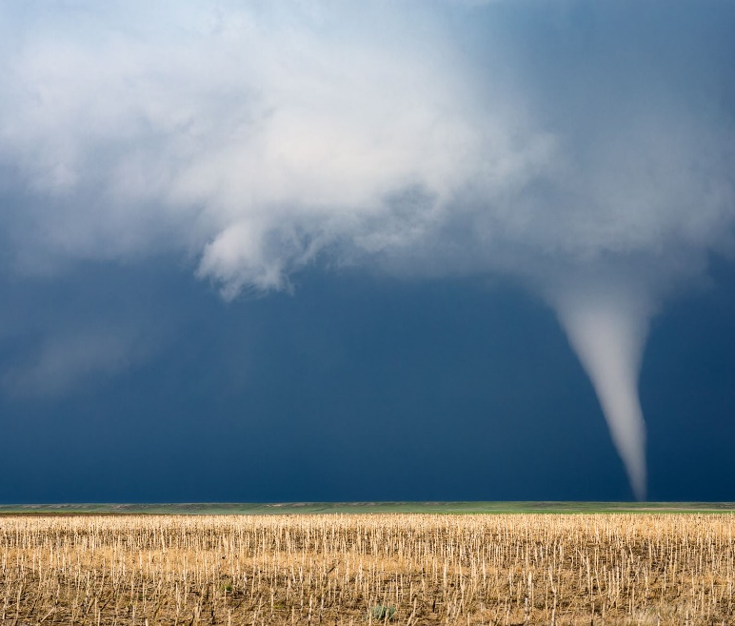

Top challenges
Staying secure & compliant during changing times
Cyber Threats
State-sponsored attacks
Organized cyber crime
Ransomware and ransomware as a service
Unplanned Disruptions
Natural disasters
Hardware failures and corruptions
User errors
Cloud Complexity
Data governance & sovereignty
Skills gaps
Vendor/platform lock-in

Slide 3
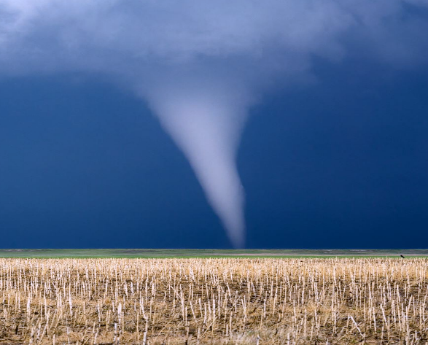




Solving for any disruption with HPE and Zerto
Data resilience with depth and breadth
Unplanned/Reactive
Planned/Proactive
MITIGATE
DISASTERS
Hardware Failures
Natural Disasters
Power Outages
Data Corruptions
NEUTRALIZE
CYBER ATTACKS
Ransomware
Insider Threats
Ransomware as a Service
Malware
DRIVE OPERATIONAL
EFFICIENCY
User Errors
File Deletions
Patch Testing
Dev/Test
Compliance
UNLOCK
MULTI-CLOUD
Migrations
Private, Public, Hybrid
SaaS & Cloud Native
In-Cloud & Cross-Cloud
MODERNIZE
INFRASTRUCTURE
Mergers & Acquisitions
Datacenter Consolidations
Infrastructure Modernization
Upgrades & Refreshes

Slide 4
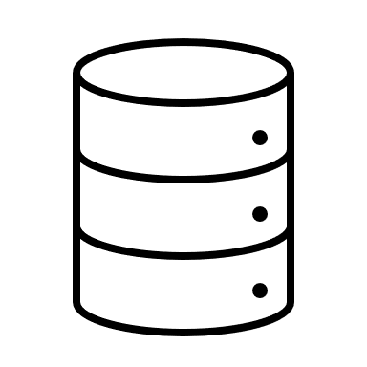


New threats require new solutions
Protection for the modern landscape
Modern Data Protection Portfolio:
All Workloads
All Tiers
All SLAs
Physical, virtualized, and containerized; databases, cloud instances, DBaaS, apps
Mission-critical, business-critical, back office, and test/dev
Customizable RPOs and RTOs of seconds, minutes, hours; tailor protection to each workload and application
Need 24x7 Availability • No Data Loss or Downtime

Slide 5


End-to-end data protection
DISASTER RECOVERY
BACKUP
Two Distinct
Design Centers
Tier 1-2 Applications
Very Low RPO
First and Fastest Recovery
Performance Optimized
Ideal for Resilience
All Applications
Average RPO
Last Resort Recovery
Cost Optimized
Ideal for Compliance
Converging to a single platform

Slide 6
Complementary IT practices
Implementing both backup and DR together ensures depth and breadth
Cyber Recovery
Disaster
Recovery
Backup
Archive
RECOVERY:
Minutes Hours Days Weeks Months Years
RETENTION:
Minutes Hours Days Weeks Months Years

Slide 7
Data protection with HPE and Zerto
The right protection for the right workload with the right SLAs
Tier 1-2 Applications / Mission-Critical
Tier 3-4 Applications / Business-Critical
5-15 sec RPO
Mins – Hours RPO
Daily → 7+ years
DISASTER
RECOVERY
CYBER
RECOVERY
BACKUP &
LONG-TERM RETENTION
Zerto for VMs and Cloud
Zerto DRaaS with MSP
HPE GreenLake for
Disaster Recovery
Zerto Cyber Resilience Vault
Zerto Backup for SaaS
HPE GreenLake for
Backup and Recovery
Unified portfolio running on best-in-class HPE storage, compute, networking

Slide 8

Disaster Recovery
Zerto for VMs and Cloud
HPE GreenLake for Disaster Recovery

Slide 9







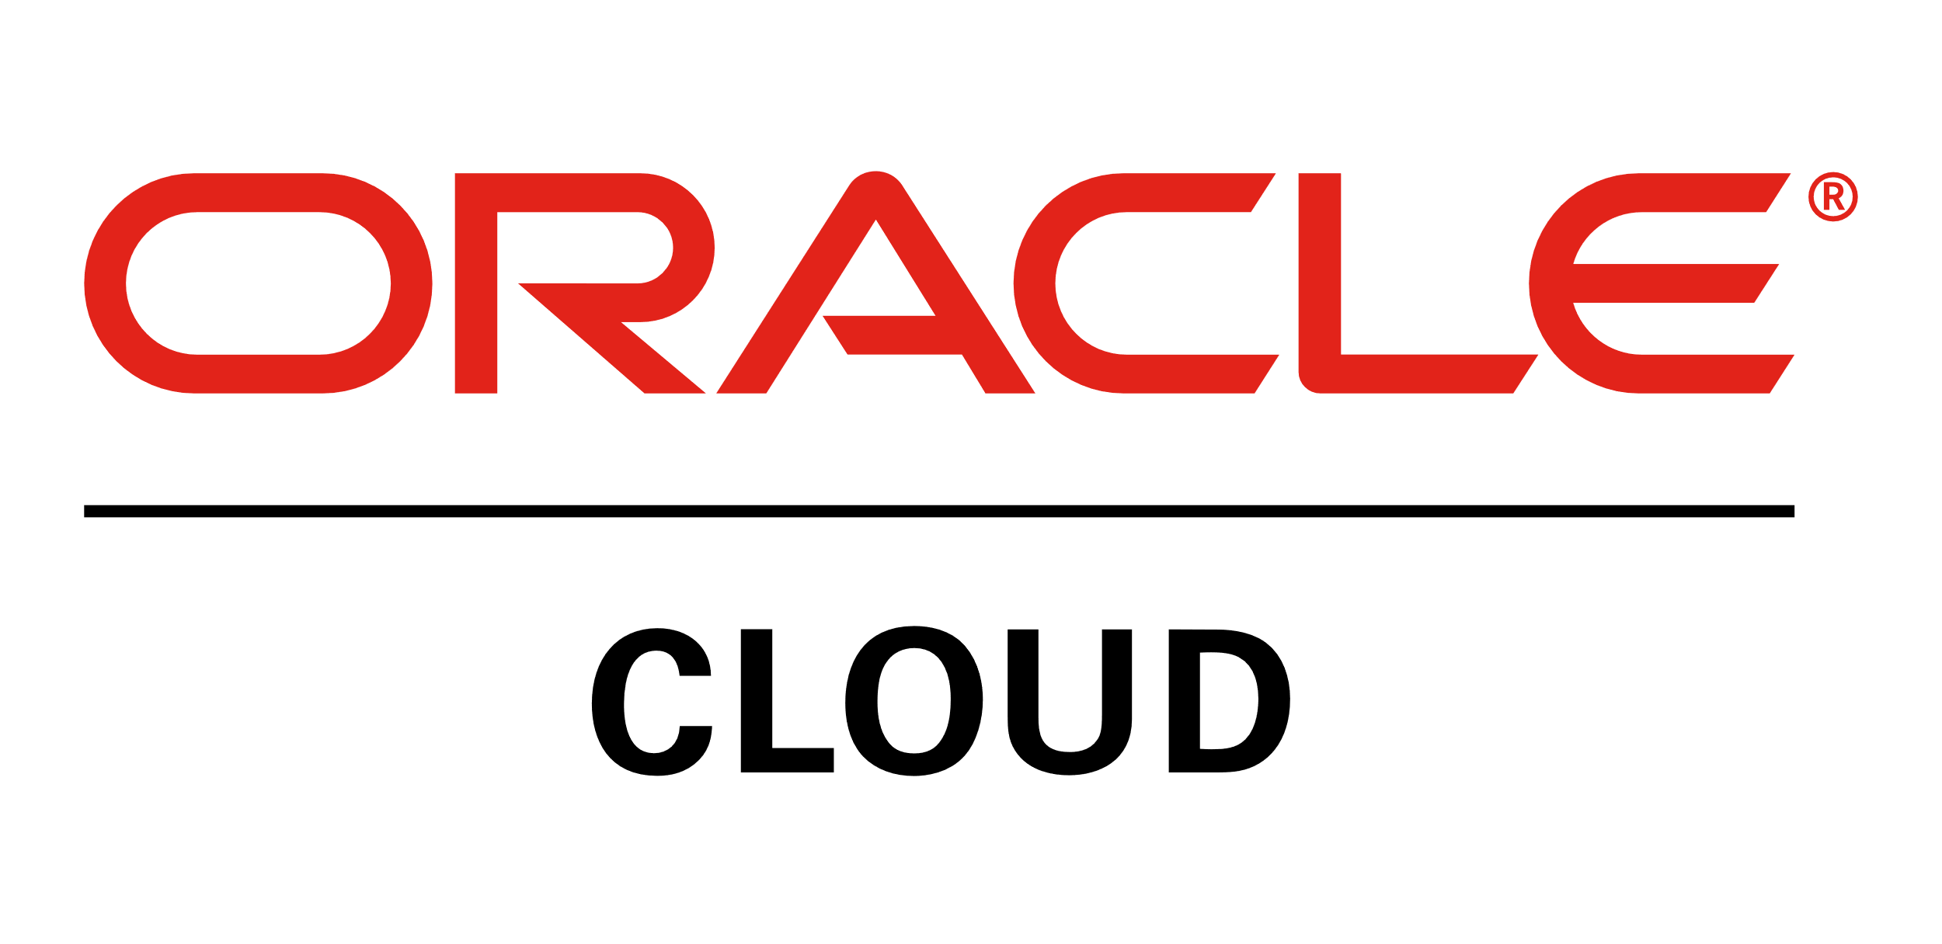


Disaster recovery across on-premises, hybrid, and multi-cloud
Replicate on-premises, to/from/within the cloud, or any combination simultaneously
Disaster Recovery to the Cloud
Protect applications to a cloud target, with additional offsite copies on immutable storage
Disaster Recovery Within the Cloud
Orchestrated, agentless protection at scale for migrated or native cloud instances
One-to-Many
Disaster Recovery On-premises
Real-time hypervisor-level replication regardless of underlying hardware
Disaster Recovery as a Service
Expert protection with one of 350+ MSP partners who offer full or partially managed DRaaS
MSP

Slide 10

01
02
Continuous Data Protection
Orchestration and Automation
What makes
us different
Real-Time Replication & Detection
Journal-Based Recovery
App-Centric Protection
Orchestration
Automated Protection & Recovery
Non-Disruptive Testing
03
04
Multi-Cloud
Simplicity at Scale
Public, Private, Hybrid
One-to-Many
HPE GreenLake
Ease of Deployment
Flexible Architectures
Analytics & Reporting

Slide 11

Unique journaling
Granular, point-in-time recovery with the dynamic Zerto journal
10:00:00
DISASTER HITS
10:00:00 BACKUP
Up to 24 hrs data loss
6:00:00 SNAPSHOT
Up to 4 hrs data loss
9:59:55 REWIND
BACK SECONDS WITH ZERTO
DETECT
anomalous encryption in real-time to alert to possible ransomware
RESPOND
quickly to minimize data loss & downtime with low RPOs and fast RTOs
RECOVER
in minutes to a clean state seconds before an attack or disruption

Slide 12
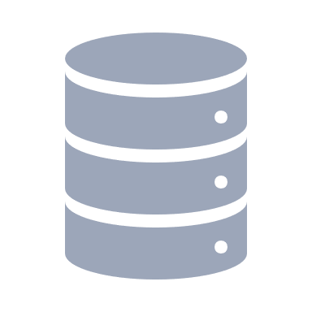

Flexible architectures with Zerto
Easily interoperate with existing infrastructure stack
PRODUCTION
DR
v C E N T E R
Z V M
v C E N T E R
Z V M
Real-Time Detection & Replication
Continuous sync for low RPO with no performance impact
H O S T
H O S T
Scale-Out Architecture
Small footprint, low overhead components with no compute at DR until recovery
V M
V M
V R A
V R A
D A T A S T O R E
D A T A S T O R E
ANY
S T O R A G E
ANY
S T O R A G E
Replicas
Immutable Copies
Azure Blob, Amazon S3,
S3-compatible (e.g. Scality)
Compressed Journals
1 hour to 30-day retention
OFFSITE REPOSITORY

Slide 13


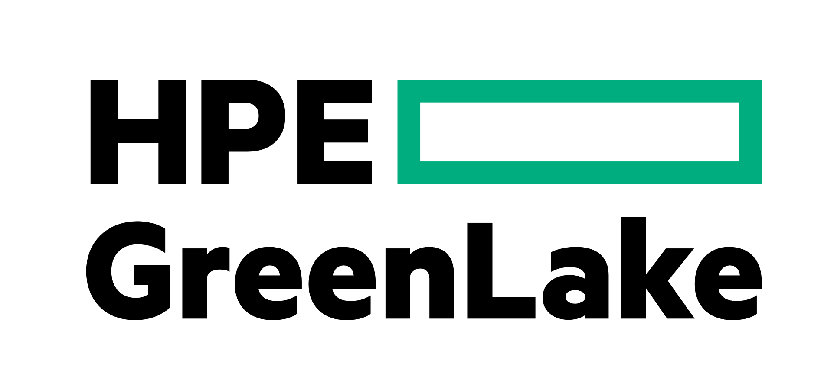
Deeply integrated DR for AWS, Azure, VMware, and HPE GreenLake
Scalable replication to, from, within leading platforms
CDP to/from AWS plus orchestrated DR for EC2 instances, including cross-region
and cross-AZ replication
Immutability via Amazon S3 Object Lock
CDP to/from Azure, including cross-region in-cloud DR
Immutability via Azure Blob Storage
Support vCenter and Cloud Director to protect VMs backed by any storage, plus VMware on public clouds such as Azure, Google, Oracle, and IBM
Immutability via S3-compatible storage
Simple, SaaS-based DR with global multi-site management
Integrated into single edge-to-cloud platform to store, manage, and protect data

Slide 14

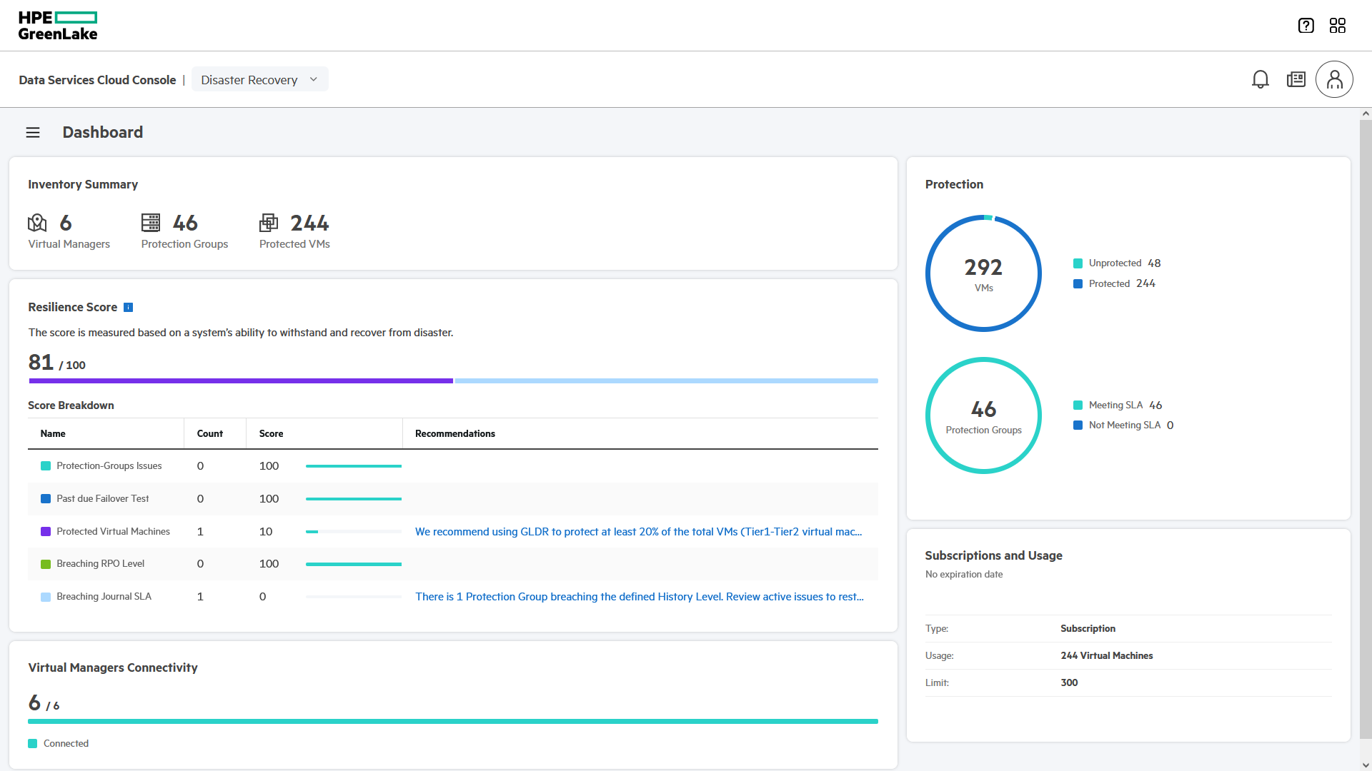
Disaster recovery on HPE GreenLake
Ultra-low RPOs and RTOs available as scalable SaaS offering
Continuous data protection from Zerto now available on HPE GreenLake
Simple SaaS-based DR with global multi-site management for your hybrid cloud
Integrate DR into hybrid cloud IaaS with the HPE GreenLake cloud platform
HPE GreenLake for Disaster Recovery

Slide 15
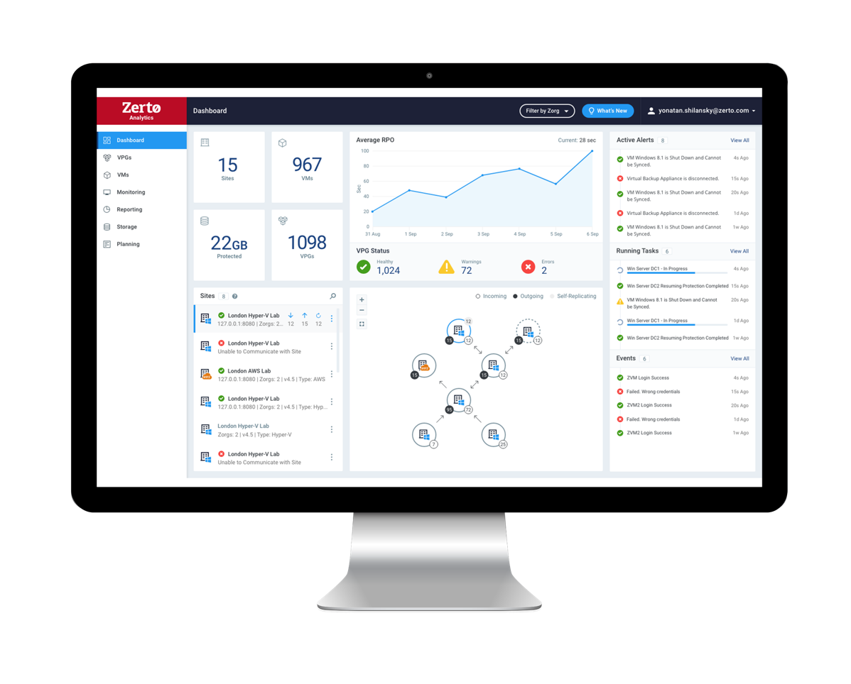
HPE GreenLake for Disaster Recovery
Simple cloud operations and control
HPE GreenLake Cloud Platform
Cloud console orchestrates on-premises components
Replication between customer-owned sites
Data stays within customer boundary
Local console available when needed
On-Premises
On-Premises
Public Cloud*
App.
App.
App.
App.
App.
App.
App.
App.
App.
Web
Web
Web
Replicated data
Web
Web
Web
Replicated data
Web
Web
Web
DB
DB
DB
DB
DB
DB
DB
DB
DB
File
File
File
File
File
File
File
File
File
No scheduling,
snapshots, or agents
Hardware- and
Storage-agnostic
Protect on-premises,
to the cloud, or both* simultaneously
(* Coming Soon)

Slide 16




Only HPE and Zerto
Battle-Tested CDP Since 2012
Proven Reliability at Scale
Gold Standard in Performance
TOP SOFTWARE CUSTOMER
FORTUNE 10 CUSTOMER
4100 VMs
Avg 8 Sec RPO
7000 VMs
Avg 7 Sec RPO
2600 VMs
Avg 6 Sec RPO
1400 VMs
Avg 9 Sec RPO

Slide 17
Backup
Zerto Backup for SaaS
HPE GreenLake for Backup and Recovery

Slide 18
Simple, cost-effective backup
Take the hassle out of achieving your 3-2-1 strategy
Backup to the Cloud
Protect applications to a managed cloud repository
Backup in the Cloud
Protect Amazon EC2, EBS, RDS, or cloud native apps on EKS
Backup On-premises
Protect applications locally to self-managed on-premises repositories
Backup for SaaS
Protection of SaaS data as part of shared responsibility model

Slide 19


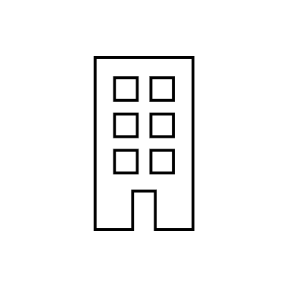


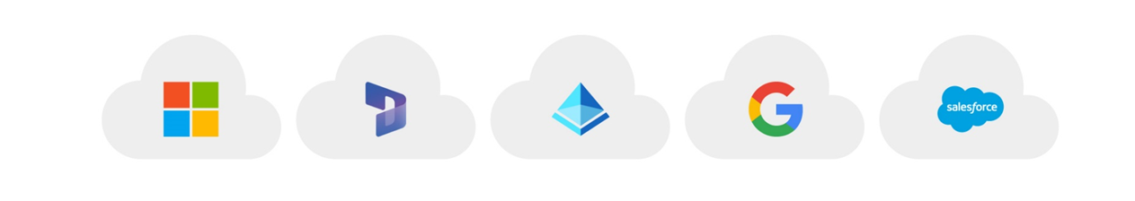
Zerto Backup for SaaS, powered by Keepit
Comprehensive backup for Microsoft 365, Salesforce, Azure AD, and more
Independent data protection cloud—no 3rd party or public cloud
Secure, encrypted, immutable
Fully redundant multi-region support
Simple billing with no retention fees for exited users
4 copies
2 copies sent to
Data Center A
2 copies sent to
Data Center B
Fully Secure and Encrypted
Automated Daily Backup Blockchain-verified Technology
Fast and Easy Recovery

Slide 20
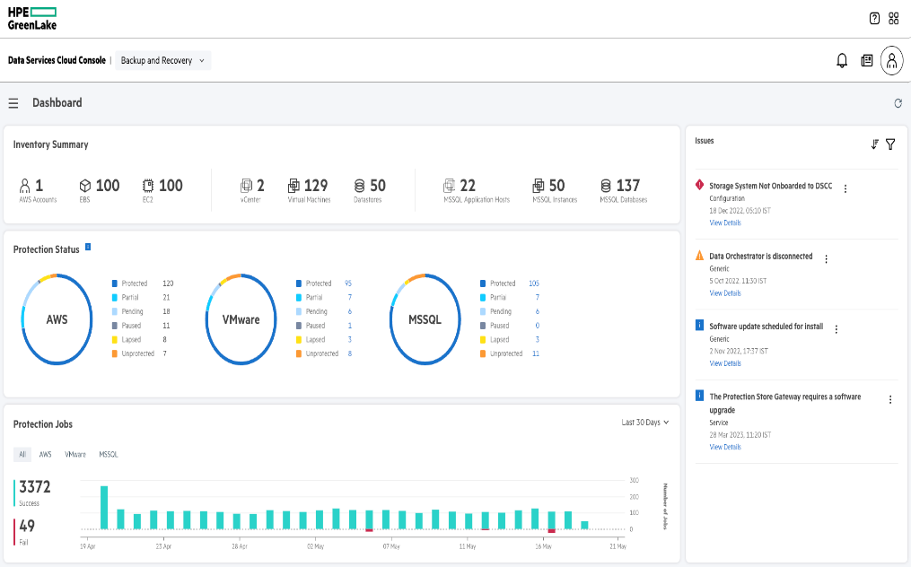
HPE GreenLake for Backup and Recovery
Secure, cost-effective SaaS backup for VMware vSphere and Amazon Web Services
Efficient
Industry-leading data reduction unlocks operational efficiency: lower costs, shorten backup windows, and streamline bandwidth
Secure
Thwart threat actors and keep data untouchable during a ransomware attack
Effortless
Eliminate bottlenecks and silos with a simple SaaS experience built on the HPE GreenLake platform
Notes:
Intent of the slide: To highlight the value proposition of HPE GreenLake for Backup and Recovery
It is easy to deploy, set up policies through a single management console and the service gets automatic timely upgrades without causing any disruption or downtime. The cloud native service eliminates complexity, freeing you from the day-to-day hassles of managing your backup infrastructure.
HPE Catalyst provides super-efficient backup capacity utilization with source side deduplication, making the most efficient use of network bandwidth.
Our testing has shown the Backup & Recovery Service to be is up to 8x more storage efficient than similar software/services.
Finally it is secure—built on the HPE GreenLake platform. With built in encryption data is inaccessible to attackers by creating backup stores which are not directly accessible by the operating system. Then there’s the new data immutability feature, which prevents backup being deleted or modified before the configured retention date. Once the retention date has been set it cannot be reduced and the backup is safe from attack or accidental deletion.
We have included dual factor authentication To provide defense and protection against ransomware attacks or insider attacks, where the malicious user attempts to delete the user’s data

Slide 21
Efficient
Industry-leading data reduction unlocks operational efficiency
Unparalleled source-side deduplication and compression
Up to 8x*
Sends incremental changes for efficient data transfer to cloud store
Better capacity efficiencies than other solutions
Only retrieves missing blocks from the cloud store for recovery
Retain more with predictable costs, cloud scale, and no egress fees
* Based on HPE internal testing conducted in October 2022 comparing HPE GreenLake for Backup and Recovery with four competing on-prem and AWS cloud native backup solution.
Notes:
Intent of the slide: This slide explains the cost efficiency of the service
This service incorporates proven HPE Catalyst technology which provides space efficient backups enabling HPE Greenlake for Backup and Recovery to deliver better storage efficiency compared to alternate backup solutions – up to 8x better storage efficiency** or the need to use as less than 15% of the capacity other protection solutions require.
Storage efficiency benefits include:
Less storage to purchase and manage for backup data
Reduced network bandwidth costs
Faster finish time for backups
Ability for users to retain more with predictable costs and cloud scale

Slide 22

Secure
Thwart threat actors and keep data untouchable during a ransomware attack
Encryption
All data, at rest and in flight
Immutability
Data copies that cannot be changed by anyone to extend from 3-2-1 to 3-2-1-1
Dual authorization
Destructive operations require escalation and
dual approval
Air gap
Physical disconnection between production environment and backup copy
Built on the HPE GreenLake platform
Multi-level security for access, authentication, authorization, and communications

Slide 23

Effortless
Eliminate bottlenecks and silos with a simple SaaS experience built on the HPE GreenLake platform
1
Allocate VMs, MS SQL, Amazon EC2 & RDS instances, or EBS volumes to protection groups
2
Easily configure robust
protection policies
3
Apply global policies to
protection groups
Fast protection for vSphere, MS SQL or RDS databases, Amazon EBS, EC2, and EKS
Notes:
Intent of the slide: This slide explains how simple is it to start protecting VMs using the HPE GreenLake for Backup and Recovery.
Data protection involves protecting large collections of VMs, EC2 instances and EBS volumes. Most of the time, these large collections of data needs similar protection SLAs. It is a tedious job for an administrator to apply protection and monitor jobs for these resources individually. HPE GreenLake for Backup and Recovery encapsulate backup targets into the Protection Groups to enable consistent protection at scale. These Protection Groups enable the user to apply protection for multiple VMs or datastores or AWS Resources in a single operation to automate the protection of VMs.

Slide 24







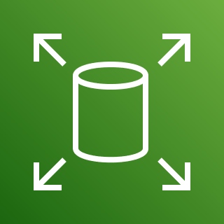

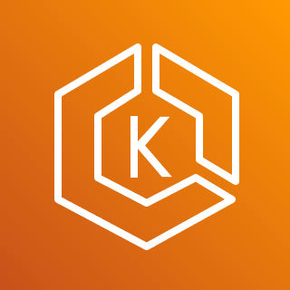





How it works
Single, simple SaaS control plane with built-in orchestration and automation
HPE GreenLake for Backup and Recovery console
DSCC-managed
storage
Any storage
Array-optimized or CBT backup
CBT backup
HPE-managed cloud repository
Instant recovery
from local snapshots
Rapid recovery
from on-prem backups
Long-Term Retention (LTR)
via cost-effective backup to cloud
Cloud Native Backup
of Amazon EC2, EBS, RDS, and EKS

Slide 25

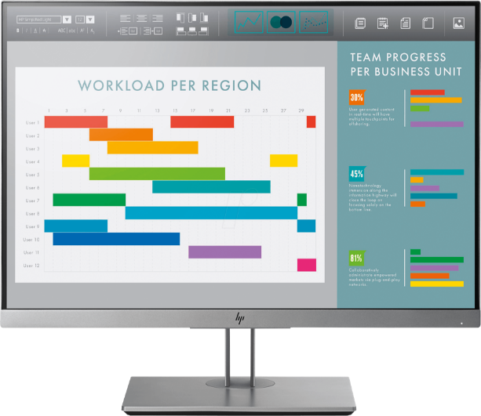
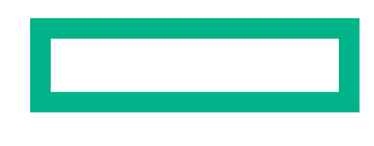
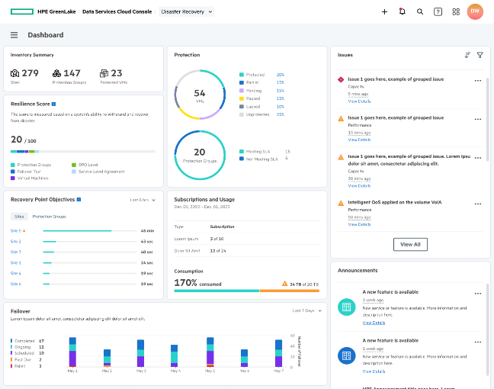
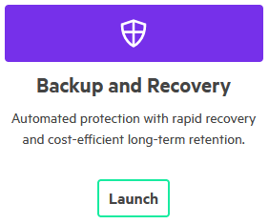
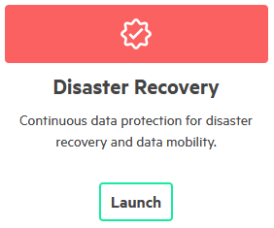
Unified data protection with HPE GreenLake
Single destination for SaaS-based backup and DR alongside infrastructure services
\
– ◻ X
Data Services Cloud Console
HPE GreenLake edge-to-cloud platform

Slide 26
CPU + Accelerators: Differentiated Performance On Real Workloads
4th Gen Intel® Xeon® Scalable processors
Intel® Xeon® CPU Max Series
General
Purpose
Compute
Artificial Intelligence
Network 5G vRAN
Networking
& Storage
Data Analytics
HPC
53%
Up to 10x
Up to 2x
Up to 2x
Up to 3x
Up to 3.7x
average performance gain*
higher inference and training performance*
capacity for vRAN workloads at same power envelope*
higher data compression with 95% fewer cores*
higher performance*
on memory-bound workloads**
See [G1, A17, N10, N16, D1] at intel.com/processorclaims: 4th Gen Intel Xeon Scalable processors. Results may vary
*4th Gen Intel Scalable Processor vs. 3rd Gen Intel Xeon Scalable processors
** Intel Xeon CPU Max Series vs. Intel Xeon 8380
Notes:
Intel’s and HPE’s collaboration is on real world workloads and bringing differentiated performance
We partnered with HPE and many customers across the ecosystem to learn about their needs
On HPE’s Gen 11 product line, Intel offers broad platform of advanced technologies that incorporates both hardware and software offerings that help customer reach these performance numbers

Slide 27
Cyber Recovery
Zerto Cyber Resilience Vault

Slide 28




Challenges with cyber recovery
Unique problem domain with key differences from DR and backup
Unpredictable attack patterns
Since each attack can vary so much, how can we prepare for unknown unknowns and fold data protection into larger security stack?
Unknown blast radius
How can we determine what’s been compromised and how extensive the lateral movement is?
Unclean recovery points
Which points in time are better to revert to and how do I know this as soon as possible?
Unacceptable data loss and downtime
How do I minimize how much we lose and how long we’re down? Are days and weeks of RPO and RTO an inevitability?
NIST Cybersecurity Framework 1.1

Slide 29
Cyber recovery with HPE and Zerto
#1 REPLICATE AND DETECT
Real-time replication combined with real-time encryption detection
Three Pillars
of Resilience
#3 TEST AND RECOVER
Non-disruptive tests to prove recoverability plus flexible options for rapid air-gapped recovery
#2 ISOLATE AND LOCK
Isolate with Cyber Resilience Vault, 3-2-1, multi-cloud, and immutability

Slide 30
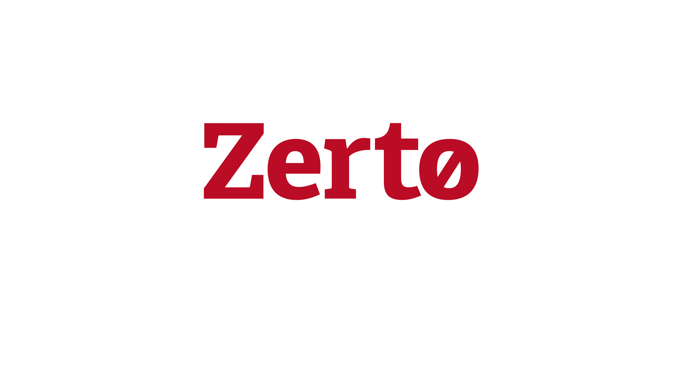
Built-in technical advantages for cyber recovery
CDP means never missing a backup or going unprotected
No in-guest agents to be disabled or hijacked and no local journals required
Full analytics suite for vital visibility into recoverability
Encrypted communication between all components
Security-hardened Linux appliances reduce the overall attack vector
One-to-many replication makes it easy to evolve from 3-2-1 to 4-3-2
Zero Trust CDP
Deep interoperability & open APIs with Swagger unlock power of security + Zerto
Offsite immutable copies from the journal are untouchable by ransomware

Slide 31
Zerto Cyber Resilience Vault
ISOLATED
Isolated, offline, and air gapped with immutable data copies using zero trust architecture
Purpose-built for cyber recovery — option of last resort in worst case scenarios
AIR GAPPED
Your data
IMMUTABLE
ZERO TRUST

Slide 32


Why a Cyber Vault
NEED TO PROTECT
YOUR DATA PROTECTION
INCREASINGLY MANDATED BY REGULATORS
“Isolated recovery environments (IREs) with immutable data vaults (IDVs) provide the highest level of security and recovery against insider threats, ransomware and other forms of hacking.”
REQUIRE MULTI-LAYERED DEFENSE IN DEPTH
EMERGENCY RECOVERY OPTION

Slide 33





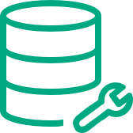


Zerto Cyber Resilience Vault
PRODUCTION
REPLICATION TARGET
VAULT
v C E N T E R
Z V M
v C E N T E R
Z V M
HPE ARUBA
NETWORKING
HOST
HOST
HOST
Encrypted continuous replication
Resilience Automation Server manages port access, air gap, & immutability, etc
V M
V M
V R A
V R A
HPE PROLIANT
RAS
HPE PROLIANT
Inline encryption detection & alerting
D A T A S T O R E
D A T A S T O R E
D A T A S T O R E
Encrypted periodic replication
PHYSICAL
STORAGE
HPE ALLETRA
HPE ALLETRA
Full air gap with port-to-port direct connect
Replica
Immutable snapshots of all replicas, journals, and all Zerto components needed for recovery
Compressed journal
<= 30-day retention

Slide 34



Zerto Cyber Resilience Vault – with backup
PRODUCTION
REPLICATION TARGET
VAULT
v C E N T E R
Z V M
v C E N T E R
Z V M
HPE ARUBA
NETWORKING
HOST
HOST
HOST
VM
VM
VRA
V R A
GLBR
RAS
HPE PROLIANT
D A T A S T O R E
D A T A S T O R E
Immutable backups in the cloud via
HPE GreenLake for Backup and Recovery
DATA SERVICES CLOUD CONSOLE
HPE ALLETRA
HPE ALLETRA
HPE GREENLAKE
Replica
Compressed journal
<= 30-day retention

Slide 35


Zerto Cyber Resilience Vault – recovery
PRODUCTION
REPLICATION TARGET
VAULT
v C E N T E R
Z V M
v C E N T E R
Z V M
v C E N T E R
Z V M
HOST
HOST
HOST
V M
V M
V R A
V R A
HPE PROLIANT
RAS
HPE PROLIANT
D A T A S T O R E
D A T A S T O R E
D A T A S T O R E
PHYSICAL
STORAGE
HPE ALLETRA
HPE ALLETRA
Select apps or
VMs to recover
Select clean checkpoint
from journal
Non-disruptively test and
validate clean restore point
Recover all infected
workloads within minutes
2
Power on vCenter, ESXi, and Zerto VMs
Mount VMFS from immutable snapshot
3
Recover from Zerto journal using clean checkpoint
1
2
3
4
1

Slide 36

Zerto Cyber Resilience Vault ROI
Rapid recovery = less ransomware impact
 | Leading Backup-Based Cyber Vault * | Zerto | Zerto Benefits
Last Good Copy (RPO) | 32 – 56 hours | 4 hours | >87% Reduction
Time to Restore (RTO) | 16 – 18 days | 2 hours | >99% Reduction
Total Ransomware Impact | 20+ days | 6 hours | >99% Reduction
Journal-Based Recovery | NO | YES | Only journal-based solution for cyber recovery
* Real-life example based on customer protecting 300 VMs and 300 TBs

Slide 37
Zerto Cyber Resilience Vault
Unlocking rapid air-gapped recovery
Combines isolated recovery environment with secure data vault using unique zero trust architecture.
No centralized control plane: the vault has no exposed management port and no single point of compromise.
Air-gapped and immutable data copies on secure, high-performance hardware.
Meet compliance and regulatory requirements for security, data vaulting, and disaster/cyber recovery.

Slide 38

























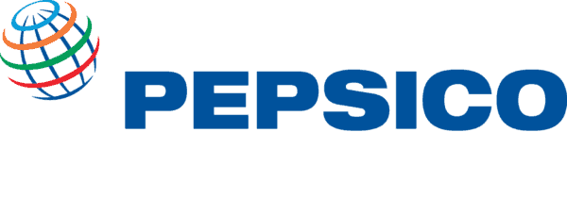





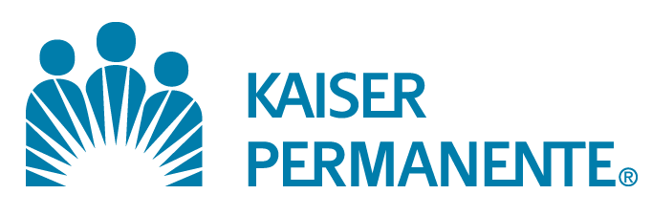



Solving for
any disruption together
Notes:
AMS

Slide 39








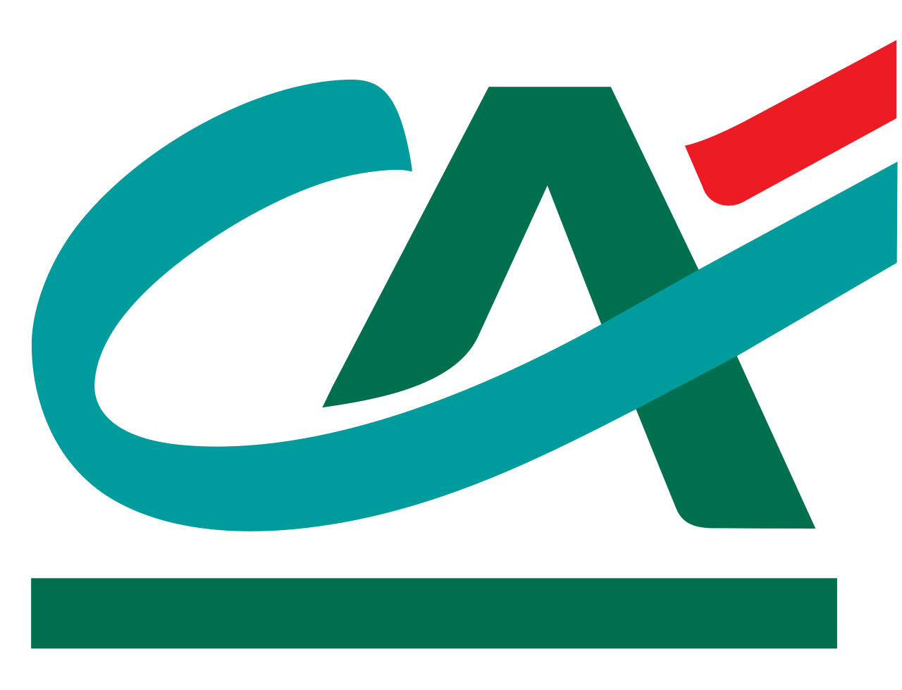


















Solving for
any disruption together
Notes:
EMEA

Slide 40


























Solving for
any disruption together
Notes:
APAC

Slide 41





















Solving for
any disruption together
Notes:
LATAM

Slide 42









Experience HPE and Zerto firsthand
LIVE TAILORED DEMO
HANDS-ON LABS
HPE GREENLAKE FREE TRIAL
HEAR FROM YOUR PEERS
See HPE and Zerto in action with an expert. Email for details:
info@zerto.com
Test drive Zerto for free in
self-paced, on-demand labs:
zerto.com/labs
Try HPE GreenLake free for
90 days:
testdrive.greenlake.hpe.com
Read honest reviews from real customers:

Slide 43
Thank You
a00134979enw

