Slide 1

Fortinet SecOps - Soluții eficiente și flexibile de securitate cibernetică
Silviu Pufan
Sr. Systems Engineer

Slide 2
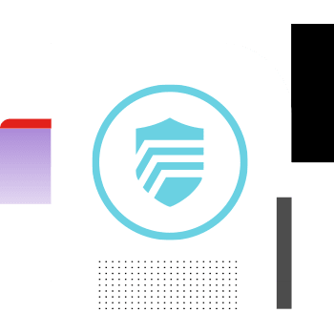
What is SECOPS?
Security Operations
Combination of Security & IT Operations
Highly skilled team focusing on Monitoring Risk Assessment to protect Corporate Assets
Operating from a Security Operations Centre
Notes:
SecOps este un termen utilizat atunci cand se combina/unifica partea de Securitate cu partea Operationala, caz in care discutam despre Functionalitati SecOps, tehnologii SecOps, echipe SecOps

Slide 3




Build a “Target Operating Model Framework”
Availability Monitoring
Reactive
Monitoring
Proactive
Monitoring
Proactive Monitoring
with Automation
Cyber Defense Center, CFC, CSOC
NOC
NSOC/SOC V1
SOC V2
SOC V3
Next Gen SOC
Before 1995
1996 – 2000
2001 – 2006
2007 – 2013
2013 – 2015
2015 – 2020
Present
NOC
Internal SOC
SOC
SOC/MSS
Hybrid SOC
MDR
Network device mgmt.
Malicious code analysis
Virus alerts
Intrusion Detection & Response
Compliance
Incident response
Regulatory compliance
Log monitoring
Malware Analysis
Reverse engineering
AI/ML models
Threat intelligence
Threat hunting
Automation
Orchestration
Playbooks
Analytics
External risk scoring
Notes:
In ce masura sunt nceseare si adoptate tehnologiile, functionalitatile sau procedurile SecOps ?

Slide 4
Services of modern CDC
Security event monitoring, detecting, investigating, triaging
Malware analysis, reverse engineering, digital forensics, insider threats, cyberfraud
Threat intelligence platform management
Threat hunting
Content management
Threat and vulnerability management
Compliance
Reporting and notifications
Training
Identity and access governance

Slide 5

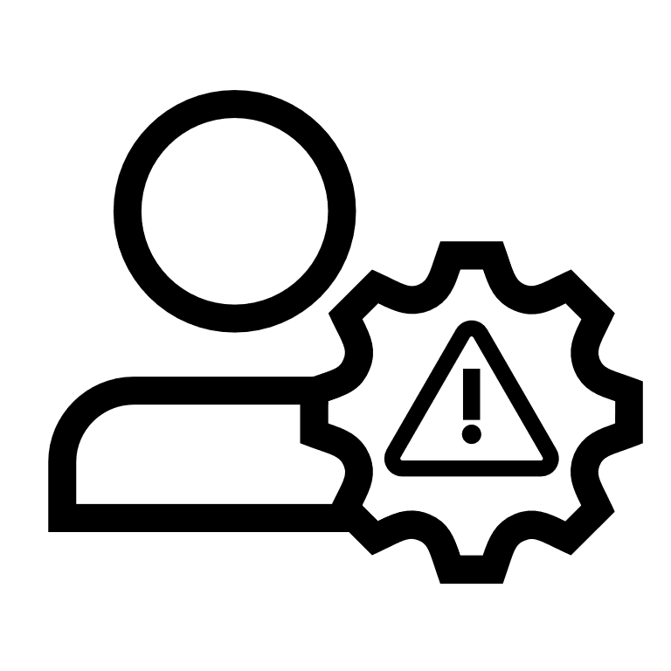

Not Keeping Up
Limited Resources
Slower Reaction
With The Threat Landscape
Straining SOC Teams
= Higher Risk & Cost
SOC as a Service Market is forecast to grow to 10.1B by 2027
Notes:
According to the 2022 annual Cyberthreat Defense report, "3.5 million cybersecurity jobs will remain unfulfilled through 2025." Today many small and mid-size organizations need the cybersecurity skills and staff to build, maintain, and operate a 24*7 security operations center (SOC). Although IT teams configure and deploy defensive layers to protect the business, the threat landscape can change within hours because Cybercriminals never take a break. They're always on and continue to advance tactics speeding attacks by weaponizing Artificial Intelligence (AI). Without a modern around-the-clock SOC to continuously protect, detect and rapidly adapt, ensuring existing investments keep pace, an organization faces higher risk on multiple fronts.
In terms of some of the newer, troubling trends, is an uptick in what we would call more Aggressive Tactics -- for instance, covering tracks and obfuscating movement by just wiping systems as they go without as much concern for stealthiest. The As-A-Service model has become popular, greatly reducing start-up costs and time-to-market for new ransomware strains and family extensions.
And AI is being weaponized, enabling a significant reduction in the time it takes to establish a foothold, find their targets, and execute. Anyone stuck in the SOC trenches with manual investigation and response tactics is going to have an increasingly hard time, and we've already seen that the average breach cost to an organization without fully deployed security automation is multiples greater than those that are leveraging security automation Too much noise is hitting an increasingly stretched SOC team, limited by resources on both fronts, skilled staff, and technology hindering them from building, maintaining, and operationalizing 24*7*365 Security Operation Center (SOC). This presents a higher risk to the organization. As a result, they are looking for ways to automate and outsource to reduce risk and increase scale.

Slide 6


SOCaaS Market Opportunity
$10.1B
2027
$10.1 Billion
By 2027
$6.1B
TODAY
10.5% CAGR
Growth attributed to advanced threats, breaches, & talent
Top three verticals
  Education
  Retail
  Healthcare
Notes:
https://blogs.idc.com/2021/02/17/understand-the-difference-between-managed-security-services-managed-detection-and-response-and-soc-as-a-service/
With organizations needing more help in advanced security functionality, especially around SIEM, organizations were forced to have either a security team in-house to do their own SIEM tuning, configurations, and updates or turn to a service provider that provided a managed SOC. A managed SOC is a central center that combines a team of security experts and 24X7X365 support of round the clock monitoring and management of security services. Organizations can outsource a set of security functionality to a SOC team, including those such as SIEM, vulnerability management, endpoint security, and other detection and response tools. Managed SOC models can be deployed in a co-managed or fully managed/outsourcing of security.
A managed SOC or SoC as a service, the “as a service” piece sometimes alludes to the fact that first of all, it’s a service, and second, it is a cloud-based platform and/or cloud-hosted or multitenant. That is not to say that the provider would not manage and monitor a customer’s premise equipment (CPE – Based) but the monitoring and response pieces can be done by a managed SOC or SoCaaS

Slide 7
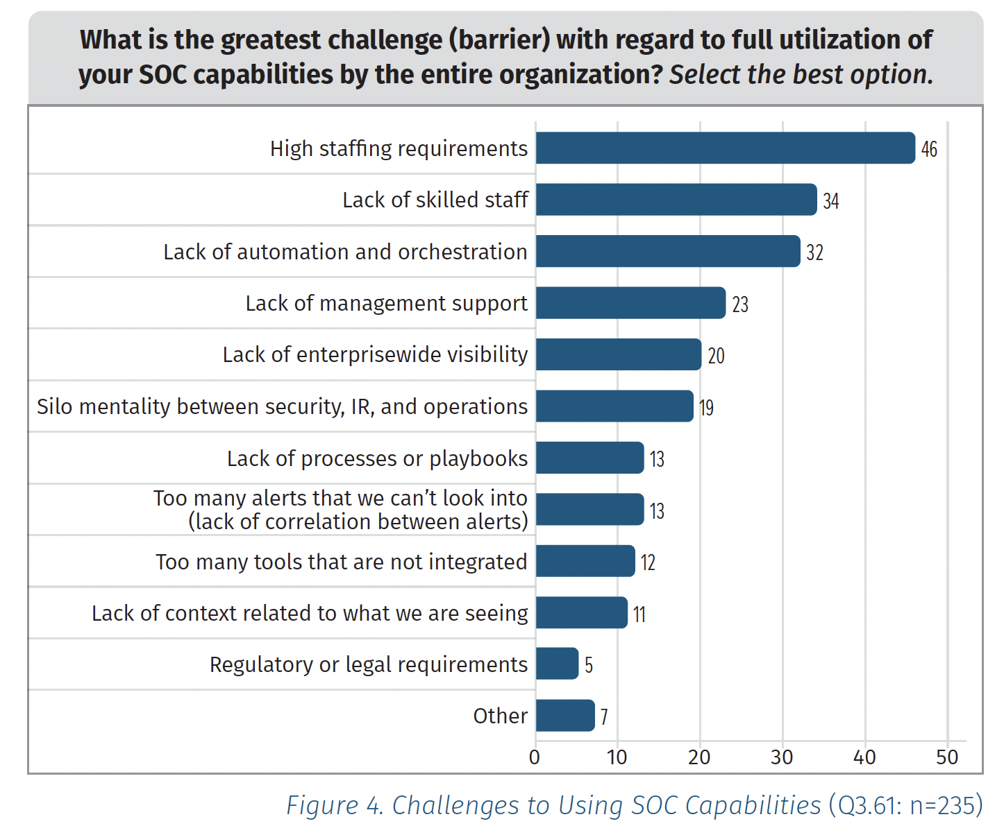
The State of the SOC
SOC Analyst burnout
  False positives
  Staffing & skills shortage
Inadequate tooling
  Lack of automation and integration
  Little information optimization
  Process latency
Inadequate processes
  Unclear or missing use cases/playbooks
  Lack of context, understanding of TTPs
Insufficient authority
  Improper budget allocation
  Insufficient visibility and reporting of value and ROI
SANS 2022 SOC Survey
Other sources:
1 Top 4 Reasons Analysts Quit Their Jobs, Arcanna
2 Top Challenges SOC Teams Need to Address in 2021, ITSecurity Wire
Notes:
SANS stands for "SysAdmin, Audit, Network, Security". The SANS Institute is a private organization that provides cybersecurity training and certification programs, as well as research and information security resources to help organizations improve their cybersecurity defenses. The organization was founded in 1989 and has since become a leading authority in the field of cybersecurity, with a focus on practical, hands-on training and education.
SOCs everywhere are challenged with key issues that are common among them.
According to Gartner, “Many [SOCs] have yet to achieve their desired maturity level and target operating model. For those who have achieved their ideal maturity level, they still must react to changes like more evolving threat landscapes; digital business initiatives; and mergers and acquisitions.”¹ During our own SOC product conversations, Fortinet prospects and customers have shared many of the typical SOC challenges as echoed in the public discourse. Collectively, the market is acknowledging that SOCs need and want assistance to improve their operations. Having a good place to start, a framework by which to measure progress, and other resources may be needed and this is where our SOC Assessment service can be valuable to customers and their SOC functions/teams.
¹ Tips for Selecting the Right Tools for your Security Operations Center, Gartner, 2022

Slide 8
CxO Challenges Today
Gartner Cybersecurity MESH Architecture (CMSA) vs Fortinet Fabric
DLP
SOAR
EASM
SOAR
SIEM
EASM
IAM
CASB
IAM
CASB
XDR
EMAIL
XDR
EMAIL
Cybersecurity Point Products
Cybersecurity Platform Approach
EPP
EDR
SIEM
WAF
EPP
EDR
WAF
20 Vendors
ZTNA
CWP
ZTNA
CWP
4 – 6 Platforms
NAC
vFW
NAC
vFW
LAN
NGFW
SWG
LAN
NGFW
SWG
Current IT architecture are impossible to make sense off
To many products, to many platforms, to many dependencies
The real (net) result is that your teams are killing themselves to the task of just see what you have
Just embrace everything you have in one single visibility

Slide 9









Build a “Target Operating Model Framework”
Technology
SecOps Platform
EDR/XDR, SIEM, SOAR,
Deceptor, NDR, Recon
Align
Partners
Compliance or Framework
Organization
Process
Incident Response
Forensics Metrics and Reporting
Threat Intelligence
Threat Hunting
Post Infection Review
Digital Playbooks
Invest
People
Process
Technology
Measure
People
FortiGuard Incident Readiness & Response Services
Managed Detection and Response
State
Threat
Efficacy
Notes:
<dd> option 1

Slide 10







Aligned to Cybersecurity Standards
International cyber security standards
with a focus on the ISO/IEC27001 and the NIST Cybersecurity Framework
Identify
Respond
Data and systems that need to be protected are identified.
Identify
Protect
The response phase requires a company to devise a plan for responding to a threat. The plan will include the different methods used to mitigate the threat, as well as which tools will be used.
Protect
Team puts security measures into place to safeguard the data. These will often involve specific tools, hardware, and software designed to address common security concerns.
Cybersecurity Framework
Recover
In the event an attack penetrates the network, the process outlined by NIST also includes ways of helping an organization recover as quickly as possible.
The Core
Recover
Detect
Detect
Tools and policies are designed to discover an incident when it happens.
Respond
Notes:
National Institute of Standards and Technology (NIST)

Slide 11
SOC Toolset Technical Focus
Identify
Identify
Recover
Protect
Recover
Protect
FortiSIEM
FortiEDR
(endpoint)
Respond
Detect
Respond
Detect
Identify
Identify
Recover
Protect
Recover
Protect
FortiSOAR
Advanced Network Security
(E.g. Fortinet Security Fabric)
Respond
Detect
Respond
Detect
Categories based on NIST Cybersecurity Framework
https://www.nist.gov/cyberframework

Slide 12

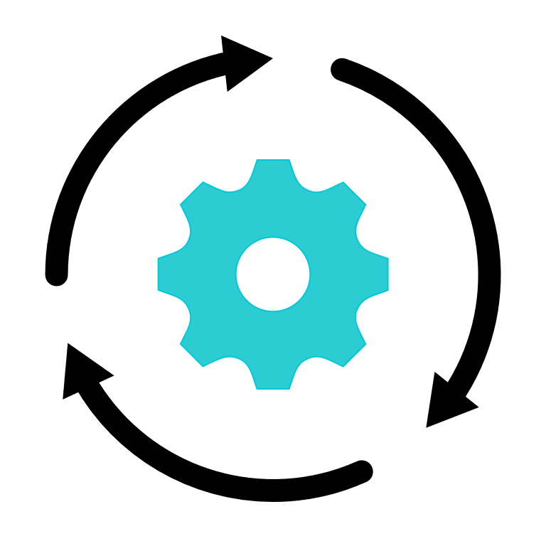
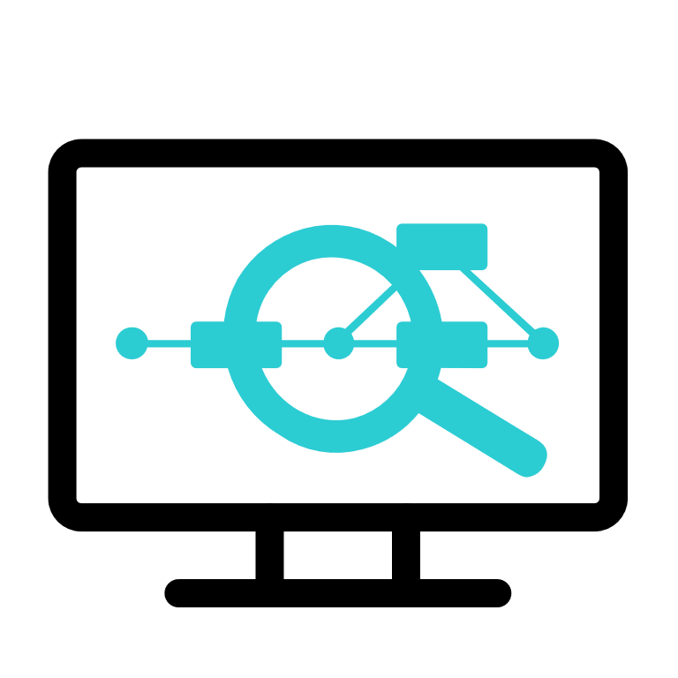

Comprehensive Functionality
Identify
FortiSIEM
Recover
Protect
FortiSOAR
Comprehensive Coverage
for
Infrastructure & Endpoint
FortiEDR
Fortinet Security Fabric
Respond
Detect
Categories based on NIST Cybersecurity Framework
https://www.nist.gov/cyberframework

Slide 13
















Security Operations Vision
Speed Operations With AI-Powered Analytics, Automation and Augmentation
FortiEDR
Key use cases
Attack Surface Reduction
NGAV
EDR/ XDR
Ransomware Protection
Compromise Assessment
SOC Assessment
Tabletop Exercises
FortiAnalyzer
Key use cases
Fabric Visibility
Fabric Analytics
Fabric Automation
SOC as a Service
Key use cases
Managed Firewall and Endpoint
Alert Triage
Managed Detection & Response
Key use cases
Endpoint Detection and Response
Threat Hunting
Alert Triage
FortiSIEM
Key use cases
Multi-vendor Visibility
Advanced Analytics
Incident Management
Managed SOC
SOC Platform
Incident Response Service
Key use cases
Identify and contain incidents
Scope and remediate
Breach Protection
FortiSOAR
Key use cases
Multi-vendor Automation
Process Orchestration
Threat Intelligence Management
Security Awareness & Training
Key use cases
Automated phish testing
Integrated user training
FortiDeceptor
Key use cases
Detect Reconnaissance
Engage Ransomware
Identify Lateral Movement
FortiNDR
Key use cases
Detect Anomalies
Analyze Malware
Automate Response
FortiInsight(UEBA)
Key use cases
Identify Insider Risk
Detect compromised accounts
FortiRecon
Key use cases
Map the attack surface
Detect threat infrastructure
FortiTester
Key use cases
Assess security posture
Identify gaps

Slide 14


Cybersecurity Maturity Levels Mapping
FortiAnalyzer
FortiSIEM
FortiDeceptor
Level 1 - Secure
Initial
Level 2 - Defend
Managed
Level 3 - Contain
Defined
Level 4 - Monitor
Quantitatively Managed
Level 5 - Manage
Optimizing
FortiGate
FortiNAC
FortiXDR
FortiSandbox
FortiNDR
FortiSOAR
FortiGate
FortiEDR
3rd Party
Technology
FortiAuthenticator
3rd Party
Levels of Protection
FortiSwitch
FortiToken
FortiClient
Asset Inventory, Data Flows, Risk Assessment, Vulnerability Management, Secure Remote Access, PKI
Technology Gap
Threat Intelligence, SOC Integration, SOAR
Based on CMMI, NIST, ARC
Cybersecurity Maturity

