Slide 1
VMware Ransomware Recovery
Click to edit optional subtitle
Cristian RADU
Lead Solution Engineer

Slide 2
VMware Cloud Disaster Recovery
DRaaS for VMC on AWS

Slide 3
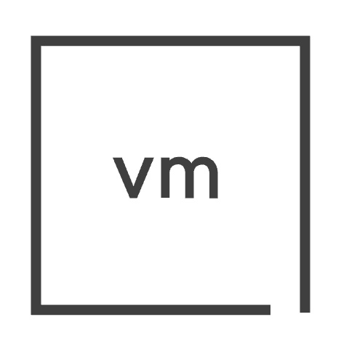
Ransomware Recovery for VMware Cloud DR
Two use cases for the same SaaS platform
Disaster Recovery:
Scale Out for
Point In Time DR
Replication
Live Mount
NFS
DRaaS Connector
Instant Power-on
SaaS Orchestrator
Cloud File System
VMFS / NFS / vSAN / vVols
SDDC Cluster(s)
Delta-based
Recovery
VMware Cloud on AWS
Recovery Target
(On-Demand or Pilot Light)
Ransomware Recovery:
Per VM Isolated Recovery Environment
Production Site
VMware Cloud Disaster Recovery
Green: Steady-state operations Purple: Activated for tests, failovers, failbacks

Slide 4
VMware Cloud Disaster Recovery Deployment Steps
Building the solution from start to ready
Customer Site
VMC on AWS
vCenter
DRaaS Connector
Software setup
Orchestrator
vCenter
SDDC
Scale-out Cloud
File System
Groups of VMs recovered together
Protection Groups
Protection Groups
Resources: networks, folders, resource pools, datastores
Resources: networks, folders, resource pools, datastores
Site pairing mapping
One or more Protection Groups
DR plans
DR plans

Slide 5
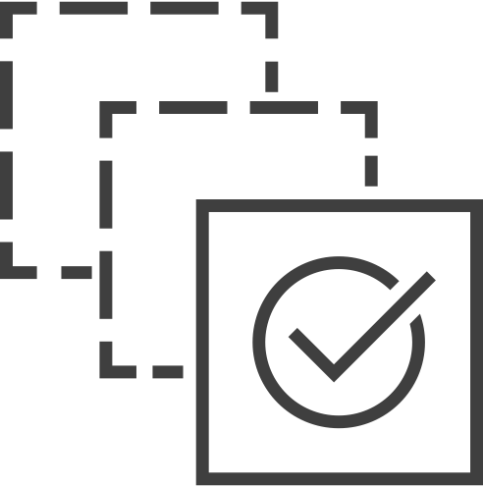
Protection Groups
Policy based automation for VM recovery points replicated to the cloud
Flexible policies
VM names, folders, tags
Multiple schedules
Defined retention levels
Any datastore
vCenter
DRaaS Connectors
Selection
Scheduling
App1 PG
App2 PG
App3 PG
Retention

Slide 6
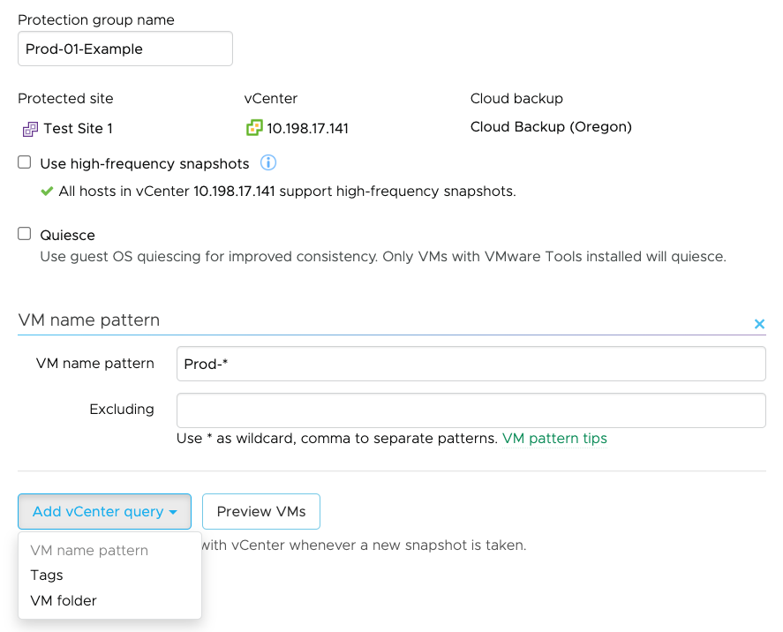
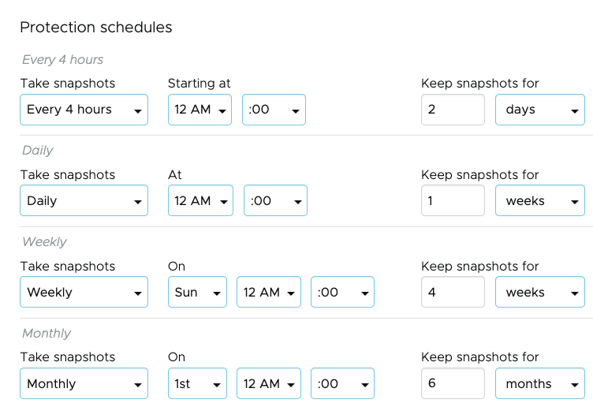
Protection Group Policy Example
Ransomware considerations – retention levels
Scope
Granularity
Selection criteria
Type
RPO SLA
Frequency
Retention
Recovery Points

Slide 7
Recovery Plan Structure
Defines the what, where, how, and when
General
Scope
General, sites, groups
Mappings
vCenters, folders, compute resources, virtual networks
Customizations
IP addresses, scripts
Sequence
Recovery steps
Ransomware
Integration setup
Alerts
◆ General
◆ General
Sites
Sites
Plan name
Groups
Groups
vCenters
vCenters
vCenter folders
Description
vCenter folders
Compute resources
(optional)
Compute resources
Virtual networks
Virtual networks
IP addresses
Failover site type
IP addresses
Script VM
Failover to SDDC on VMware Cloud on AWS
Failover to VMware software-defined datacenter. Requires schedule replication to the linked SCFS.
Script VM
Recovery steps
Recovery steps
Ransomware
Ransomware
Alerts
Alerts

Slide 8
Manage Failover Sequence / Priority
Plan recovery steps define order of orchestration events
Recovery steps
Recovery step placement:
Protection Group
Individual VMs
Special actions
◆ General
◆ General
Choose the virtual machine recovery steps
Sites
Add step
Edit
Delete
Sites
Groups
Groups
Recover Worker2020
Recover VMs: Worker2020
Power on only VMs that were powered-on when snapshotted
vCenters
vCenters
vCenter folders
Recover protection group Demo
Recover VMs: Demo VMs
Power on all recovered VMs
vCenter folders
Compute resources
Compute resources
Virtual networks
Recover App1-VM-test
Recover VMs: App1-VM-test
Do not power on VMs
Virtual networks
IP addresses
IP addresses
Script VM
Wait for App1 to be ready
One or more standalone actions
Script VM
Recovery steps
Recover protection group WorkerVMs
Recover VMs: WorkerVMs
Do not power on VMs
Ransomware
Ransomware
Alerts
Alerts

Slide 9
VMware Ransomware Recovery
Add-on Solution to VMware Cloud DR

Slide 10
Yesterday’s Recovery Solutions Can’t Address Today’s Challenges
Ransomware Evolution
1989
2010
2017
2023
First ransomware attack discovered
Birth of Bitcoin
First ransomware fileless attack
Ransomware costs organizations over $4.5M/breach
Ransomware 1.0
Modern Ransomware
Snapshots
Backups
Offsite copies
Storage immutability
Next-Gen Anti-Virus w/ Behavioral Analysis
Air-gapping
Secure Isolated Recovery Environment
Traditional file scanning
Prevent reinfection and lateral movement
Not Enough
Required

Slide 11
Ransomware Recovery Is a Critical Last Line of Defense
NIST Framework
Identify
Protect
Detect
Respond
Recover
Preventative Measures
Ransomware Recovery
Security Team
Infrastructure Team
National Institute of Standards and Technology
https://www.nist.gov/cyberframework

Slide 12
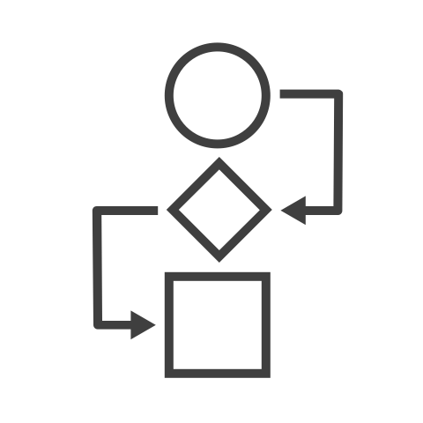
Top Challenges in Ransomware Recovery
DR SLAs
Data Loss
Downtime
Re-infection of production workloads
Complex and manual operations
Inability to properly validate recovery points
Lengthy recovery point iterations
Source: IDC, customer interviews

Slide 13
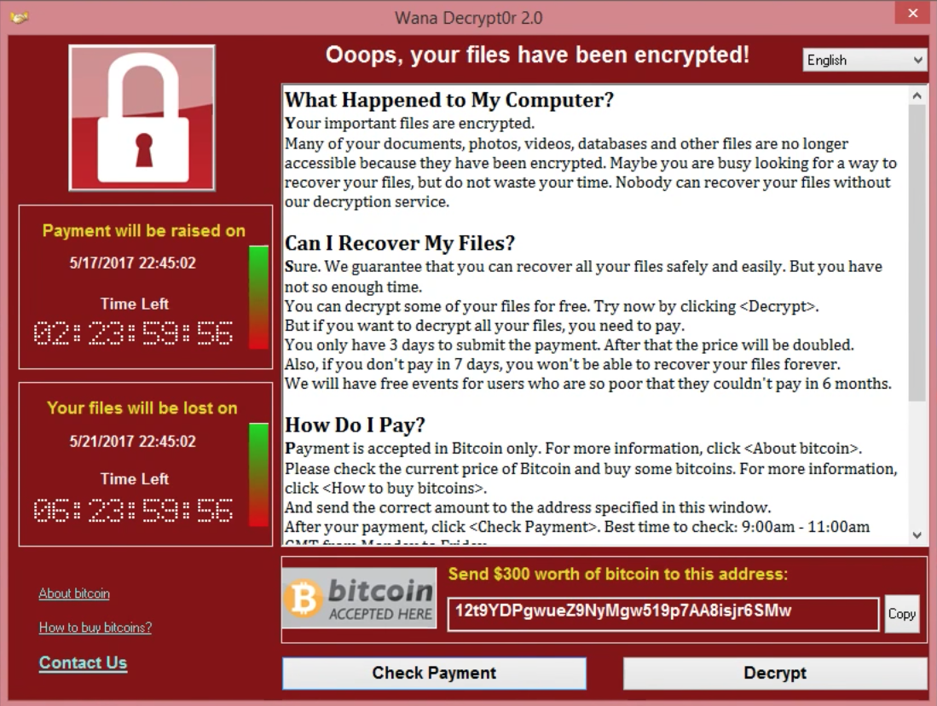
Ransomware Recovery
Recovery of VM + Recovery of Data = Clean VM with Recent Data
Identified Ransomware Infection
Protection Schedules
Week 12
. . . . . .
Week 6
Week 5
Week 4
Week 3
Week 2
Week 1
Daily
Hourly
Recovered VM +
Recovered Data

Slide 14
VMware Ransomware Recovery for VMware Cloud DR
A purpose-built, industry leading Ransomware Recovery as-a-Service solution
Air-gapped, immutable recovery points
New
Guided restore point selection
Preserve data integrity of restore points
Confidently assess and identify recovery points
Instant VM Power-On
On-demand IRE and VM network isolation
New
Conduct rapid recovery point iterations
Prevent reinfection at recovery
New
Ransomware recovery workflow
New
Next-Gen AV + Behavioral Analysis
Streamline recovery with a step-by-step guide
Embedded in a single UI

Slide 15
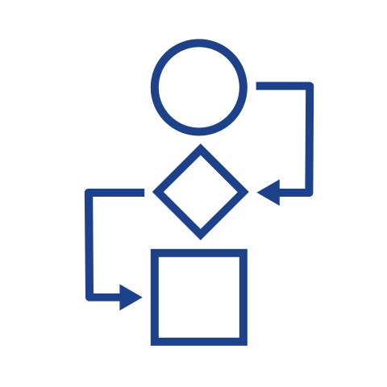
Introducing VMware Ransomware Recovery
Recover from an attack faster, with more predictability, and with less errors
Streamline and automate operations with a dedicated ransomware recovery workflow
Identify recovery point candidates with guided selection
Rapid iterations with instant VM power-on
Air Gapped
Immutable Storage
Validate recovery points with embedded behavioral analysis
Delta-based
Recovery
VMware Ransomware Recovery
VMware Cloud on AWS
Production Site
Prevent reinfection with an on-demand Isolated Recovery Environment
(Quarantined)

Slide 16
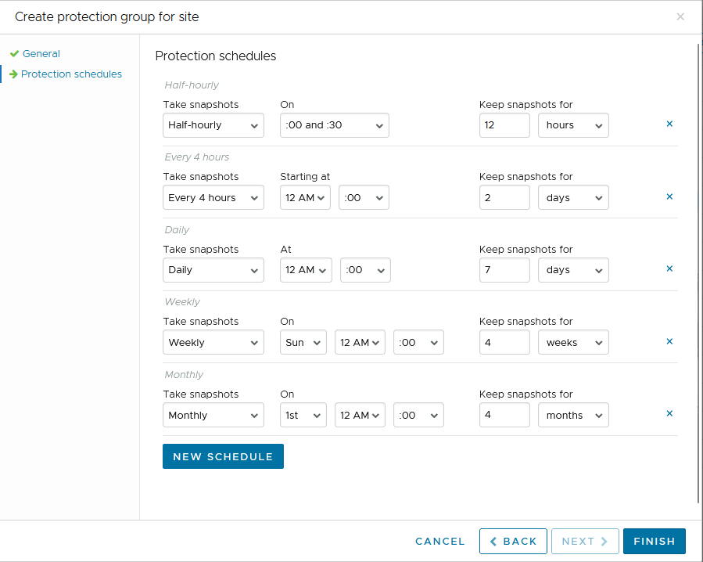
VMware Ransomware Recovery in Action
Configure adequate snapshot retention
Activate Isolated Recovery Environment
Guided restore point candidate selection
Restore from snapshot and scan workload
Evaluate using Behavioral Analysis
Final inspection and curated image build
Recover

Slide 17
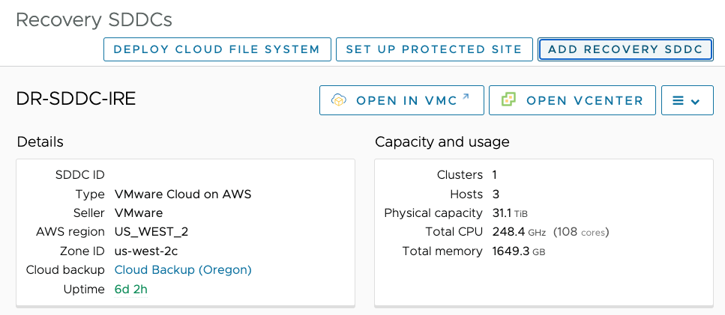
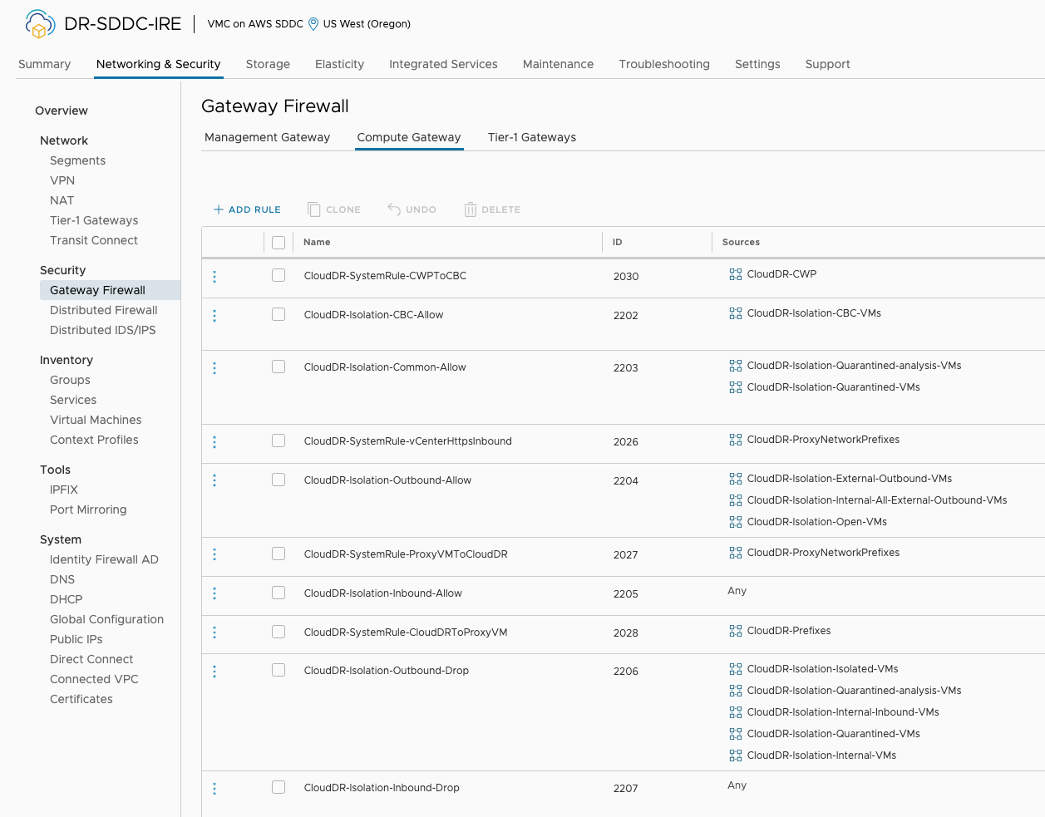
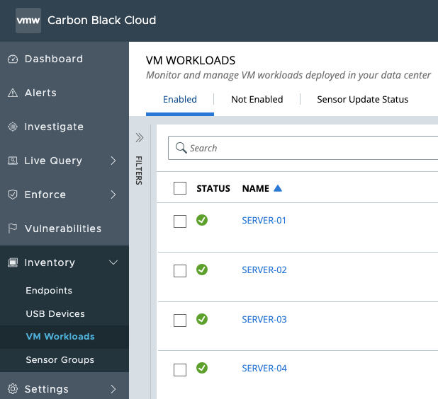
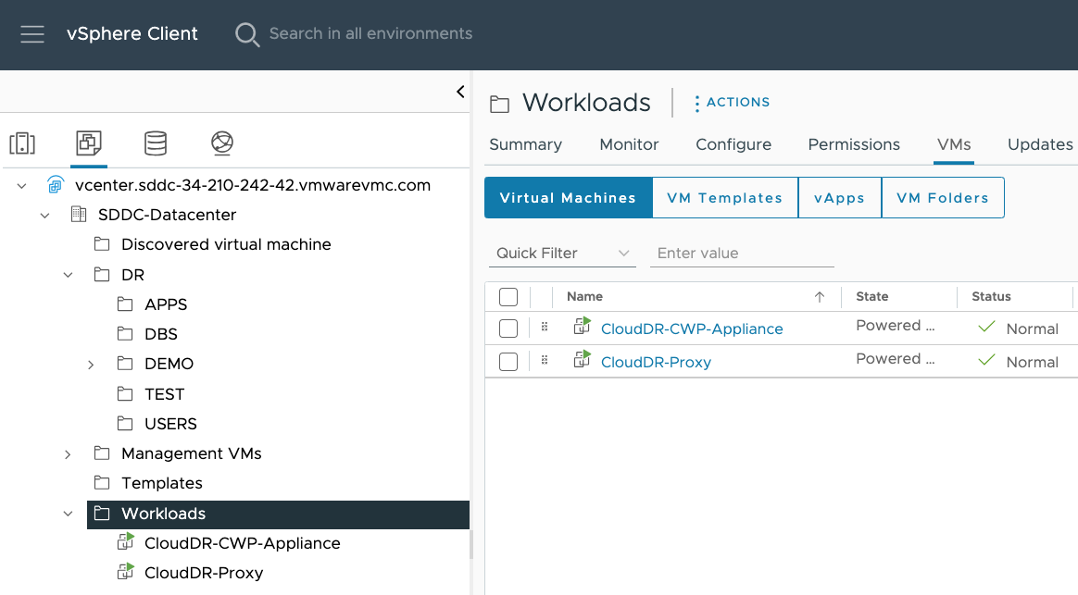
VMware Ransomware Recovery in Action
Configure adequate snapshot retention
Activate Isolated Recovery Environment
Guided restore point candidate selection
Restore from snapshot and scan workload
Evaluate using Behavioral Analysis
Final inspection and curated image build
Recover

Slide 18
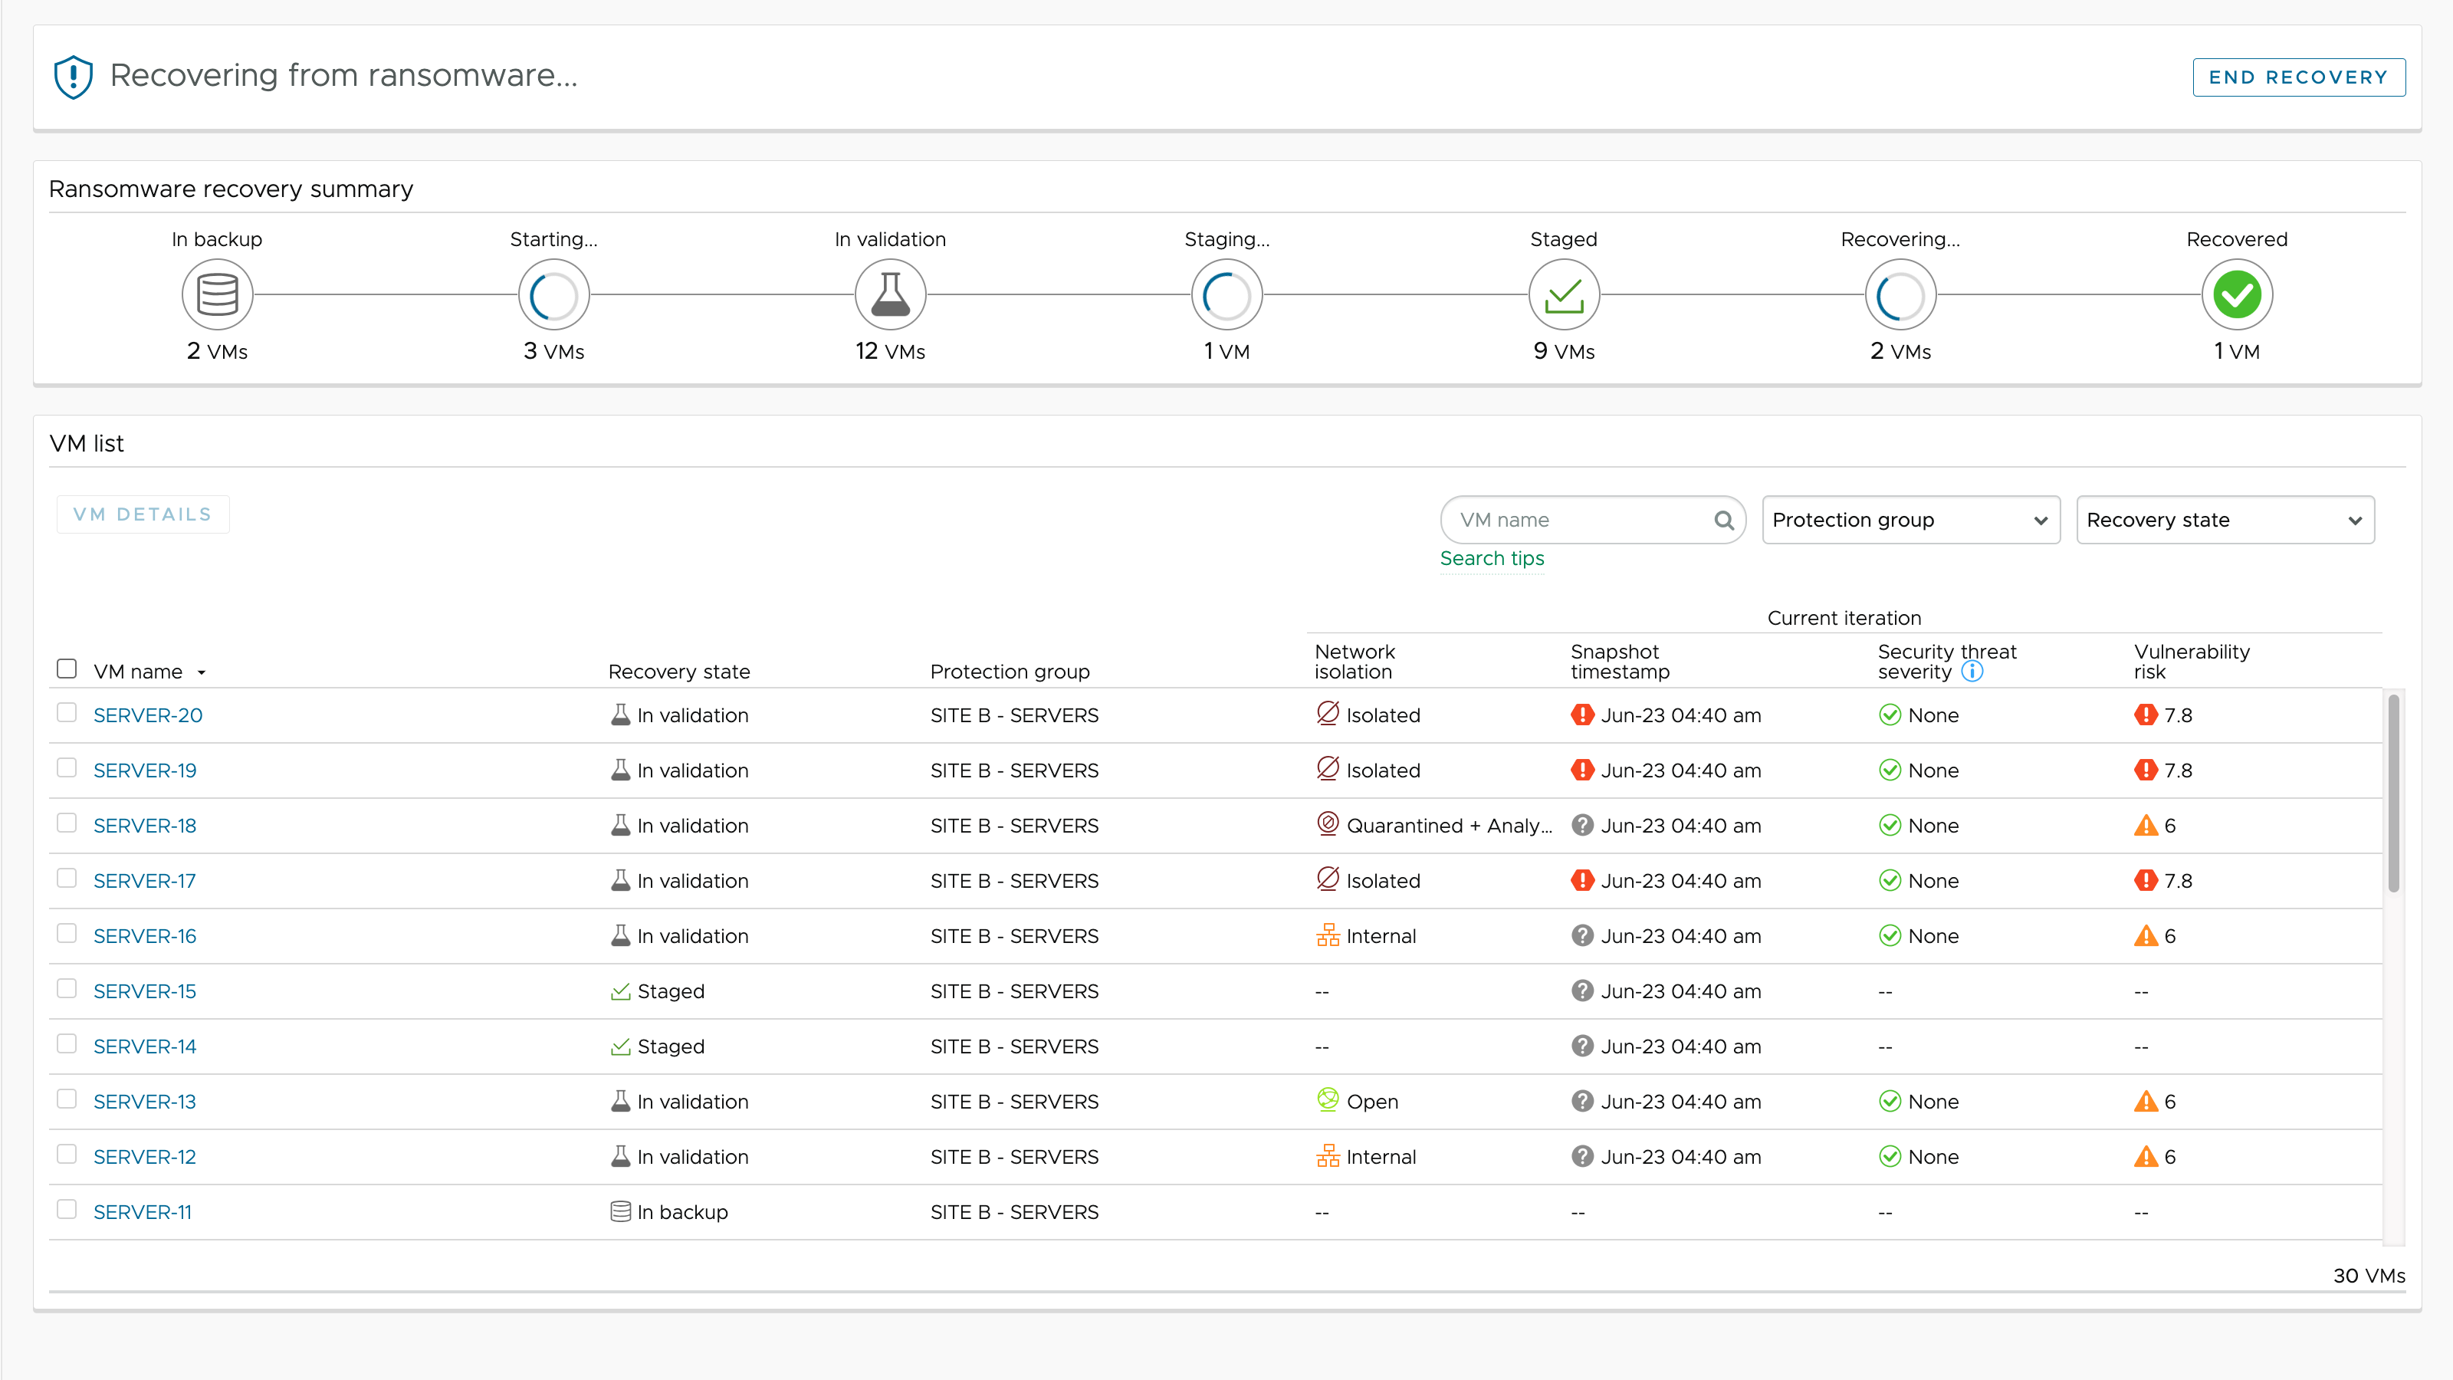
VMware Ransomware Recovery in Action
Configure adequate snapshot retention
Activate Isolated Recovery Environment
Guided workflow / Recovery point selection
Restore from snapshot and scan workload
Evaluate using Behavioral Analysis
Final inspection and curated image build
Recover

Slide 19
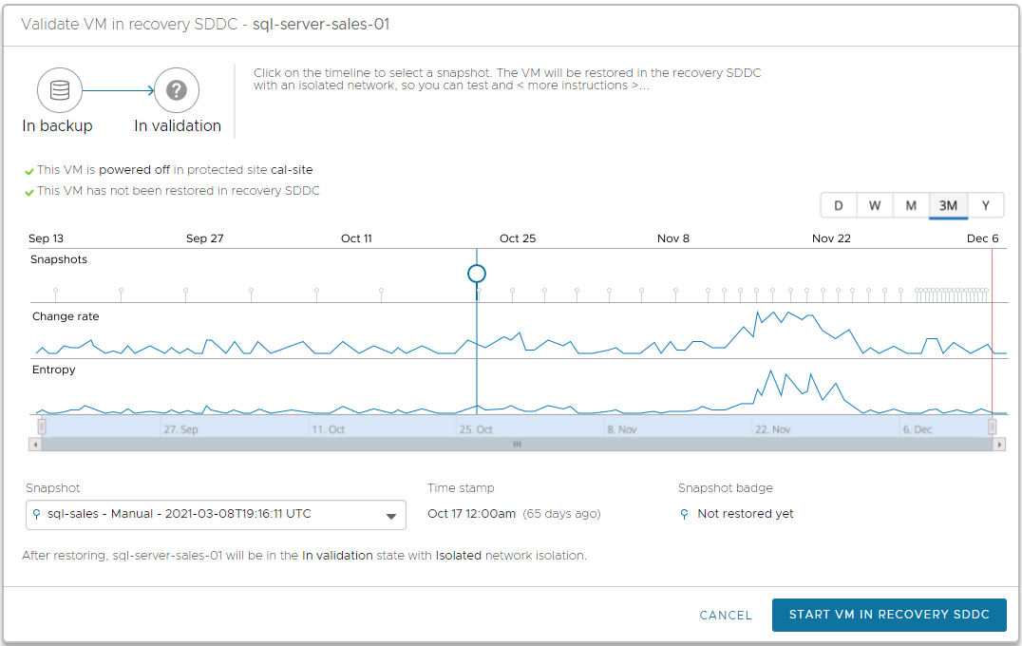
VMware Ransomware Recovery in Action
Configure adequate snapshot retention
Activate Isolated Recovery Environment
Guided workflow / Recovery point selection
More Data Loss
Higher Risk
Encryption Event
Restore from snapshot and scan workload
Evaluate using Behavioral Analysis
Final inspection and curated image build
Recover

Slide 20
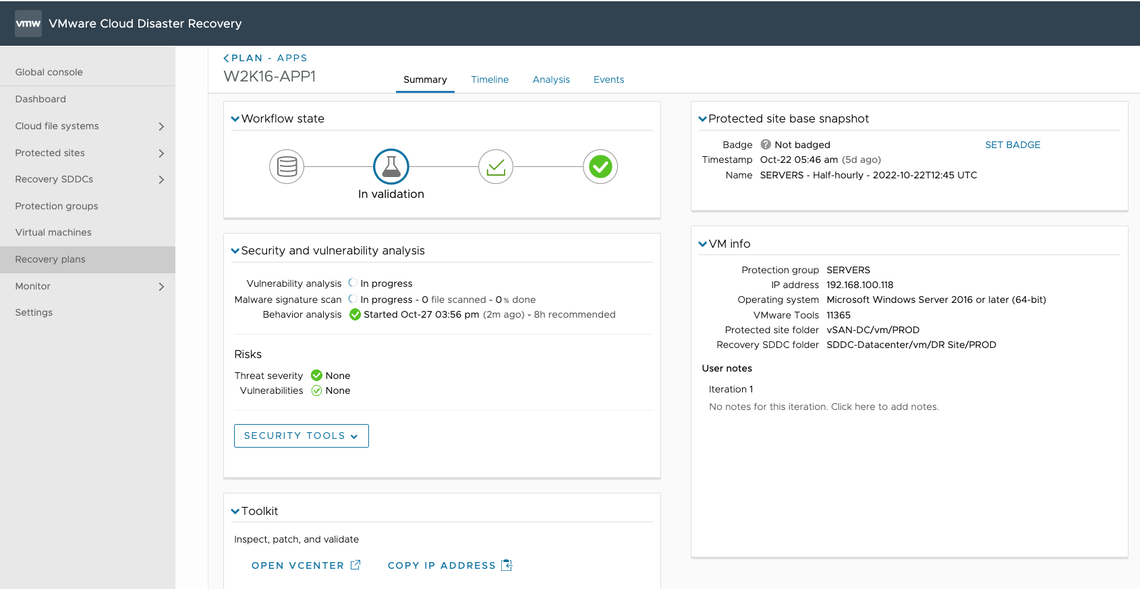
VMware Ransomware Recovery in Action
Configure adequate snapshot retention
Activate Isolated Recovery Environment
Guided restore point candidate selection
Restore from snapshot and scan workload
Evaluate using Behavioral Analysis
Final inspection and curated image build
Recover

Slide 21
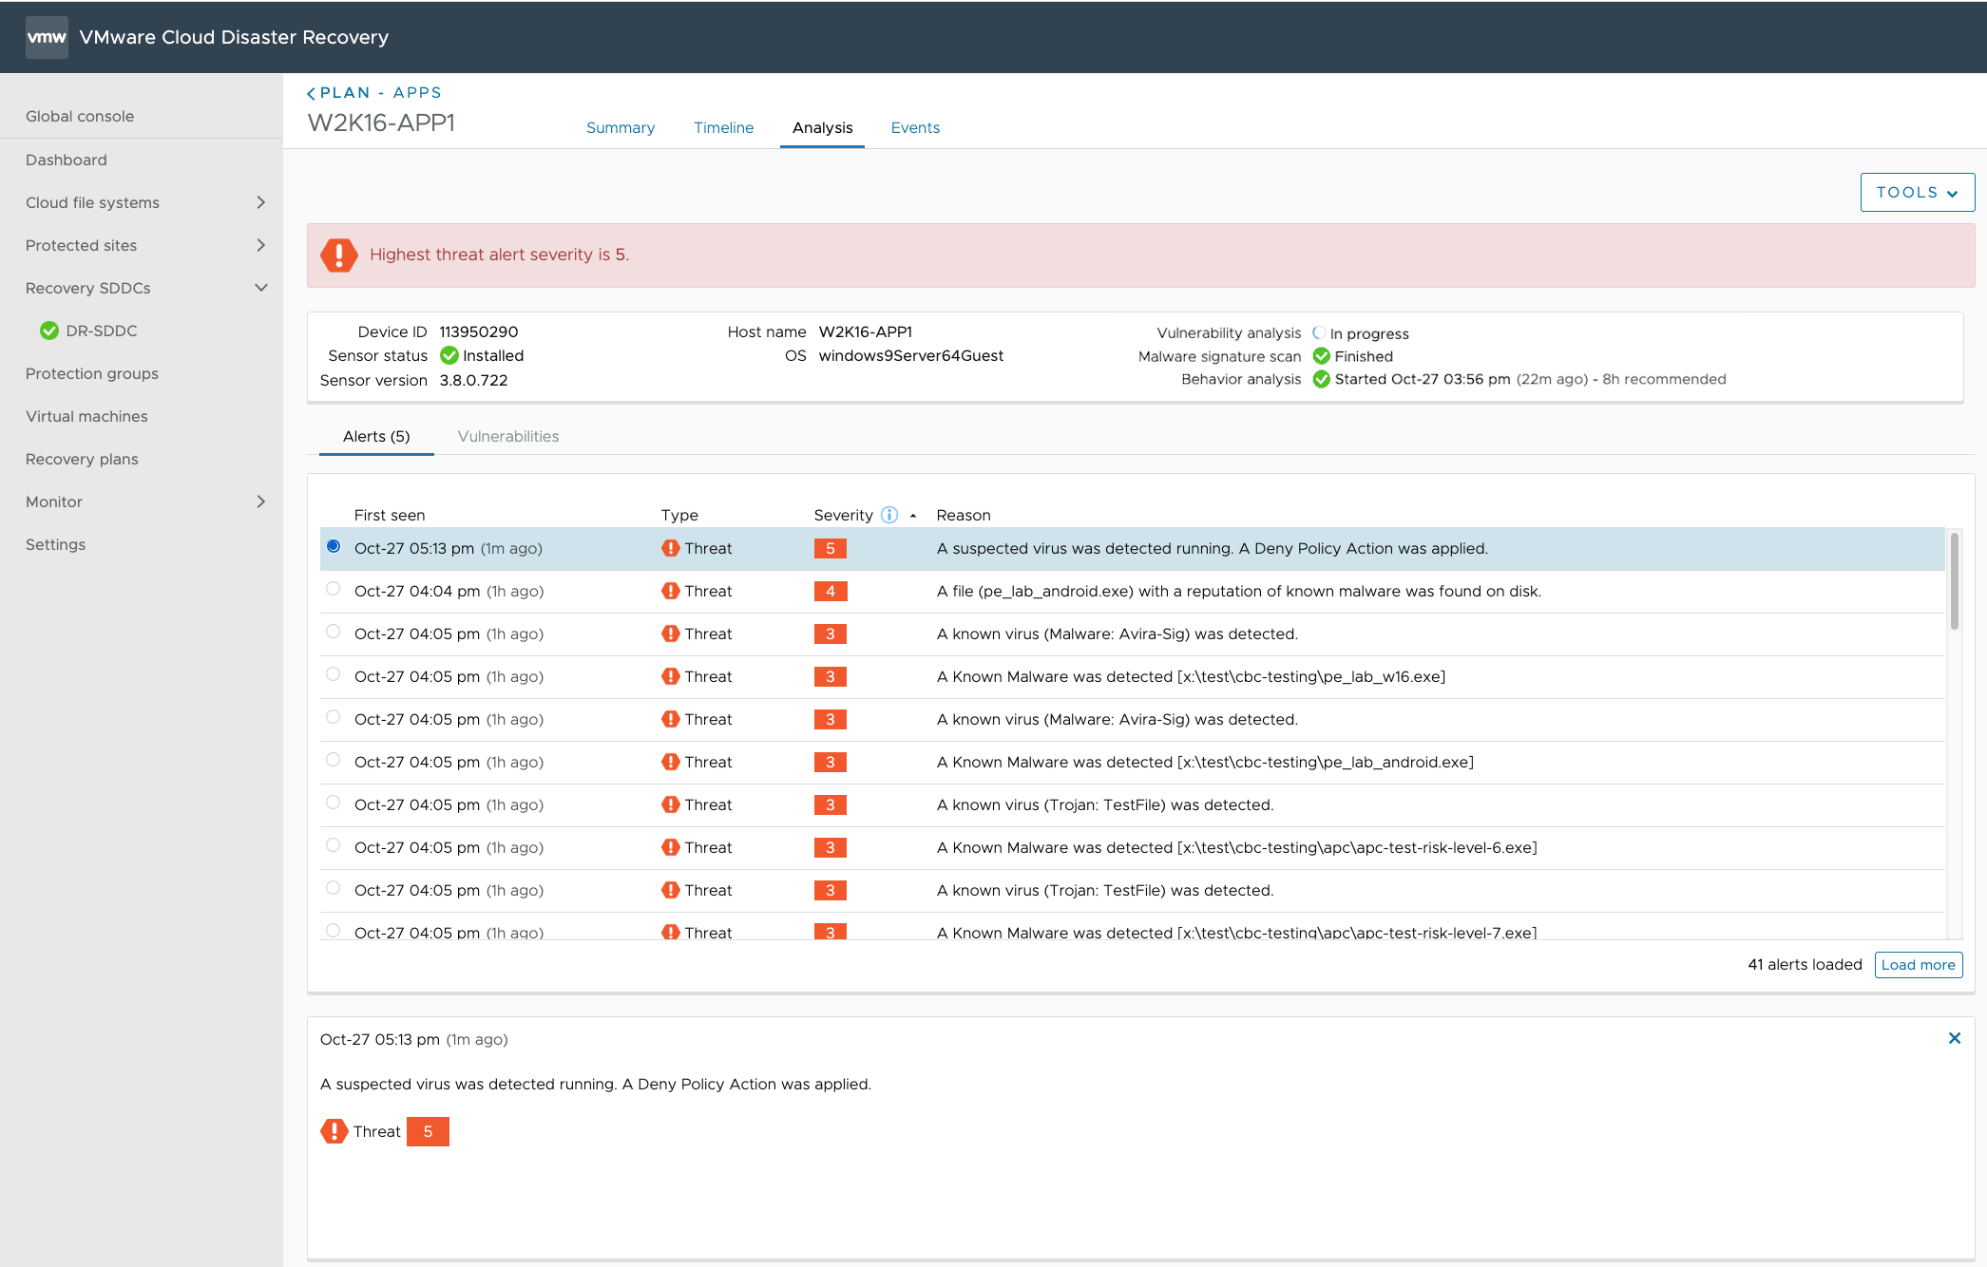
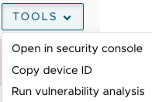
VMware Ransomware Recovery in Action
Configure adequate snapshot retention
Deep-dive into Alerts and Vulnerabilities
Activate Isolated Recovery Environment
Guided restore point candidate selection
Restore from snapshot and scan workload
Evaluate using Behavioral Analysis
Fileless Script and Code Injection alerts
Final inspection and curated image build
Recover

Slide 22
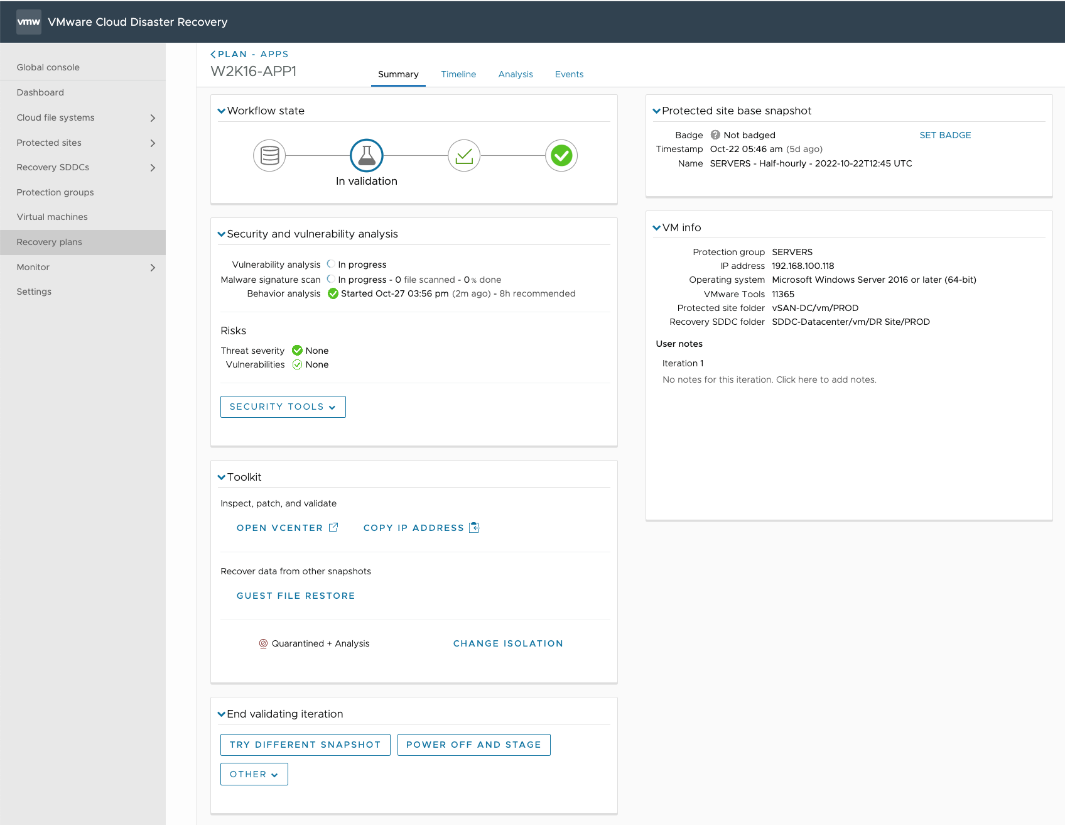
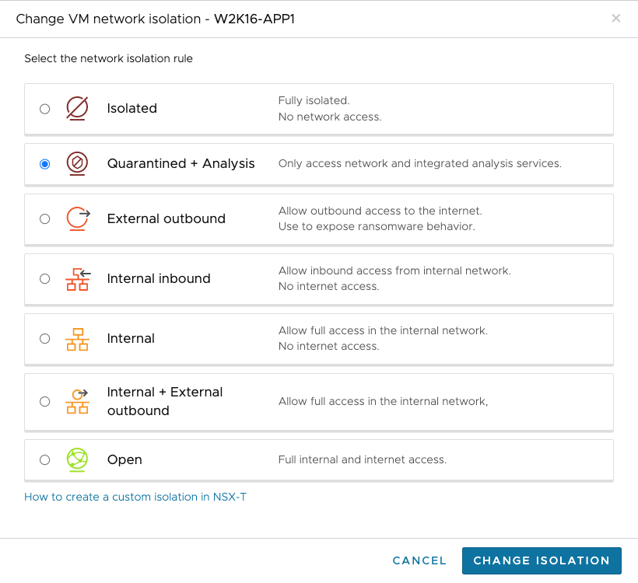
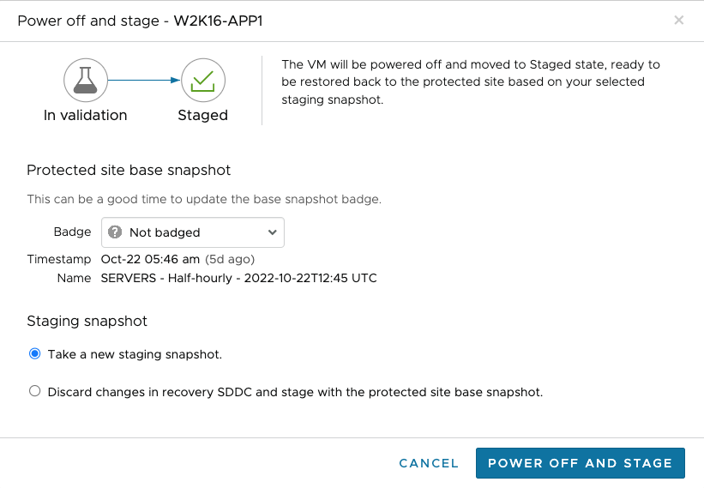
VMware Ransomware Recovery in Action
Configure adequate snapshot retention
Activate Isolated Recovery Environment
Mark recovery point
Guided restore point candidate selection
Inspect VMs in IRE / Recovery SDDC
Restore from snapshot and scan workload
Evaluate using Behavioral Analysis
Restore files from other snapshots
Final inspection and curated image build
Push Button Isolation control
Recover
Stage recovery point with changes

Slide 23
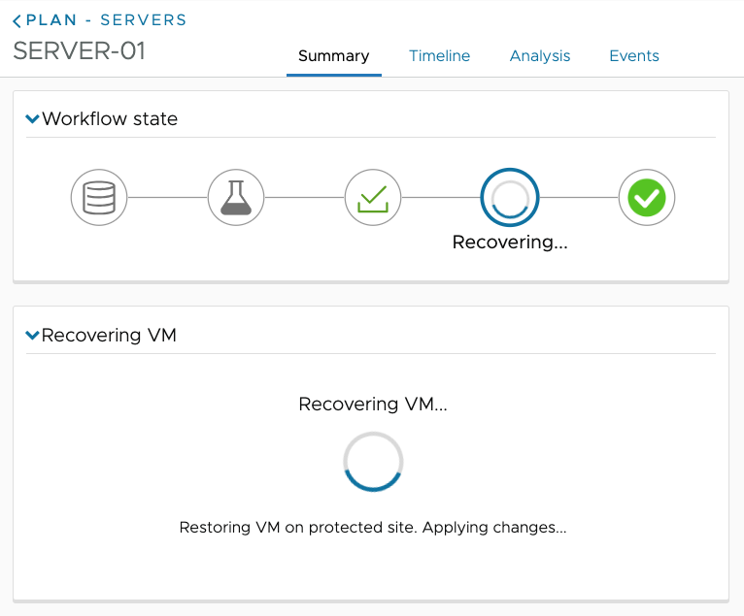
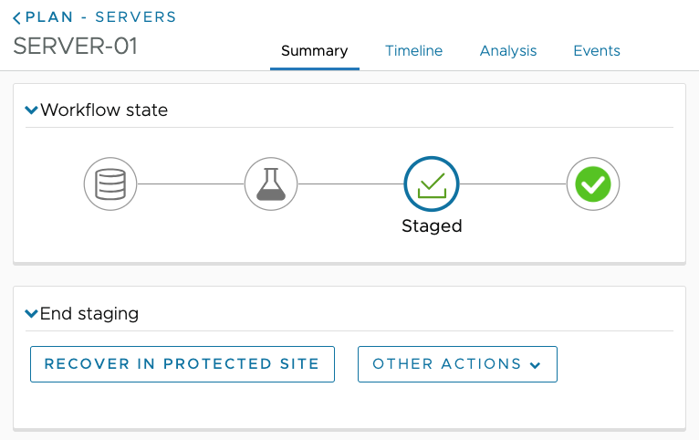
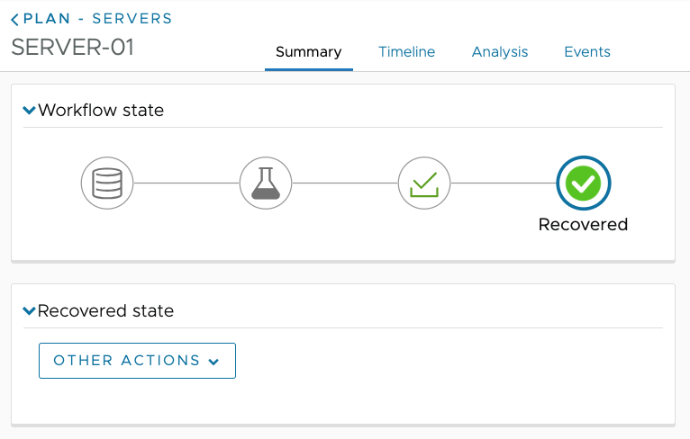
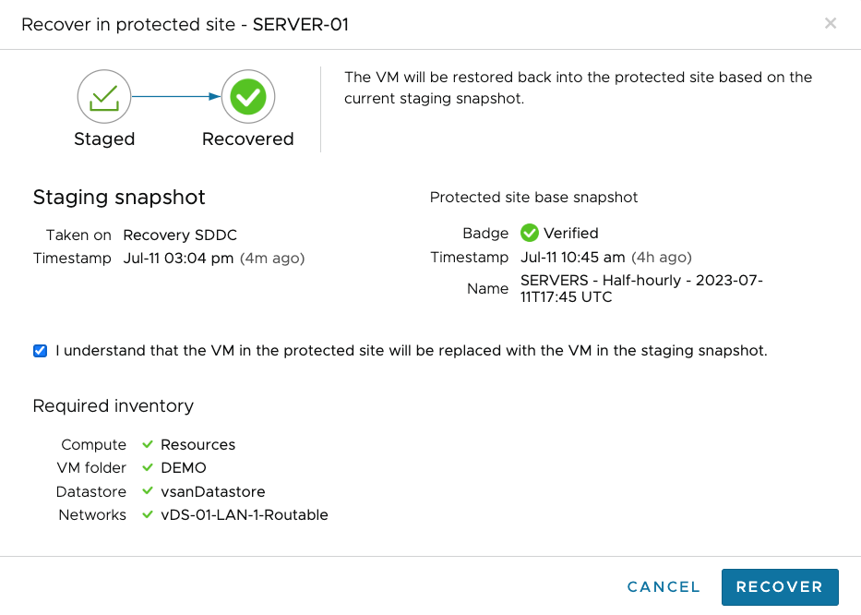
VMware Ransomware Recovery in Action
Configure adequate snapshot retention
Activate Isolated Recovery Environment
Guided restore point candidate selection
Restore from snapshot and scan workload
Evaluate using Behavioral Analysis
Final inspection and curated image build
Recover

Slide 24
What Makes Ransomware Recovery with VMware Different
Recover from an attack faster, with more predictability, and with less errors
VMware:
On-demand, VMware-managed IRE*
Embedded behavioral analysis
Dedicated, end-to-end workflow
Rapid, iterative evaluation
Traditional
IREs* are built, secured and managed by the user
Scanning offline backups (ineffective at identifying fileless attacks)
Disconnected & manual experience, multiple tools and processes
Slow process to iterate and evaluate multiple snapshots
*Isolated Recovery Environment. Includes push-button VM network isolation levels.

